Slide 1
Aeronautical Rules and Facilities
References: FTGU 29th Pages 89-119, AIM AGA & RAC, Pilot’s Handbook of Aeronautical,
Knowledge Chapter 12, CARs Part VI
Notes:
Writing in regular script down here is to be taught
Writing in italics is for extra information

Slide 2
Topics to be covered
Aerodromes
Traffic procedures
Documentation
Classifications of airspace
Rules of the air
VFR minima
Transportation of dangerous goods

Slide 3
Why learn this stuff?
Just like with every other aspect of life, rules must be followed
If everyone knows and follows the rules, it makes for a safer flying environment

Slide 4
Aerodrome vs. Airport
Aerodrome: Any area of land or water designed for the arrival, departure, movement and servicing of aircraft and includes buildings, installations and equipment situated there
Airport: an aerodrome in which a Canadian Aviation document (certificate) is in force
Notes:
Military aerodrome may only be used by civil aircraft if prior permission is obtained or in an emergency.
In an in-flight emergency, any aerodrome may be used at the discretion of the pilot.

Slide 5
Movement area: any surface used for aircraft movement including manoeuvring area and apron
Manoeuvring area: parts of airport designed for taking off, landing and movement of aircraft (runways and taxiways)
Apron: area intended for loading and unloading of passengers and cargo, refuelling, servicing, maintenance and parking
Notes:
No person may walk, stand, park a vehicle or aircraft or cause and obstruction on the movement area of an aerodrome unless permission has been given by:
a. the aerodrome operator; or
b. ATC or the appropriate flight information station
Minister: the Minister of Transportation
Owner: the person holding legal possession and responsibility for an aircraft

Slide 6
Take off: for an aircraft other than a dirigible balloon, the act of leaving the surface, including the take-off roll and the operations immediately preceding and following this act
Landing: in the case of an aircraft other than a dirigible balloon, the act of touching down on a surface, including the operations which immediately precede and follow this act.

Slide 7
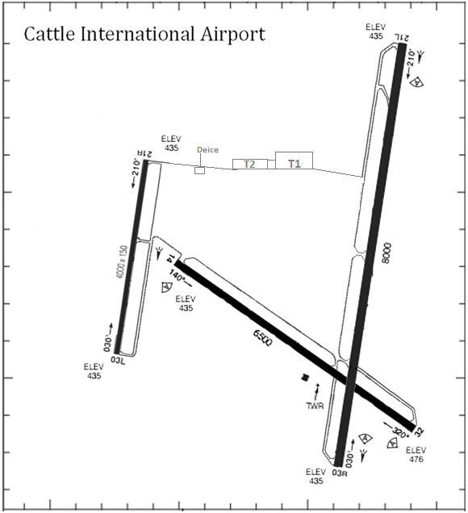

Slide 8
Air Traffic: All aircraft in flight and aircraft operating on the maneuvering area of an aerodrome
Airport Traffic: All traffic on the maneuvering area of an airport and all aircraft flying in the vicinity of an airport

Slide 9
Important Abbreviations
AAE: Above Aerodrome Elevation
AGL: Above Ground Level
ASL: Above Sea (mean) Level
AIP: Aeronautical Information Publication
AIM: Aeronautical information manual
FSS: Flight Service Station
ICAO: International Civil Aviation Organization
VMC: Visual meteorological conditions
ATS: Air Traffic Services

Slide 10

Runway Numbering
Numbered according to the direction it’s pointing (called “bearing”)
The number is rounded to the nearest 10° and the last number is dropped (ex. A bearing of 186° would be numbered runway 19)
In Northern Domestic Airspace (NDA), bearings are true, in Southern Domestic Airspace (SDA), bearings are magnetic
Notes:
Multiple runways at one airport that lie in the same direction are differentiated with L, C, R for left, centre, right.

Slide 11
Runway Markings

Slide 12
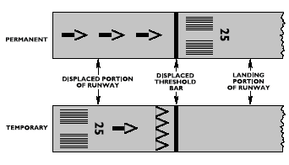
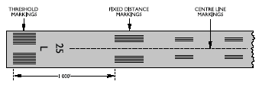
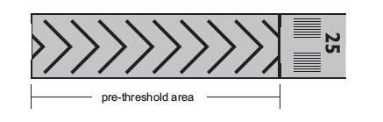
Paved Runways
Normal Runway
Displaced Thresholds
Stopway
Notes:
Centerline: line of uniformly spaced stripes and gaps. Normally 30m long, gaps 20m long. for ease of aircraft alignment during takeoff and landing
Large white runway numbers at both ends of runway
Runway marking distances vary depending on runway length and width.
The colour of the markings is white.
Threshold – Runway thresholds are markings across the runway that denote the beginning and end of the designated space for landing and take-off under non-emergency conditions.
Threshold markings are provided at the threshold of a paved instrument and non-instrument runway intended for use by international commercial air transport.
Displaced Thresholds:
Displaced thresholds are usually put into place for the purpose of obstacle clearance on landing. They can be used for taxiing, take-off and the roll out for landing. However, depending on the actual reason for the displaced threshold, it may not always be available for use and be made unserviceable by NOTAM.
Indicated by arrows pointing to the displaced threshold line. The landing area of the runway begins after the new threshold line
Stopway: The paved area preceding a runway threshold prepared and maintained as a stopway may be marked with yellow chevrons. This area is not available for taxiing, the initial takeoff roll or the landing rollout; it must not be included in runway length calculations. The chevron markings may also be used on blast pads and extra length in case of a discontinued take off. Marked with red lights on all three sides.

Slide 13
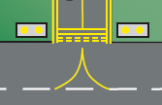
Taxiway Markings
Centre line is used for lining up the aircraft on the taxiway
Aircraft must stop at the hold short lines unless otherwise cleared by ATC
Taxiway centre line
Hold short lines
Runway hold short lights (amber)
Notes:
Taxiways – used by aircraft to move to and from runways without interfering with traffic taking off and landing
Usually have solid yellow lines marked down centre. Broad yellow line across it indicates the end of the taxiway where an aircraft must “hold short” until ready for takeoff. Dashed lines are on the side of the runway, giving the aircraft exiting the runway clearance to leave.
Located 200 feet from the edge of the runway. These yellow markings tell the pilot where to wait while waiting for clearance or for traffic to land.
Hold Lines: Solid and dashed yellow line running across the taxiway where aircraft must “hold short” until cleared for take-off.

Slide 14
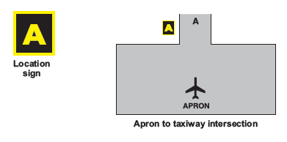
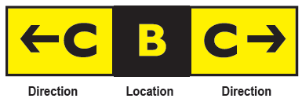

Airside Guidance Signs
Location Sign
Direction Sign
No Entry Sign
Notes:
Location Sign: A location sign has a yellow inscription on a black background and is used to identify the taxiway which the aircraft is on or is entering. A location sign never contains arrows
Direction Sign: A direction sign has a black inscription on a yellow background and is used to identify the intersecting taxiways toward which an aircraft is approaching. The sign is, whenever possible, positioned to the left-hand side of the taxiway and prior to the intersection. A direction sign will always contain arrows to indicate the approximate angle of intercept. Direction signs are normally used in combination with location signs to provide the pilot with position information. The location sign will be in the centre or datum position. In this configuration, all information on taxiways that require a right turn are to the right of the location sign and all information on taxiways that require left turns are to the left of the location sign.
No Entry Sign: A no entry sign will be located on both sides of a taxiway into which entry is prohibited. It consists of a white circle bisected by a white horizontal crossbar on a red background.

Slide 15
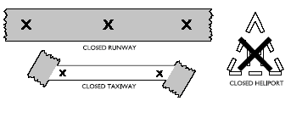
Aerodrome Markings
Any runway or taxiway that is unserviceable will be marked by large white or yellow X’s
Snow covered areas may be marked with yellow dye
Other unserviceable areas may be marked with red flags, marker boards or cones
Notes:
X’s will be 20 feet in length
When a runway, taxiway or helicopter takeoff and landing area is permanently closed, all markers and markings except the X’s are removed. Runway lights are turned off.
Unserviceable Area Markings: Unserviceable portions of the movement area other that runways and taxiways are delineated by markings such as marker boards, cones, or red flags and, where appropriate, a flag or suitable marker is placed near the centre of the unserviceable area. Red flags are used when the unserviceable portion of the movement area is sufficiently small for it to be by-passed by aircraft without affecting the safety of their operations.

Slide 16
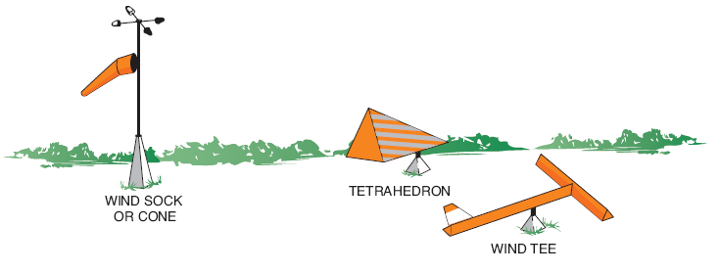
Wind Indicators
The runway to be used is usually determined by a wind indicator
3 main types of indicators: Wind sock or cone, tetrahedron and the wind tee
Notes:
Wind Direction Indicators: Runways greater than 1200 m (4000 feet) in length will have a wind direction indicator for each end of the runway. It will be located 150 m in from the runway end and 60 m outward, usually on the left side. Runways 1200 m in length and shorter will have a wind direction indicator centrally located so as to be visible from approaches and the aircraft parking area. Where only one runway exists, it will be located at the mid-point of the runway 60 m from the edge.
For night operations the wind direction indicator will be illuminated.

Slide 17
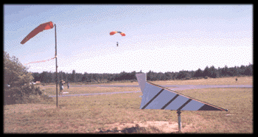
Notes:
Wind "T" and wind tetrahedrons are no longer recognized in TP312.

Slide 18
Determining Wind Speed
Wind speed on a wind sock is determined by how many degrees the wind sock hangs below the horizon
A dry Transport Canada standard “Wind Direction Indicator” (wind sock) has the following properties:
Wind speed | Wind indicator angle
15 KT or above | Horizontal
10 KT | 5° below horizontal
6 KT | 30° below horizontal
Notes:
Elongates as the wind increases;
If the wind sock is straight out then the wind is 15Kts or more;
If the wind sock is on a 30° down slope then the wind is 6Kts; and
If the sock is fluctuating then gusty conditions exist.

Slide 19
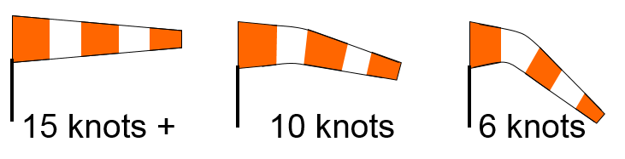
Runways longer than 4,000 feet will have indicator at both ends of runway. Otherwise halfway and 200 ft. to side.
At certified aerodromes, ie. Airports, the wind sock indicates
Notes:
On a windsock with alternating white and orange stripes, each stripe represents approximately 5 knots of wind

Slide 20
301.06 WIND DIRECTION INDICATOR
Runways longer than 4,000 feet will have indicator at both ends of runway. Otherwise halfway and 200 ft. to side.
At certified aerodromes, ie. Airports, the wind sock indicates
15 knots + 10 knots 6 knots

Slide 21
Review
How are runways numbered?
If you were flying over an airport and saw big white X’s on the runway, what would that mean?
If you see a dry windsock hanging 5 degrees below the horizon, how strong is the wind?
Notes:
Southern Domestic Airspace: magnetic orientation rounded to nearest 10 degrees
Northern Domestic Airspace: true orientation rounded to nearest 10 degree
The runway is closed
10 knots

Slide 22
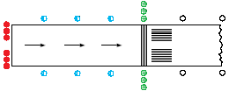
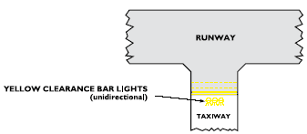
Aerodrome Lighting
Runway edge lights – white
Taxiways edge lights – blue
Threshold lighting – green for approach side, red for departure side
Displaced threshold – red on edge, blue on either side
Clearance bars – yellow
Notes:
Aerodrome Beacon: White strobe flashing at 20 to 30 beats per minute. Visable for approximately 10 nm
Runway Edge Lights: Two parallel lines of white lights of variable intensity at the runway edges along the full length of the runway spaced at 200-foot intervals, except at intersections with other runways. Visable at least 2 miles in all directions.
Taxiway edge lights: Taxiway edge lights are blue in color and are spaced at 200-foot intervals. Where a taxiway intersects another taxiway or a runway, two adjacent blue lights are placed at each side of the taxiway. The intersection of taxiway and aprons is indicated by two adjacent yellow lights at taxiway/apron corners. Centre line taxiway lights (if fitted) are green in color and are installed on the taxiway surface. They are spaced at 200-foot intervals with less spacing on taxiway curves.
Runway threshold lights: green lights placed across the beginning of the runway on either side of the centerline. (red from the back)
Runway end lights: Red lights placed across the end of the runway on either side of the centerline.
Obstruction lights: minimum requirements dictate that obstacles be identified by red lights (steady or flashing). Mark tall buildings and towers that might be flight hazards.
At some aerodromes, the lights can be activated by radio control from the aircraft (ARCAL) activated by keying the microphone a given number of times.

Slide 23
Aerodrome Traffic Procedures

Slide 24
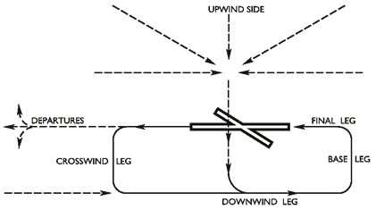
Traffic Circuit
Notes:
Standardized pattern at all aerodromes for taking off and landing aircraft.
The purpose of the circuit is to maintain separation and to increase efficiency. Circuits are normally left hand (unless specified in the CFS) and are flown at 1000’ Above Airport Elevation (AAE). Landing runway should be chosen by determining the runway most nearly aligned into wind.
Upwind side – area on opposite side of the landing runway from the downwind leg. Approach should be made from this side at or above circuit height.
Crosswind – Links the upwind side to the downwind leg
Downwind – Flight path parallel and opposite to the landing direction
Base – Links the downwind and the final leg at right angle
Final – Flight path in the direction of landing for aircraft to line up with runway and descent for landing

Slide 25
Air Traffic Control Unit: (ATC)
  An area control centre established to provide air traffic control service to Instrument Flight Rules (IFR) flights and Controlled Visual Flight Rules (CVFR) flights;
  A terminal control unit established to provide air traffic control service to IFR flights and controlled VFR flights operating within a terminal control area; or
  An airport control tower unit established to provide air traffic control service to airport traffic; as the circumstances require.
Notes:
Role of ATC: Prevent collisions and accelerate the flow of air traffic
Flight information services and Air Traffic Control services are offered through the Area Control Centers (ACC) and Terminal Control Units (TCU) and air traffic control towers inside a control zone. The range of services provided includes but not limited to:
· Airport control service
· Area control service
· Terminal control service
· Terminal radar service
· Alerting Service
· Airspace Reservation service
· Aircraft Movement Information service
· Customs Notification service (ADCUS)
· Flight Information service

Slide 26
Controlled Airports
Must establish communication with the control tower
May join circuit from any direction as directed by tower
Wait for clearance to land or take-off
Notes:
In the event of an in-flight emergency, any aerodrome may be used at the discretion of the pilot
All Canadian airports have identifiers that consist of the code CY or CZ followed by a letter, i.e. CYKF = Waterloo Regional Airport
Canadian aerodromes have identifiers that consist of the letter C followed by two letters and a number, i.e. CNC3 = Brampton Flying Club

Slide 27
Uncontrolled Airports
MF: Mandatory Frequency
  Must establish communication with the dedicated frequency to advise position, intentions and obtain traffic information
ATF: Aerodrome Traffic Frequency
  Should advise with position, intentions etc. however NORDO traffic may be using this area as well
Notes:
MF: usually operated by RCO (remote communication outlet). Operator may not be on site to see what is happening in the circuit. Relying on information relayed on radio. Must have 2 way radio to operate in this area.
-First transmission 5 minutes prior to entering MF area: report position, altitude, arrival procedure intentions and estimated time of landing.
-Maintain listening watch while in MF area (until well clear when leaving)
-Report position when entering circuit
-Report on final approach
-Report when clear of runway after landing
-Report clear of circuit
ATF: UNICOM frequency. Will not necessarily be monitored. If nothing specified, designated ATF 123.2 MHz

Slide 28
Uncontrolled Circuit Procedures
ATF:
  Approach circuit from UPWIND side of runway and enter crosswind at circuit height
MF:
  If advisory information is available, may join straight or 45° in downwind, or straight in base or final legs
Report when joining circuit, downwind, final and when clear of landing area (CAR 602.101)
Notes:
Circuit height should be reached before entering the traffic circuit.
If crossing over the aerodrome , cross-over should be done at least 500 feet above circuit height and descent into circuit altitude made on the upwind side or well clear of the traffic circuit.

Slide 29
ATF Circuit Joining

Slide 30
MF Circuit Joining

Slide 31
NORDO and RONLY
NORDO
RONLY
Aircraft has no radio
Must receive visual signals if operating at a controlled airport
Aircraft can only receive radio transmissions, cannot transmit
Must acknowledge transmissions through a visual signal (flashing of a landing/taxi light, rocking wings)
Notes:
NORDO:
Pilot must approach the aerodrome circuit from the upwind side of the runway to join the circuit on the crosswind leg at circuit altitude, at a point situated about halfway between the two ends of the runway, so as to integrate the aircraft in the circuit on the downwind leg
Before turning for final approach, the pilot must confirm visually that no aircraft is performing a straight-in approach
Authorization to land will be given by light signals when the aircraft is established on final approach. If the pilot does not receive this clearance, they must go around and fly another circuit
RONLY:
Same procedures as NORDO
Airport controller may request the pilot to acknowledge a message in a particular fashion (rocking wings, flashing landing light, pressing IDENT on the transponder, etc.)

Slide 32
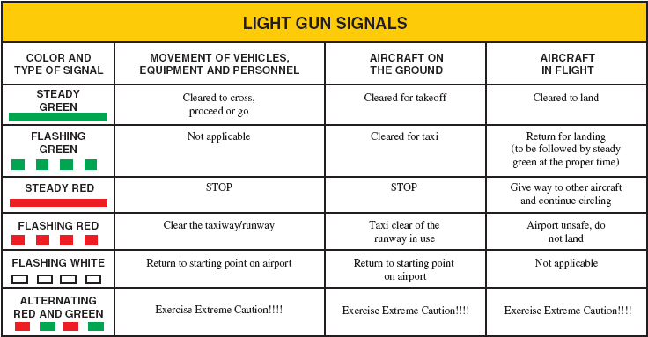
Light Signals
Red pyrotechnical flare: Do not land for time being
Flashing runway lights: Advises vehicles and pedestrians to vacate runways immediately
Notes:
Visual Signals: signals used to communicate with someone with visual means. The most common visual signals includes: air to ground signals, interception signals and search and rescue signals
Interception Signals:
No person shall give an interception signal or an instruction to land except:
a. A peace officer.
b. A person authorized to do so by the Minister
The Minister may authorize a person to give an interception signal or an instruction to land if such authorization is in the public interest and is not likely to affect aviation safety.
The pilot-in-command of an aircraft who receives an instruction to land shall, subject to any direction received from an air traffic control unit, comply with the instruction.
The pilot-in-command of an intercepting aircraft and the pilot-in command of an Intercepted aircraft shall comply with the rules of interception set out in the Canada Flight Supplement.

Slide 33
Review
If you were at an airport at night and were looking for a taxiway, what colour lights would you be looking for?
What are the legs of the circuit?
If you were on final approach to land and you saw a red light from the tower, what would you do?
Notes:
Blue
Crosswind, downwind, base, final
Go around and do another circuit

Slide 34
The Canadian Airspace System

Slide 35
Canadian Domestic Airspace
Canadian Domestic Airspace:
All airspace over the Canadian land mass, Canadian Arctic, Canadian Archipelago and areas of the high seas
Split into two areas:
Northern Domestic Airspace (NDA)
Southern Domestic Airspace (SDA)
Notes:
Archipelago – a sea or stretch of water containing many islands

Slide 36
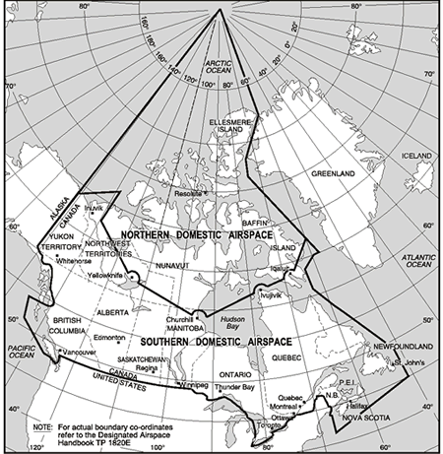

Slide 37
Canadian Domestic Airspace
Northern Domestic Airspace (NDA)
Southern Domestic Airspace (SDA)
The magnetic north pole is located within the NDA
Magnetic compass heading are erratic
Runway headings, cruising altitudes and surface winds use degrees TRUE
Most of the Canadian land mass is located within this region
Magnetic compass heading are fairly reliable
Runway headings, cruising altitudes and surface winds use degrees MAGNETIC
Notes:
NDA:
-aircraft operating at night or under IFR must be equipped with a gyroscopic direction indicator

Slide 38
Altimeter Regions

Slide 39
Altimeter Setting
Altimeter Setting Region
Standard Pressure Region
Airspace of defined dimensions below 18,000’ ASL
Prior to take off, set altimeter to current altimeter setting, or field elevation
During flight set it to the nearest station
While approaching an airport, set it to the current altimeter setting of that airport
All high level airspace over Canada (18,000’+) and all low level airspace not in the altimeter setting region
The altimeter is generally set to 29.92 “Hg
Prior to take off, the pilot sets it to the current altimeter setting or field elevation
Set to current airport altimeter setting before descending for landing
Notes:
Transition between altimeter setting and standard pressure:
The pilot must change calibration once established in the Standard Pressure Region. On a climb, the pilot will change calibration immediately after passing through 18 000’ ASL. On a descent, the pilot will change calibration immediately prior to passing through 18 000’ ASL. The same principle applies when crossing horizontally from one region to another. Changes in altimeter setting always take place in the standard altimeter setting region.

Slide 40
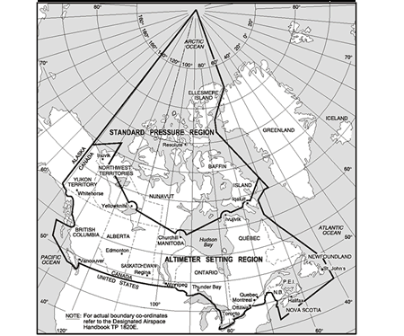

Slide 41
Uncontrolled airspace:
  Monitor 126.7 MHz and make periodic enroute position reports and changes in flight altitudes
Controlled airspace:
  Air Traffic Control service provided
  Divided into High Level Airspace and Low Level Airspace
Identification Zones (ADIZ):
  Air Defence Identification Zones established for security control of air traffic.
  Locations indicated on aeronautical charts, radio facility charts and the Canadian Air Pilot (CAP)

Slide 42
High Level Airspace
All airspace 18,000 feet ASL and above
Includes high level airways (controlled),
And high level air routes (uncontrolled)

Slide 43
Low Level Airspace
All airspace below 18,000 feet ASL
Not all is controlled
Includes low level airways, control area extensions, control zones, transition areas, Class F restricted, advisory and danger areas

Slide 44
Low Level Airways: routes between radio navigation aids
Control Area Extensions: additional controlled airspace surrounding a control zone
Control Zone: designated areas around certain aerodromes
Transition Area: 700 feet AGL to base of controlled airspace
Terminal Control Area: Provide area for IFR control service
Notes:
Low Level Airways:
-12,500-18,000 feet ASL is Class B airspace, below 12,500’ ASL is Class E
-4 nm on either side of centreline for VHF/UHF; 4.32 nm for LF/MF; unless specified otherwise, base is located at 2200 feet AGL
-VFR in Class E are not subject to ATC control, however control for IFR provided
Control Zone:
Classified as Class B, C, D, E depending on surrounding airspace
Terminal Control Area: Class A, B, C, D, E

Slide 45
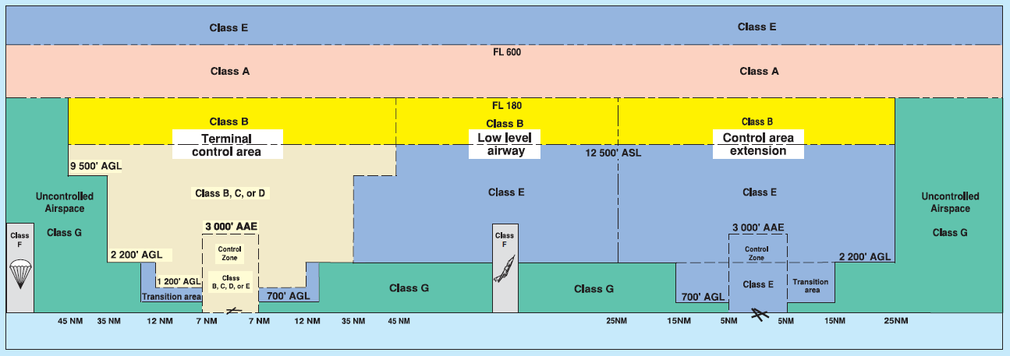

Slide 48
Classification of Canadian Airspace

Slide 49
Classifications of Airspace
Canadian Domestic Airspace is divided into 7 classes – A, B, C, D, E, F and G
Flight within each region is governed by specified rules and operating procedures
Controlled airspace: A-F
Uncontrolled airspace: G
Notes:
VFR: Visual Flight Rules: regulations concerning flight conducted with constant visual contact with the ground.
IFR: Instrument Flight Rules
Must establish and maintain radio communication with appropriate control tower prior to entering its control zone (Class D and up). Recommended to establish contact at least 5 minutes before requesting clearance or entering the zone.
Initial Clearance: On initial contact, the controller will inform the pilot about the runway in use, the direction and strength of the winds, the altimeter setting and will brief him on all other pertinent information. Then the controller will authorize the pilot to enter in the circuit at a specified stage of that circuit and will provide a sequences number if the aircraft is not first in for landing. A clearance to enter class C and above airspace is required as opposed to a class D airspace where only establishing communication with ATC is required before entering.
Landing Clearance: The pilot must obtain a landing clearance before landing at a controlled airport.

Slide 50
Classifications of Airspace
Class A Airspace
Class B Airspace
18,000 feet ASL to FL600
IFR only
ATC clearance required
ATC separation is provided to all aircraft
All aircraft must have a Mode C transponder (altimeter reporting)
12,500’ ASL to 17,999’ ASL
Any CZ/TCA can be made into class B if necessary
VFR or IFR
ATC clearance required
ATC separation is provided to all aircraft
Two-way radio
Radio navigation equipment
Mode C transponder
Notes:
CVFR: Controlled VFR: VFR in Class B airspace
Pilot in CVFR flight must conform to IFR rules save that s/he must remain in VMC and:
A flight plan must be filed;
Two-way radio equipment is mandatory, and;
The aircraft must be equipped with radio-navigation equipment

Slide 51
Classifications of Airspace
Class C Airspace
Class D Airspace
IFR and VFR
VFR requires a clearance
Separation is provided for IFR traffic, and VFR conflict resolution if the workload permits
Two way radio
Mode C transponder
IFR and VFR
VFR traffic must make two-way communication before entering
Separation is provided for IFR traffic, and VFR conflict resolution if the workload permits
Two way radio
If in transponder airspace, a Mode C transponder
Notes:
Class C and D airspace reverts to Class E when the ATC unit is not operational

Slide 52
Classifications of Airspace
Class E Airspace
Class F Airspace
IFR and VFR is permitted
Separation is provided to IFR traffic only
If within Transponder Airspace, a Mode C transponder is required
Special use airspace
Will be defined as “Advisory” or “Restricted” depending on operations
Is subject to the rules of whatever airspace it is in (uncontrolled/controlled)
Permanent or temporary

Slide 53
More on Class F Airspace
Advisory Airspace
Restricted Airspace
Areas where non-participating aircraft should be aware of operations
Pilots are allowed to enter at their own discretion
Activities include:
Training
Parachuting
Hang gliding
Military operations
No person may conduct aerial operations in restricted airspace unless permission has been given

Slide 54
More on Class F Airspace
Danger Area
Over international water where Canadian ATC has authority
Activities may cause danger to the aircraft

Slide 55
How do you know what’s Class F
Class F airspace will be indicated on all applicable charts
With the boundaries, a code will be given
Example: CYA113(A)
CY – Indicates Canada
A – Indicates advisory
113 – Number inside BC
(A) – Indicates aerobatics
Notes:
101 to 199 – British Columbia
201 to 299 – Alberta
301 to 399 – Saskatchewan
401 to 499 – Manitoba
501 to 599 – Ontario
601 to 699 – Quebec
701 to 799 – New Brunswick, Nova Scotia, Prince Edward Island, Newfoundland
801 to 899 – Yukon Territory
901 to 999 – Northwest Territories and Nunavut (including the Arctic Islands)
A – acrobatic
F – aircraft test
H – hang gliding
M – military operations
P – parachuting
S – soaring
T – training

Slide 56
Airspace Classification
Class G Airspace
Any airspace that hasn’t been classified as A, B, C, D, E or F
ATC does not have any authority or responsibility
Consists of all uncontrolled domestic airspace
Airway: established between specified radio-navigation aides. Air traffic control services are always provided
Air Route: routes are established between specified radio-navigation aides. Air traffic control service is not provided

Slide 57
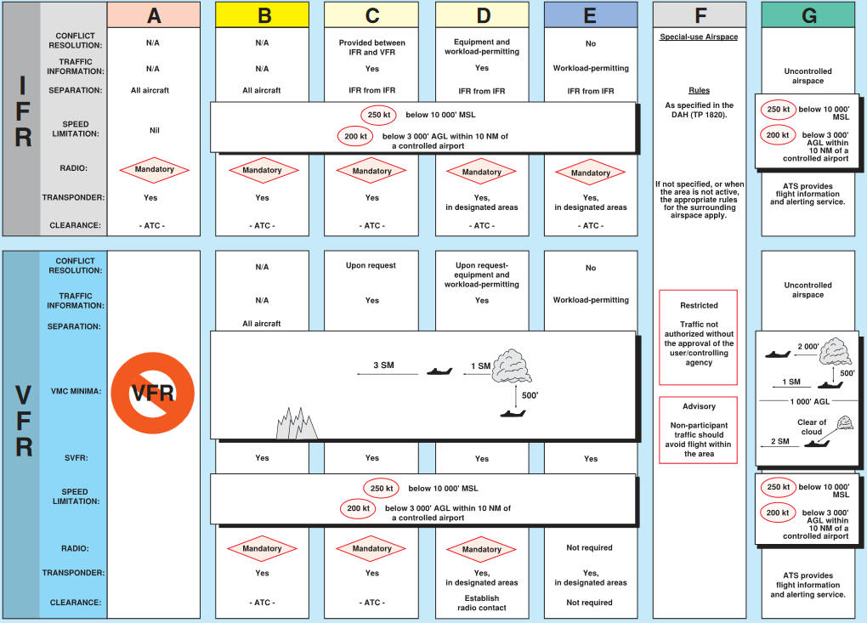

Slide 58
Review
What are the two types of domestic airspace in Canada, and what are the differences?
What would you set your altimeter to in the Altimeter setting region?
What does CYA123(M) mean?
Notes:
Northern Domestic Airspace – True tracks used; contains Standard Pressure Region
Southern Domestic Airspace – Magnetic tracks used; contains Altimeter Setting Region
The airport’s current altimeter setting, or if on the ground and no altimeter setting, the elevation of the airport
Canadian (CY)
Advisory airspace (A)
Somewhere in British Columbia (123)
Military operations (M)

Slide 59
Air Rules and Procedures

Slide 60
Aircraft Documents
The following documents are required to be on board the aircraft:
  C - Crew Licences and Medicals
      Pilot licence, Medical Certificate, Restricted Radio Operator’s Certificate (unless NORDO)
  P – POH (Pilot Operating Handbook)
  R – Certificate of Registration (C of R)
  A – Certificate of Airworthiness (C of A)
  I – Liability Insurance
  L – Journey Log

Slide 61
Aircraft Documents
The following documents are recommended to be on board the aircraft:
  Airworthiness Certificate (C of A)
  Registration Certificate (C of R)
  Operating handbook (POH/Aircraft Flight Manual)
  Weight and balance and Equipment
  Journey log
  Insurance
  Licences of Crew
  Intercept orders
Notes:
Certificate of Airworthiness:
A conditional certificate of fitness for flight issued in respect of a particular aircraft
Certificate of Registration:
A certificate issued to the owner of an aircraft with respect to the registration and registration markings for that aircraft
Pilot Licence:
Document permitting the holder to act as a flight crew member of an aircraft
Journey Log:
The Journey Log must be carried on a board the aircraft if the pilot in command intends to stop at an airfield other than the point of departure or if the flight exceeds 25NM from the point of departure. Flight times, air times and details on the flight and any defects are recorded in the Journey Log.
Technical Log:
The technical log MUST NOT be carried on board.
C of A:
Airworthy: In respect to an aeronautical product, in a fit and safe state for flight and in conformity with the applicable standards of airworthiness.
Flight Permit: Issued for experimental aircraft or for a specific purpose.
Annual Airworthiness Information Report: Certifies that the information regarding Airworthiness is correct. No independent certification, inspection or flight test is required. The date of the most recent inspection as well as the last incident of damage to the aircraft, the total flight time of the aircraft as well as the owner’s signature must be included.
Airworthiness (4 items):
· Maintained in accordance with the calendar of maintenance
· 100-hour inspection or annual inspection within the 12 months prior to the flight.
· Airworthiness Directives have been respected
· There are no deficiencies in the Journey Log, nor any found during the pre-flight
inspection.
Cancellation of Certificate of Airworthiness (5 items):
· Aircraft destroyed
· Aircraft exported
· Certificate destroyed
· Aircraft used other than as approved in the POH
· Maintenance not performed or improperly performed
C of R:
A certificate issued to the owner of an aircraft with respect to the registration and registration markings for that aircraft
No civil aircraft, other than a hang glider or model aircraft shall be flown in Canada unless it is registered in accordance with the Canadian Aviation Regulations (CARs), Part II, or under the laws of an International Civil Aviation Organization (ICAO) member state, or a state that has a bilateral agreement with Canada concerning interstate flying. No aircraft except a hang glider or model aircraft shall be flown in Canada unless it bears nationality and registration markings painted or permanently affixed on the aircraft and has attached a fireproof identification plate inscribed with the registration and manufacturing information. Canadian nationality markings consist of the capital letter(s) C, or CF prefixed to the registration letters. Any change in aircraft ownership including change of address must be communicated to Transport Canada in writing within 7 days of the transaction.
Journey Log:
It should be kept for at least one year when full (CARs 605.94(3))
Items to check before flight (9 items):
· Hours remaining before the next inspections
· 100 hour inspection performed within 12 months prior to the flight
· no snags
· Compass calibrated within 12 months prior to the flight.
· First aid kit inspected within 12 months prior to the flight
· Fire extinguisher inspected within 12 months prior to the flight
· ELT inspected within 12 months prior to the flight
· ELT battery replaced within 24 months prior to the flight
· Calibration of the transponder, the recording altimeter, the static port and dynamic port
within 24 months prior to the flight, if the flight is carried out within Class A, B, C or D
airspace in which a transponder is required.
Technical Log:
All maintenance, installations, modifications and repairs must be recorded in the Technical Log. The Technical Log is composed of a log for the airframe, a log for each motor, a log for each propeller and a log for installations and modifications.

Slide 62
Right of Way
Pilot’s responsibility to avoid collision
An aircraft that has the right of way shall take action to avoid collision if necessary
An aircraft that has right of way will give way to another aircraft that appears to be in an emergency situation

Slide 63
Right of Way continued...
When two aircraft are approaching head on, each shall alter their headings to the right
An aircraft that is being overtaken has the right of way and the overtaking aircraft shall alter its heading to the right (pass on the right)
Aircraft on the surface shall give way to landing aircraft
An aircraft approaching an airport to land shall give way to lower aircraft
An aircraft shall not cut in front of an aircraft that is in the final stages of an approach to land
No person shall take off if they will collide with anything
Notes:
When two gliders, flown at different altitudes, have converging trajectories, the pilot-in command of the glider at higher altitude shall give way to the glider at lower altitude.

Slide 64
Right of Way
When two aircraft are converging at the same altitude, the aircraft that has the other on its right shall give way, except:
- A power driven heavier-than-air aircraft shall give way to gliders, airships and balloons
- An airship shall give way to gliders and balloons
- A glider shall give way to balloons
- A power driven aircraft shall give way to other aircraft towing gliders or any other load
Notes:
Aircraft have priority for the right-of-way in the following order:
Fixed or free balloons
Gliders
Airships
Power driven fixed wing or rotary wing airplanes

Slide 65
Day VFR
Daylight:
  The period of time during any day that begins with the morning civil twilight and ends with the evening civil twilight
Instruments required for Day VFR:
  Airspeed Indicator (ASI)
  Altimeter (ALT)
  Compass and
  Working timepiece

Slide 66
Night Requirements
Any period of time during which the centre of the sun is more than 6° below the horizon
The period between the end of evening civil twilight and the beginning of morning civil twilight

Slide 67
Night Equipment
Airspeed indicator (ASI)
Pressure sensitive altimeter (ALT)
Direct reading magnetic compass
  Non-magnetic direction indicator in NDA
Gyro magnetic compass or heading indicator
Turn and bank indicator
Instrument illuminator
Time piece and flashlight per crew member
Two way radio in controlled airspace

Slide 68

Aircraft Night Lighting
For aircraft operating at night, the following lighting is required:
Red light on the left wing visible through 110° and 2 miles
Green light on the right wing visible through 110° and 2 miles
White light on the tail visible through 140° and two miles
An anti-collision light visible through 360° and 30° above and below
Notes:
Landing light required if carrying passengers
Taxi light used during taxiing and turned off during flight

Slide 69
Rules of the Air
No person shall operate an aircraft unless in accordance with VFR or IFR procedures or in accordance with special regulations set forth by the Minister.
No person shall create a hazard to persons or property on the surface by dropping an object from an aircraft in flight. (CAR 602.23)
It is forbidden to carry dangerous goods except in accordance with the Law on the Transport of Dangerous Materials.

Slide 70
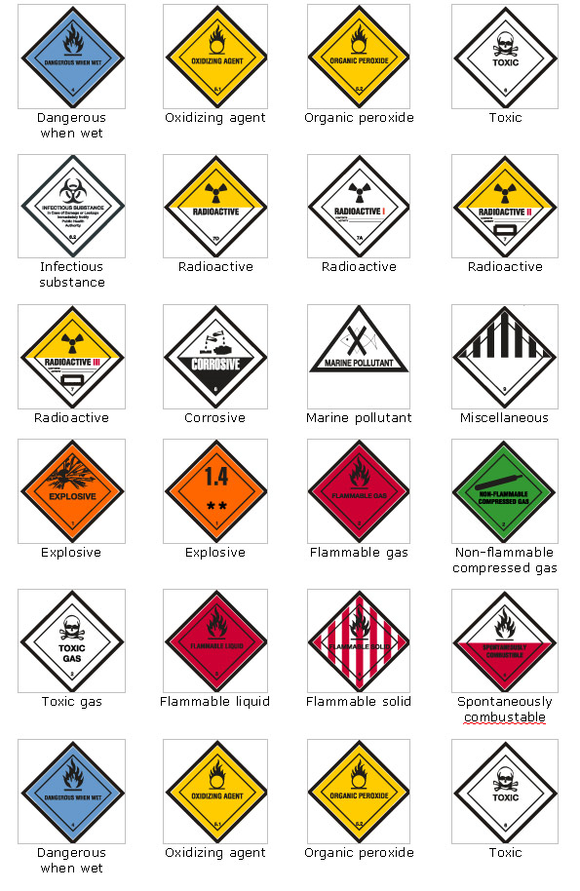
Transportation of Dangerous Goods
Anything that has been identified in section 2 of the Transportation of Dangerous Goods Act, 1992 must be transported in accordance with the regulations in the act
Essentially, proper containers and labelling must be used.
Notes:
Dangerous goods shall not be carried unless in accordance with the Transportation of Dangerous Goods Act.
General Prohibition:
No person shall handle, offer for transport, transport or import any dangerous goods unless
(a) the person complies with all applicable prescribed safety requirements;
(b) the goods are accompanied by all applicable prescribed documents; and
(c) the means of containment and transport comply with all applicable prescribed safety standards and display all applicable prescribed safety marks.
Must have permission from the Minister.

Slide 71
No person shall operate an aircraft in such a reckless or negligent manner as to endanger or be likely to endanger the life or property of any person. (CAR 602.01)
No person shall operate an aircraft that is towing an object unless the aircraft is equipped with a tow hook and release control system that meet the applicable standards of airworthiness. (CAR 602.22)
Notes:
Aerobatic Maneuvers:
-No person operating an aircraft shall conduct aerobatic maneuvers (CAR 602.27):
a. over a built-up area or an open-air assembly of persons;
b. in controlled airspace, except in accordance with a special flight operations certificate;
c. when flight visibility is less than three miles; or
d. below 2,000 feet AGL, except in accordance with a special flight operations certificate.
Restrictions Regarding Passengers:
No person shall enter or leave an aircraft in flight except with the permission of the pilot-in command of the aircraft.
No pilot-in-command of an aircraft shall permit a person to enter or leave the aircraft during flight unless the person leaves for the purpose of making a parachute descent.
No pilot-in-command of an aircraft shall permit, and no person shall conduct, a parachute descent from the aircraft:
a. in or into controlled airspace or an air route; or
b. over or into a built-up area or an open-air assembly of persons.
No person operating an aircraft with a passenger on board shall conduct an aerobatic maneuver unless the pilot-in-command of the aircraft has engaged in: (CAR 602.28)
a. at least 10 hours dual flight instruction in the conducting of aerobatic maneuvers or 20 hours conducting aerobatic maneuvers; and
b. at least one hour of conducting aerobatic maneuvers in the preceding six months.

Slide 72
Air traffic rules and procedures

Slide 73
Clearances and Instructions
Clearance
  Authorization from an ATC unit for aircraft to proceed in controlled airspace under specific conditions
Instruction
  Directive issued by ATC unit for air traffic control purposes. You are required to comply and acknowledge receipt unless safety of aircraft is jeopardized.
Notes:
Acceptance of either does not relieve the pilot of the responsibility of avoiding other traffic
If any part of clearance or instruction is unacceptable for any reason, pilot must inform ATC and ask for other instructions
May only deviate from both clearance and instruction if following ACAS/TCAS resolution advisory – and must inform ATC as soon as practical

Slide 74
Flight Rules
Visual flight rules (VFR):
  Rules which apply when flying with visual reference to the ground
Instrument flight rules (IFR)
  Rules which apply when flying with reference to cockpit instruments

Slide 75
Flight Plans and Itineraries
A flight plan or itinerary outlines what type of aircraft is being flown, what equipment is on board, who’s flying it and what route it’s taking
Allow authorities to determine with precision where you are going, ETE, passengers, etc. in an emergency
All aircraft will file a flight plan or itinerary beyond 25 NM of departure aerodrome

Slide 76
Flight Plans vs. Itineraries
Flight Plan
Flight Itinerary
Must be filed with an ATS unit
Must be closed with an ATS unit upon arrival (arrival report)
If not closed within 1 hour (or time specified in flight plan) search and rescue will be activated
Can be filed with a “responsible person”
Must be closed with that responsible person within the time specified on the flight itinerary (default 24 hours)
Cannot be used for international flights
Notes:
Flight Plan: Information, relating to the intended flight of an aircraft, which must be transmitted as a Flight Plan in application of Section III, Sub-Part 2, Part VI.
Flight Itinerary: Specified information relating to the intended flight of an aircraft, that is filed either with ATC or with a responsible person, who agrees to inform the authorities should the aircraft fail to arrive.
Only indicates ETA and destination

Slide 77
Cruising altitudes
To increase safety, pilots fly at specific altitudes depending on their direction of travel
For altitudes below 18,000’ ASL, altitudes are stated in thousands
Above 18,000’ ASL, they are called flight levels (i.e. 20,000’ would be called FL200)
Notes:
Except at an airport or military aerodrome, no person shall conduct a take-off, approach or landing in an aircraft over a built-up area or over an open-air assembly of persons unless that aircraft will be operated at an altitude from which, in the event of an engine failure or any other emergency necessitating an immediate landing, the aircraft can land without creating a hazard to persons or property. In any case, altitude must never be less than 1000’ above the highest obstacle within a 2000’ radius centered on the aircraft. (CAR 602.12)
Unless otherwise authorized by the appropriate air traffic control unit, no pilot-in-command shall operate an aircraft at an altitude of less than 2,000 feet over an aerodrome except for the purpose of landing or taking off. (CAR 602.96)
Other than over a built-up area or assembly of person, except for the requirements of take-off or landing, the minimum altitude shall not be less than 500’ above the highest obstacle within a radius of 500’ centered on the aircraft.
An aircraft may be flown over a sparsely populated area or a body of water as long as the aircraft passes over all people, boats, vehicles and structures at no less than 500’, and no person or property is endangered.
It is forbidden to over-fly the following installations below 2000’ AGL:
a. fur or poultry farms
b. herds of reindeer, caribou, moose or musk-oxen
c. national, provincial and municipal parks, preserves and wildlife sanctuaries
It is forbidden to use an aircraft over a disaster area or within 5 NM of a disaster area at an altitude lower than 3000 feet above ground. A notice-to-aviators (NOTAM) need not necessarily be published for this requirement to be in force. Notwithstanding, by virtue of article 601.16 of the CARs, Transport Canada can issue a NOTAM to further restrict airspace around a forest fire. Pilots must remember to check NOTAMs prior to flying near a forest fire. There are certain exceptions to the altitude minimums above for aircraft engaged in special activities, like fire-fighting, crop spraying, police work, etc.

Slide 78
VFR Cruising Altitudes
North
For VFR flight below 18,000’ ASL and above 3,000’ AGL the following rules apply
All aircraft on easterly tracks fly at odd thousands + 500’ ASL
All aircraft westerly tracks fly at even thousands + 500’ ASL
In SDA, they are magnetic tracks and in NDA, they are true tracks
180-359° :
Even thousands + 500’
000-179° :
Odd thousands + 500’
South

Slide 79
VFR Minima
To fly under Visual Flight Rules (VFR) certain weather criteria have to be met
These weather requirements should allow a pilot to navigate with visual reference to the ground

Slide 80
Review
When two aircraft are converging at the same altitude, which one must give way?
When two aircraft are approaching head on, what should they do?
When do you not have to file a flight plan/itinerary?
Notes:
The one with the other on their right must give way
Both should alter heading to the right
Must file if traveling more than 25 NM from departure aerodrome

Slide 81
VFR Weather Minima
AIRSPACE |  | FLIGHT VISBILITY | DISTANCE FROM CLOUD | DISTANCE AGL
Control Zones |  | 3 SM | Horizontally: 1 SM Vertically: 500’ | 500’
Other Controlled Airspace |  | 3 SM | Horizontally: 1 SM Vertically: 500’
Uncontrolled Airspace | ≥ 1000’ AGL | 1 SM (Day) 3 SM (Night) | Horizontally: 2000’ Vertically: 500’
 | < 1000’ AGL – Fixed wing | 2 SM (Day) 3 SM (Night) | Clear of cloud
Notes:
Control Zone (CZ): Controlled airspace of defined dimensions extending upwards from the surface of the earth up to and including 3 000 feet AAE unless otherwise specified

Slide 82
Special VFR
VFR aircraft may flying into control zones that are below VFR weather minima if the following conditions apply:
Clearance from ATC has been given
If operating at night, clearance will only be given for the purpose of landing
 | FLIGHT VISIBILITY | DISTANCE FROM CLOUD
Aircraft other than Helicopter | 1 SM | Clear of cloud
Helicopter | ½ SM | Clear of cloud
Notes:
Special VFR: ATC-authorized flight in controlled airspace under VFR rules when existing meteorological conditions are below VFR minima, in accordance with Section VI of Sub-Part 2 of Part VI.
Special VFR flight, exist mainly for returning to an airport when weather conditions are inferior to VFR minimums but visibility is not lower than 1 SM (for fixed-wing aircraft). Aircraft must remain clear of cloud and in visual contact with the ground at all times. These are required for SVFR:
a. a clearance must be issued by an Air Traffic Control Unit and flight in these conditions must remain inside a control zone; and
b. Special VFR requires the aircraft to remain clear of cloud and in visual contact with the ground. The aircraft shall fly no lower than 500 feet over the ground, save for landing and taking off.

Slide 83
Minimum VFR Altitudes
Except for the purposes of taking off or landing:
Built up areas:
  Minimum 1000’ above highest obstacle within 2000’ of aircraft
Non-built up areas:
  Minimum 500’ above highest obstacle within 500’ of aircraft

Slide 84
Identification Zones
Air Defence Identification Zones (ADIZ)
To enter or fly within an ADIZ, PIC is required to file IFR flight plan, Defence VFR flight plan or a flight itinerary with ATC or flight service station
No deviation permitted without authorization
Two-way radio required
Must include estimated time of penetration
+ 20 NM or + 5 minutes tolerances
Notify ATC immediately of any changes

Slide 85
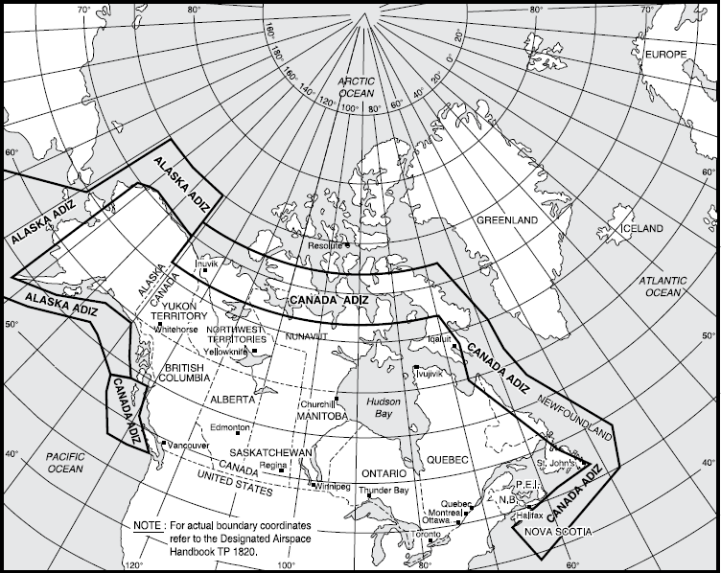

Slide 86
Review
An aircraft is flying VFR from Toronto to Ottawa at 6,500’ ASL, is he doing anything wrong?
You are flying and you hear ATC call you up and say “SCV turn right heading 230” – Is this a clearance or instruction? Can you refuse to do this?
What are the VFR weather minima for controlled airspace?
Notes:
Must be at odd plus 500 feet, not even
This is an instruction. You may only refuse if it impedes the safety of the operation.
3 SM visibility, 1 mile horizontally from cloud and 500’ vertically

Slide 87
Summary
In this class we have covered:
  Aerodromes
  Traffic procedures
  Documentation
  Classifications of airspace
  Rules of the air
  VFR minima
  Transportation of dangerous goods
The next class will be on theory of flight

