Slide 1
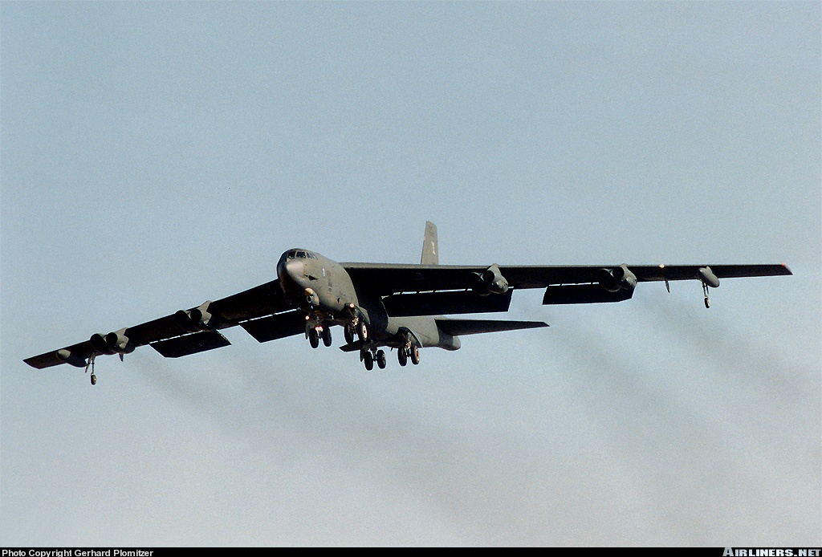
Aero Engines
CI Valentine
References: FTGU Pages 51-88

Slide 2
Review
What is Hypoxia?
When would you use the term MAYDAY?
What does line of sight mean?
Notes:
Lack of oxygen in the blood
Emergency or distress
When VHF or UHF signals are transmitted, but be in a line unobstructed in order to receive the transmission

Slide 3
Topics to be covered
Basic Construction and Four Stroke Cycle
Cooling, Fuel and Lubrication Systems
Carburetor and Exhaust System
Fuel Problems, Ignition and Basic Electrical System
The Propeller and Engine Instruments
CR-3 or E6-B Flight Computer

Slide 4
Horsepower
Horsepower
  Standard unit used to measure power produced by an engine
  Represents the amount of work required to lift a weight of 33,000 lbs 1 foot in 1 minute (1Hp)
Indicated Horsepower
  Power developed inside internal combustion engine; no losses accounted
Brake Horsepower (BHP)
  Due to friction and other losses, all indicated power is not available for useful work
  Actual power driving the propeller is BHP

Slide 5
Types of Engines
There are three main types of piston engines currently in use:
    Horizontally Opposed
    Radial
    In-Line
Jet engines
Notes:
Jet propulsion functions of Newton’s Third Law, which declares that any action creates an equal and opposite reaction
Certain types of aircraft are equipped with a jet engine. Modern military aircraft such as the F-14, F-15 and CF-18 use various types of jet engines. Large commercial aircraft such as the Boeing 747 are also equipped with jet engines.
In a jet engine, the air admitted into the engine is compressed and injected forcefully into the combustion chamber by a compressor powered by a turbine. The turbine is in turn powered by the energy of hot exhaust gases.
In the combustion chamber, fuel is mixed with the compressed air and ignited, producing a very hot gas at a very high pressure. This hot gas is exhausted out of the engine, turning the turbine as it passes. The remaining energy is converted to thrust as the hot air is ejected backwards in a continuous high speed stream, propelling the aircraft forwards.

Slide 6
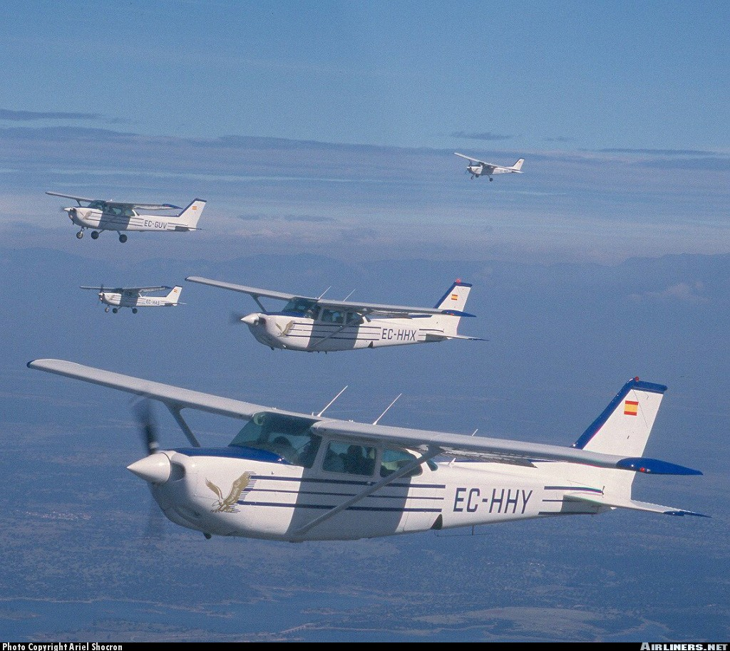
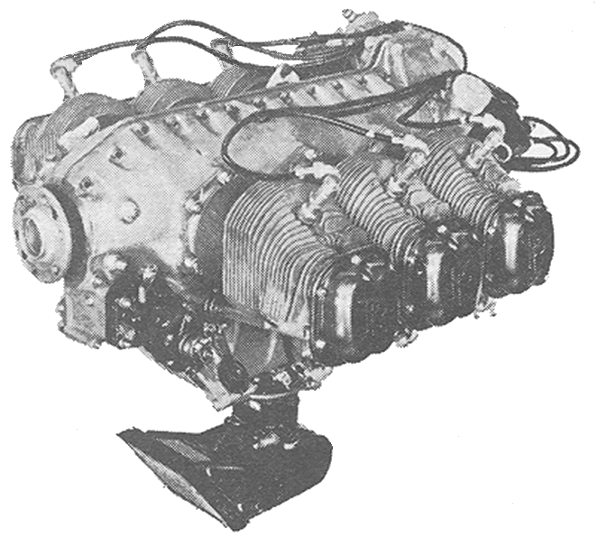
Horizontally Opposed
Two banks of cylinders which lie directly opposite to each other in the horizontal plane.
Four, six or eight cylinders.
Design is flat with small frontal area (good visibility) and low drag production.
Most commonly used aircraft piston engine

Slide 7
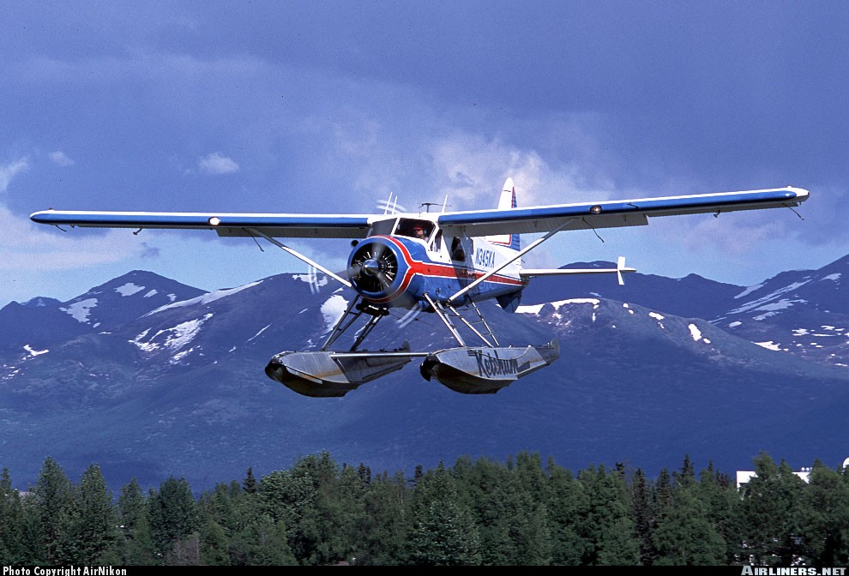
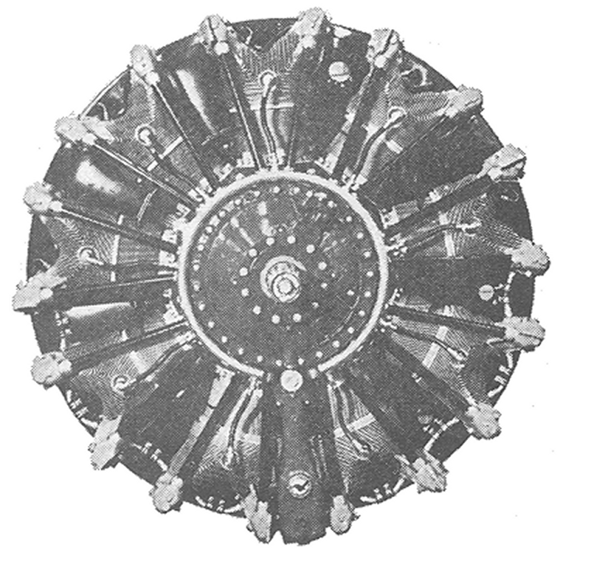
Radial
Cylinders arranged radialy around the crankshaft
Always an odd number of cylinders.
Crankshaft is short, compact and light.
Produces tremendous horsepower.
Poor shape increases parasite drag and reduces forward visibility.
Notes:
Power-to-weight ratio is acceptable
Reliable
Easy cooling
Easy to maintain

Slide 8
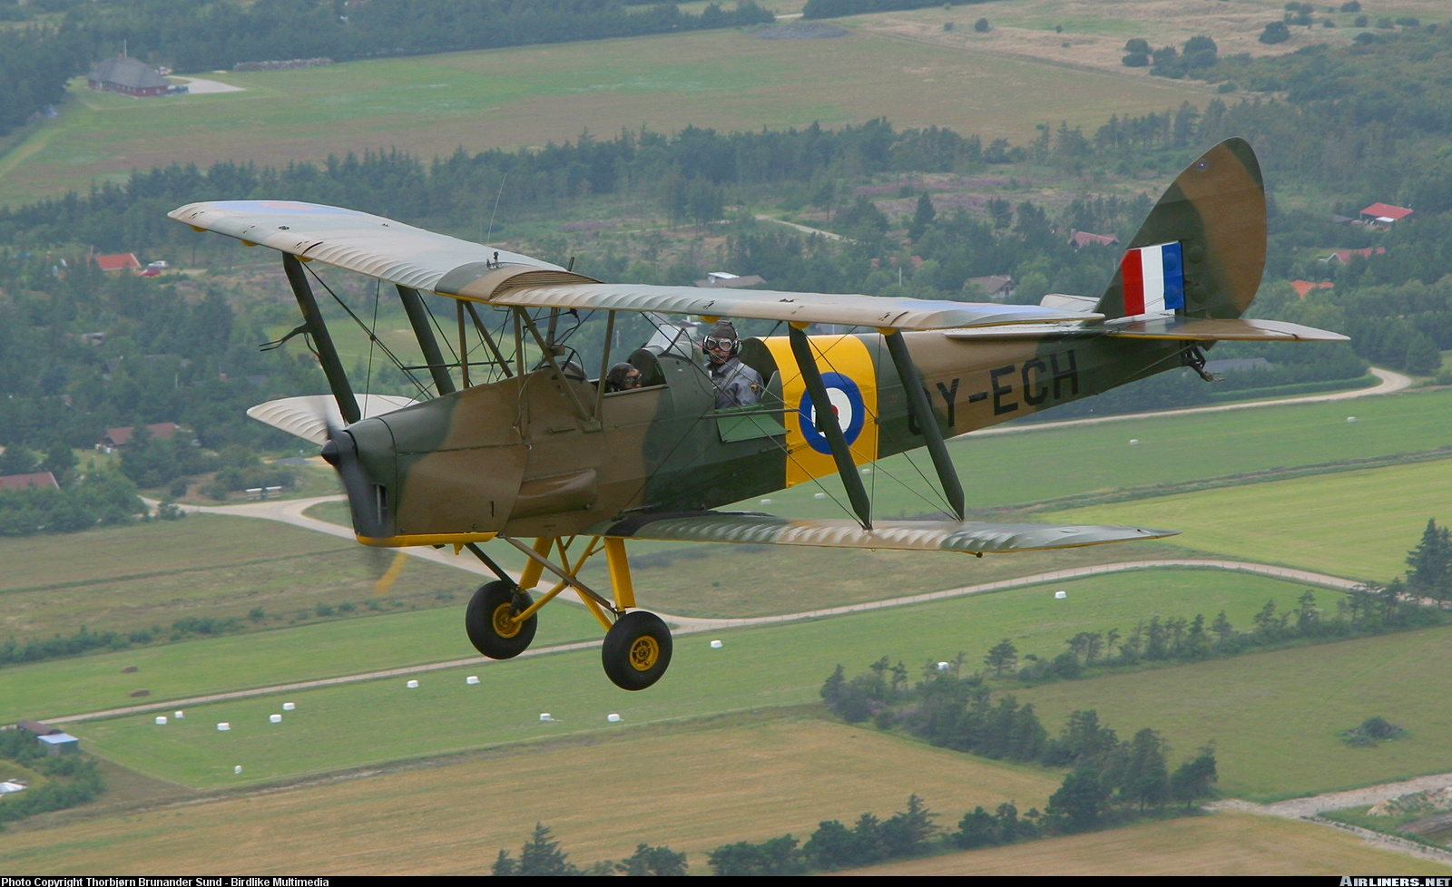
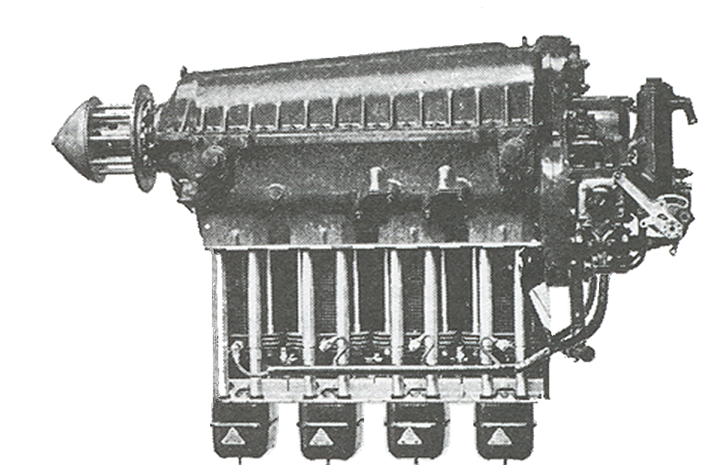
In-Line
Cylinders are arranged side by side in a row.
Limited to 6 cylinders per row
Any more cylinders and V, X or H-type configurations must be used.
Sometimes inverted for better visibility
Lower drag but greater weight
Engine size is limited

Slide 9
Construction of a Reciprocating Engine
Piston - Cylinder shaped object that moves up and down.
Piston Rings - wrap around the piston and provide a seal between the piston and cylinder.
Connecting Rod - joins the piston to the crankshaft, which turns the propeller.
Cylinder Head - The top of the cylinder. Contains the inlet (intake) valve, exhaust valve and two spark plugs
Cylinder and head are finned to better dissipate heat

Slide 10
Construction of a Reciprocating Engine
Camshaft - turned by the crankshaft and operates the push rods and rocker arms. It turns at half the speed of the crankshaft
Magnetos - provide the electrical energy to operate the spark plugs
Intake Valve Ports - allow the fuel/air mixture into the cylinder when opened
Exhaust Valve - allows the waste gasses to exit the cylinder after the power stroke
Spark plugs

Slide 11
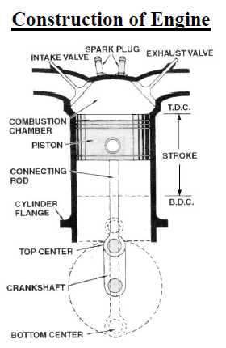

Slide 12
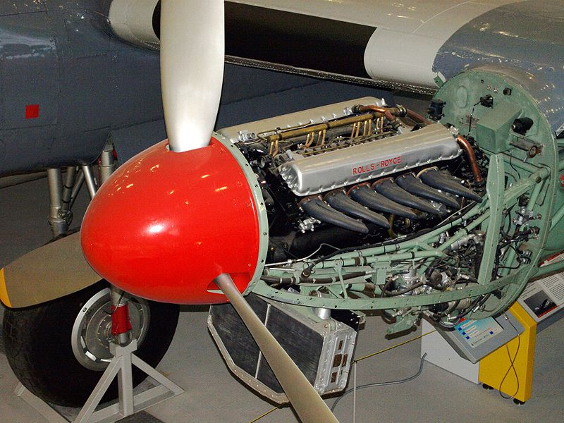
Operation of the combustion engine

Slide 13
The Four Stroke Cycle
Most piston aero engines operate on the four stroke cycle.
The piston moves through four strokes, two up and two down, to complete the cycle.
The crankshaft makes two complete revolutions during a cycle.
The four strokes are:
  the induction (or intake) stroke,
  the compression stroke,
  the power (or combustion) stroke
  the exhaust stroke.

Slide 14
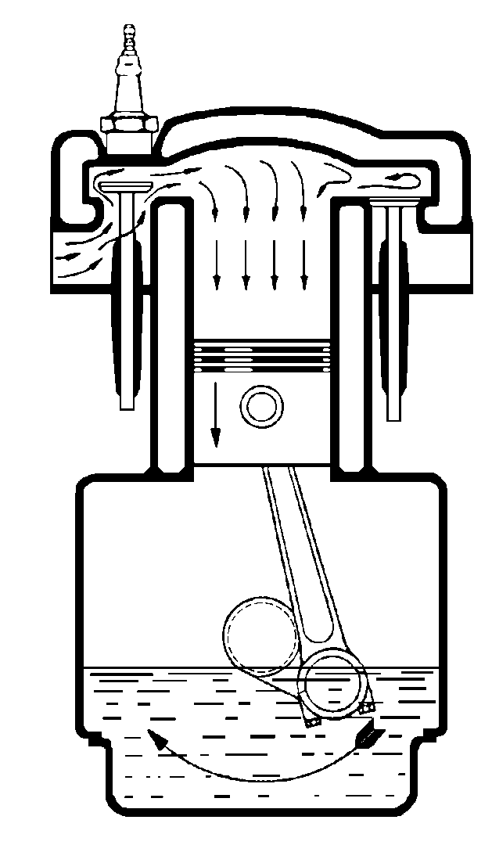
The Induction
(or Intake) Stroke
Intake valve is open; exhaust valve is closed
Piston moves down.
Fuel/air mixture drawn into combustion chamber through intake valve.
One half revolution of the crankshaft is made

Slide 15
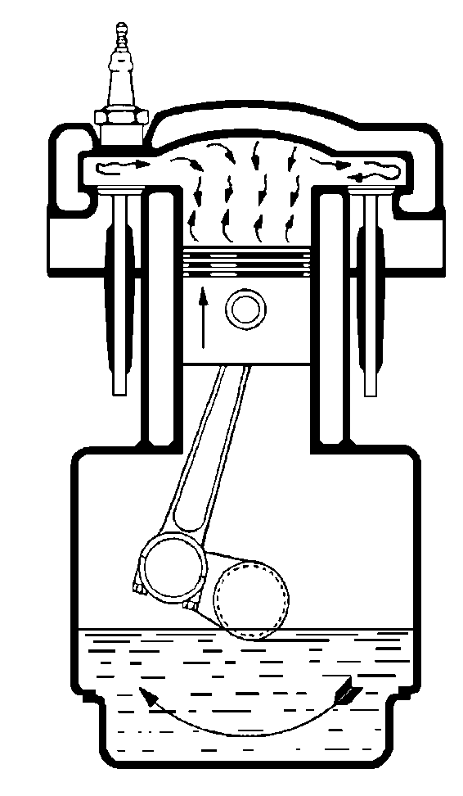
The Compression Stroke
Both valves are closed.
Piston moves up.
Mixture is compressed.
One complete rotation of the crankshaft has now been made
Compression ratio is comparison of volume of mixture with piston at the bottom and volume with piston at the top.
Notes:
Compression ratio of around 10:1 is common in atmospheric piston engine

Slide 16
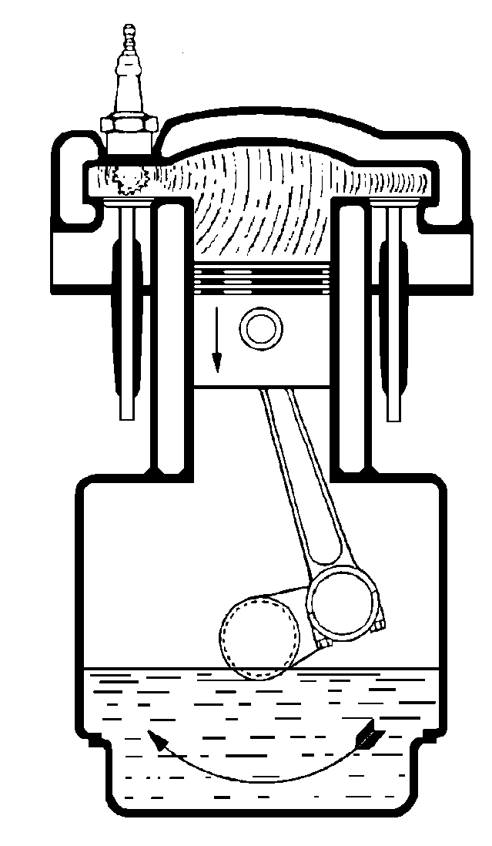
The Power
(or Combustion) Stroke
Both valves are closed.
Compressed mixture is ignited by spark plug.
Burning gas expands forcing piston down.
Crankshaft has now made one and a half revolutions
Energy drives other three strokes as well as turning the propeller

Slide 17
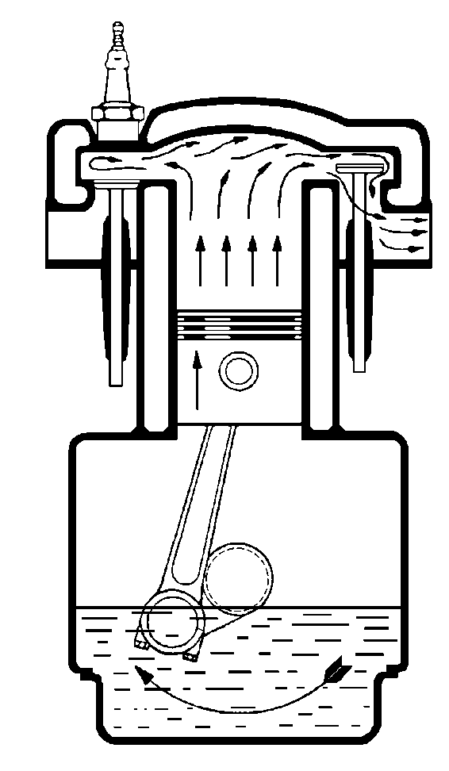
The Exhaust Stroke
Exhaust valve is open; intake valve is closed
Piston moves up
Burnt gas is pushed out through exhaust valve
Second revolution of crankshaft has been completed

Slide 18
Timing
The purpose of timing is to improve the performance of the engine.
Valves take time to open and close and fuel-air mixture has inertia may be exploited to increase the amount of mixture intake by cylinder
Therefore they are timed to open early and close late in order not to waste any of the induction or exhaust stroke

Slide 19
Timing
Valve Lead
  Timing the valve to open early
Valve Lag
  Timing the valve to close late
Valve Overlap
  Allowing both valves to remain open at the same time
Notes:
Valve overlap: allowing both valves to remain open simultaneously. This happens at the end of the exhaust stroke. By opening early, the exhausting gas helps the incoming fuel air mixture by the suction created when leaving through the exhaust piping

Slide 20
Valve Clearances
Valve clearance, or tappet clearance, is a space that must be provided between the valve stem and rocker to allow for heat expansion of the metal.
  Clearances too wide cause a loss of power, vibrations and excessive wear
  Clearances too close can warp the valves

Slide 21
Two-Stroke Engines
Only two strokes to complete full cycle
Less efficient; less than half of 4-stroke
Shorten period fuel inducted into combustion chamber
Reduces time spent exhausting burnt gases
Notes:
Fuel-air mixture is inducted through the intake port when the piston is at the bottom of the cylinder, and then compressed as the piston rises and fired when the piston reaches the top.
During the power stroke, the piston moves downwards and uncovers the exhaust port, allowing the escape of burnt exhaust gases.

Slide 22
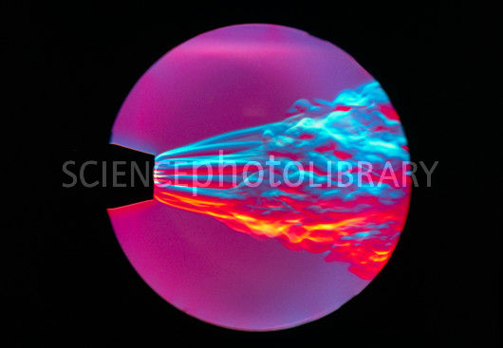
Cooling, lubrication and lubricants

Slide 23
Cooling System
In an internal combustion engine, fuel is burned, resulting in the production of a tremendous amount of heat
This heat is distributed across the engine and absorbed by the metal
Without some sort of engine cooling, this heat would result in warping which would end in engine failure

Slide 24
Cooling System
The most common method of dissipating engine heat is by circulating cooler air around the engine cylinders.
Horizontally opposed engines are usually air cooled, although some are liquid cooled
Some in-line engines are air cooled; a few are liquid cooled
All radial engines are air cooled
Notes:
Air cooling is lighter than liquid cooling

Slide 25
Parts of an Air Cooling System
Fins
  Small metal rings added to the surface of the engine cylinders providing a greater surface area for heat to be absorbed
  ram air enters the engine cowls and cools the fins as it passes by
  openings in the rear of the cowls expel this air
Fans
  gear driven fans
  mounted on the front of the engines
  assist the flow of cooling air at higher altitudes.

Slide 26
Parts of a Cooling System
Augmenter Tubes
  jet pumps direct exhaust gases through these tubes
  this produces a suction strong enough to increase the flow of cooling air past the cylinders
Cowl Flaps
  Doors on the cowl that can be opened by the pilot to increase airflow over the engine

Slide 27
Four Functions of Oil
Cooling:
  Carries away excessive heat generated by the engine
Seals
  Provides a seal between the piston rings and cylinder walls, preventing “blow-by” loss of power and excessive oil consumption.
Flushing/cleaning
  Cleans and flushes engine interior of contaminants that enter or are formed during combustion.
Lubrication
  Prevents wear and tear of metal parts by maintaining a film to reduce friction

Slide 28
Requirements of a Good Oil
Correct Viscosity
  viscosity is the resistance to flow of a liquid
  correct oil viscosity allows proper distribution throughout the engine and prevents rupturing of the oil film
  high viscosity index: the changes in viscosity, due to varying operating temperatures, are small
  Too high viscosity:
    Causes high oil pressure and prevent the oil from reaching all of the engine components
  Too low viscosity:
    Causes low oil pressure and creates wear damage to the components

Slide 29
Requirements of a Good Oil
High flash point:
  temperature beyond which a fluid will ignite
  an oil’s flash point should be in excess of the highest engine operating temperature
Low pour point:
  pour point is the temperature at which a fluid becomes too viscous to flow (solid)
  a low pour point is important for winter operations because the oil must flow as soon as the engine is started

Slide 30
Requirements of a Good Oil
Low carbon content:
  important because a small amount of oil usually enters the cylinder and is burned, leaving carbon deposits on the cylinder walls
  good oil should also have a low wax content
  oils which have good resistance to deterioration and the formation of lacquer and carbon deposits are said to have good oxidation stability

Slide 31
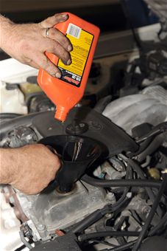
Methods of lubrication

Slide 32
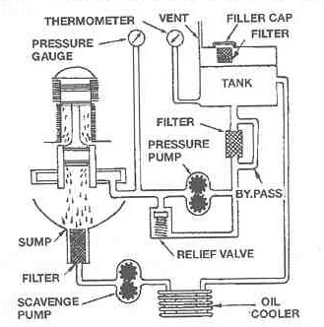
Force Feed by Dry Sump
Notes:
Force feed: oil is forced under pressure into the engine as a fine mist
Oil is contained in a separate reservoir
Pressure pump forces the oil through the hollow crankshaft to lubricate the engine
Oil is drained into a sump from which it is pumped by the scavenging pump to ensure that the oil does not accumulate in the engine.
The oil then passes through an oil cooler before returning to the reservoir
A by-pass around the filter is provided to prevent damage in case of failure (in case of neglect or carelessness) to clean the filter.
The pressure relief valve provides a means of regulating the oil pressure
Oil pressure is monitored by an oil pressure gauge on the instrument panel of the aircraft in the cockpit

Slide 33
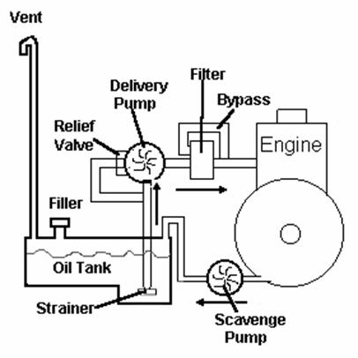
Force Feed by Wet Sump
Notes:
The engine oil supply is contained in a sump, or pan, under the crankcase.
The oil passes through a filtering screen in the bottom of the sump into the suction side of a gear-type pressure pump. The pump moves the oil around the outside of its gears and imparts a predetermined pressure to it.
A pressure relief valve is incorporated into the pump to ensure a steady supply of oil during all phases of engine operation. The pressure pump, which is engine driven, delivers oil through passageways in the crankshaft and pushrods to all the bearings of the engine for cooling and lubrication.
Some internal parts and surfaces of the engine may be splash lubricated or may be sprayed by oil flung off rotating parts of the crankcase and connecting rods.
After circulation, the oil drains through return tubes back to the sump. An oil cooler may be located in the return line to dissipate heat. The advantage of the wet sump is that it is light and simple. However, the capacity of the sump is limited by the size and design of the nacelle or cowling.

Slide 34
Splash Lubrication
Oil is contained in a sump or reservoir, at the base of the engine
It is churned by the revolving crankshaft into a heavy mist, which splashes over the various engine parts
No longer used in aircraft manufactured today, but can be found in vintage aircraft

Slide 35
Review
What are the types of engines?
Explain the conventional exhaust stroke. (no valve timing changes)
What are the four functions of oil?
Notes:
Radial
Horizontally opposed
In-line
Intake valve is closed
Exhaust valve is open
Piston rises to top of cylinder pushing burnt gases out through the exhaust valve
Crankshaft completes the second rotation
Cooling
Sealing
Flushing
Lubrication

Slide 36
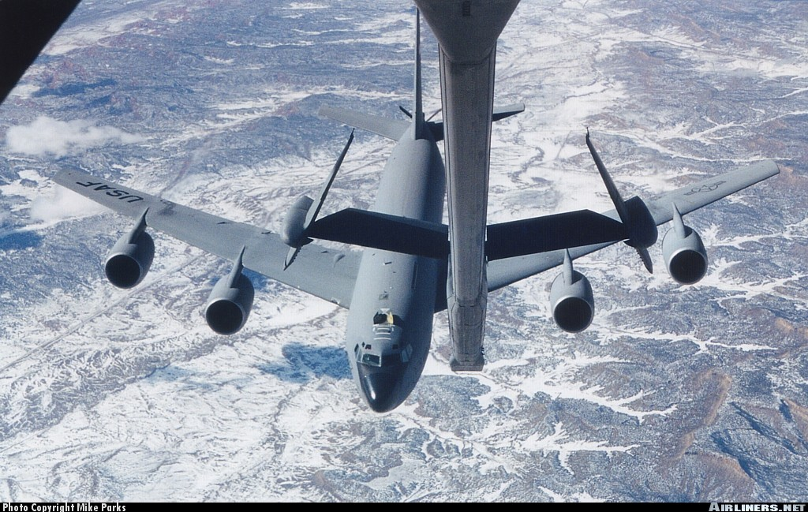
Fuel Systems

Slide 37
Fuel Systems
Stores and delivers the proper amounts of fuel at the right pressure to meet the demands of the engine.
Aircraft usually have several tanks to store the quantity of fuel required to give the airplane reasonable range.
Tanks are usually located in the wings, although some aircraft may have them located elsewhere (Katana)
The pilot can switch between tanks to balance the fuel load in the cockpit using a selector switch

Slide 38
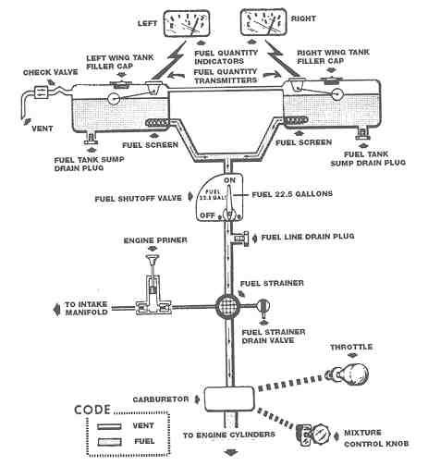
Gravity Feed Fuel System
Simplest design.
Used on many high wing, low powered airplanes.
Fuel tanks mounted in the wings above the carburetor.
Uses gravity to draw fuel from tanks, past fuel selector valve to the carburetor.
Notes:
A drain allows removal of water and sediment trapped at the strainer
A primer sprays raw fuel into the intake manifold system or directly into the cylinders to aid starting, particularly in cold weather

Slide 39
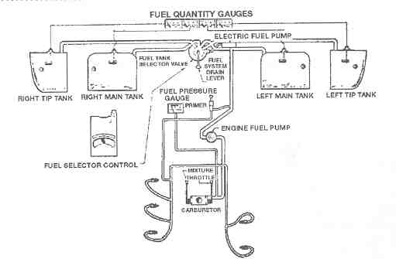
Fuel Pump Fuel System
Engine driven fuel pump supplies the pressure that keeps the fuel flowing to the engine
Used in all low wing airplanes and in any airplane with a higher performance or fuel injected engine
Incorporates a basic pump, auxiliary electric pumps or booster pumps that serve in emergency in case the engine driven pump fails
Fuel pressure gauge gives a visual indication that fuel system is working
Notes:
Fuel pressure gauge is in the cockpit

Slide 40
Other Components of the Fuel System
Fuel Tanks:
  vary in size, shape and location
  construction material is light and chemically inert to fuel
  tanks usually have a drain at the bottom to remove water and have internal baffles to prevent fuel from shifting suddenly during attitude changes
  tanks are vented to maintain atmospheric pressure inside the tank and allow the fuel to flow
Notes:
Overflow drains are also incorporated to release fuel and prevent tanks from bursting when fuel expands in the tanks

Slide 41
Other Components of the Fuel System
Fuel Selector Control:
  This device permits the pilot to select from which tank they want to draw fuel
Fuel Lines and Filters:
  Connect the fuel tanks to the carburetor
  Made of a variety of materials
  One or several filters prior to the carburetor prevent debris from clogging the system

Slide 42
Fuels
Fuels for modern high compression engines must burn slowly and expand evenly rather than explode quickly
The fuels that possess this quality are known as high octane fuels

Slide 43
Octane Ratings
Octane:
  a substance which possesses minimum detonating qualities.
Heptane:
  a substance which possesses maximum detonating qualities.
The proportion of octane to heptane in a fuel is usually expressed as a percentage
Notes:
Example:
73 Octane fuel means that the fuel would have the same burning characteristics as a chemical mixture of 73% octane and 27% heptane
The fuel itself is not composed of octane or heptane. These are used for comparison purposes

Slide 44
Fuel Grades
Usually indicated by two numbers.
The first number indicates the octane rating at lean mixture conditions and the second at rich mixture conditions.
E.g.. Grade 80/87 = octane rating of 80 at lean mixture conditions and 87 at rich mixture conditions
Octane numbers only go to 100.
Those above are called Performance Numbers and represent 100% octane with additional additives to slow the burning even more.
Notes:
Aviation fuel contains more energy than do most automobile fuels. An
aircraft's performance engine requires slow burning and an even expansion of gases rather than a quick explosion. A fuel's ability for slow burning is rated by an octane number from 0 to 100 (slowest). A number greater than 100 is called a performance number and means 100% octane with additives to slow the burning even more.

Slide 45
Applications of Various Fuel Grades
Application | Grade or Type | Colour
Low power | Grade 80 (or 80/87) | RED
Medium power | 100 (High Lead) | GREEN
Medium power | 100LL (Low Lead) | BLUE
Jet Engine | Kerosene | CLEAR or STRAW YELLOW

Slide 46
Additional Notes
If the proper grade of fuel is not available, always use the next (higher) grade, never the lower one
The pilot is responsible to see that the proper fuel is used
The correct grade of fuel can be found in the airplane flight manual

Slide 47
Detonation
Very rapid and violent explosion of the fuel in the cylinder; causes overheating and can damage engine components
Signs:
  rapid rise in cylinder pressure, and
  rapid increase in cylinder head temperature
Causes:
  use of incorrect fuel,
  overheating (lack of airflow)
  Too lean of mixture
Solution:
  Solved by enrichening mixture (temporary)
  Only use manufacturer approved octane rating (permanent)

Slide 48
Pre-ignition
Premature ignition of the fuel/air mixture due to glowing carbon particles or local hotspots
Experienced when attempting to start a hot engine and usually results in a backfire through the intake manifold
Can do severe damage including warped pistons, and cracked cylinder heads

Slide 49
Vapour Lock
Occurs in the fuel lines
Caused by high atmospheric temperatures, which causes the fuel in the lines to vaporize and block the flow of liquid fuel in the line

Slide 50
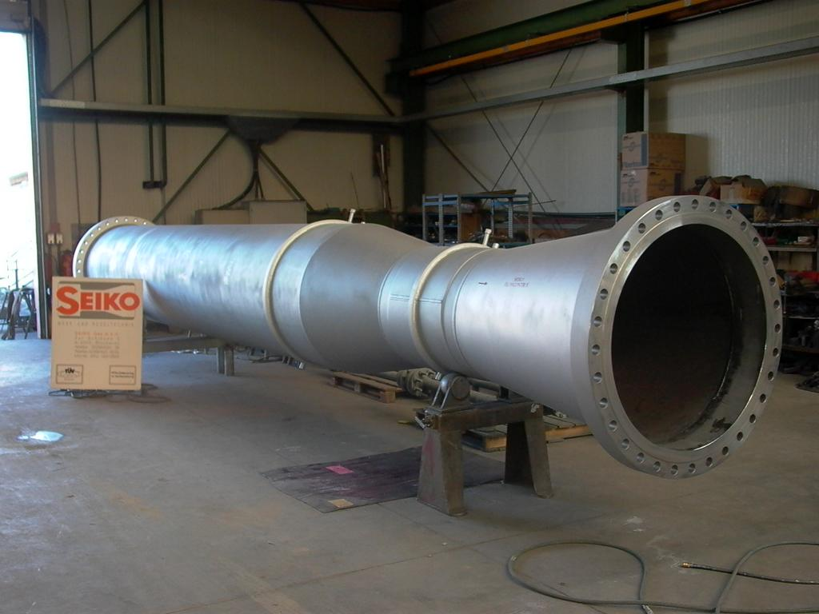
The carburetor

Slide 51
The Carburetor
The carburetor has three important functions:
  measure the correct quantity of gasoline and vaporize this fuel,
  mix it with air in the proper proportion, and
  deliver the mixture to the cylinders.

Slide 52
Components of a Carburetor
Venturi
  air is drawn into the venturi and because of its shape, the air is accelerated while the pressure is reduced
Nozzle
  provides a passage for fuel from the float chamber to the venturi
  reduced pressure draws fuel into the venturi where it is vaporized

Slide 53
Components of a Carburetor
Throttle Valve
  regulates the volume of fuel/air mixture
Intake Manifold
  distributes the fuel/air mixture from the carburetor to the cylinders
Float Chamber
  contains a constant level of fuel in order to keep fuel supply steady
Throttle Valve
To
Intake
Manifold
Float
Chamber

Slide 54
Components of a Carburetor
Float valve/ Needle Valve
  opens and closes the fuel line and is controlled by the float
Vent/air intake
  allows the pressure to be equalized with that of the changing outside air pressure
Idle Jet
  used to keep the engine going when there is insufficient air flow to drawn in fuel from the nozzle

Slide 55
Mixture
Engine temperature greatly affected by the ratio of fuel to air
Engine will run hotter with a lean mixture than with a rich mixture because the lean mixture is burning faster
Mixture ratio measured by weight
Chemically correct mixture above 15:1
Notes:
Proportion of air to fuel is controlled by the pilot via the mixture control in the cockpit
The throttle controls the flow of air penetrating into the engine and creates the turbulence at the butterfly valve, which promotes mixing of the fuel and air
Engine operating temperature is affected by the fuel-air ratio of the mixture entering the combustion chamber
Engine will run hotter with a lean mixture because a lean mixture burns more slowly and more heat is absorbed by the walls due to longer exposure
Engine will run cooler when the mixture is rich. The mixture burns more rapidly, exposing the cylinder walls to high temperatures for less time. The extra fuel contained in rich mixture promotes cooling by carrying away excess heat with the exhaust

Slide 56
Mixture Control
As altitude increases, the density of air decreases
Carburetors are calibrated for sea level operation; full rich mixture setting at sea level
Therefore, with altitude, the mixture would become over-rich, causing a waste of fuel and a loss of power
A mixture control is fitted to adjust the amount of fuel being drawn from the nozzle.
The mixture control can be used to produce a rich or lean fuel/air mixture.

Slide 57
LEAN Fuel/Air Mixture
Lean mixture has more higher air in fuel/air mixture
Too lean causes rough operation, sudden cutting out, detonation
Continuous operation can cause engine failure
Used for cruise to conserve fuel
Notes:
Too lean can cause rough running, detonation, back-firing, over-heating or a considerable loss of power

Slide 58
RICH Fuel/Air Mixture
Rich mixture has lower combustion temperature
Too rich wastes fuel and contributes to spark plug fouling and combustion chamber deposits leading to engine failure
A rich mixture should only be used for situations where a high power setting is required or when operating close to sea level (below 3000’) i.e. takeoff, landing
Notes:
Excess fuel to air
Wasted fuel is expelled through the exhaust system

Slide 59
Leaning the Mixture
Operating below 75% rated RPM for economy
For takeoff at high altitude
After climbing to higher altitude due to less dense air and enrichened during descent
Any flight at altitudes over 5,000 feet
Notes:
a. When operating below 75% of the rated RPM it can be used for economy. At higher RPM the excessive heat from leaning can cause engine damage.
b. For take-off at high altitude, and at normal settings the less dense air would cause a loss of power due to an over rich mixture.
c. When climbing to a higher altitude the mixture should be leaned due to less dense air (and enriched during descent).

Slide 60
Why Lean the Engine
Proper leaning of engine is both practical and economical. It results in:
  economy of fuel,
  a smoother running engine,
  a more efficient engine,
  extended range at cruise,
  less spark plug fouling,
  more desirable engine temperatures, and
  cleaner combustion chambers
  Reduce carburetor icing hazards

Slide 61
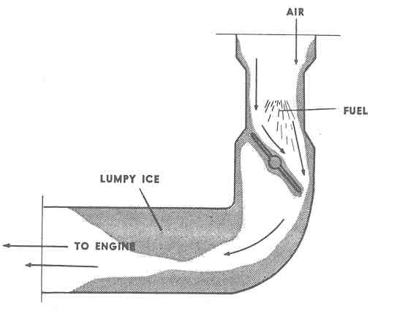
Carburetor Icing
Forms under moist atmospheric conditions with air temperatures anywhere from approximately -5°C to 30°C.
Indicated by a loss of power (RPM drop)
Can cause complete engine failure
Notes:
Can cause a total engine failure by interrupting the flow of air to the engine

Slide 62
Carburetor Ice
Two sources:
  Progressive drop in temperature as the energy is taken from the air and used to vaporize the fuel (Latent heat of vaporization)
  Cooling caused by the lower pressure existing in the carburetor
There are three forms of carburetor ice:
  fuel vaporization ice
  impact ice
  throttle ice
Notes:
This problem almost never occurs in engines with a fuel injection system rather than a carburetor. However, some fuel injection systems do use a venturi exposing it to icing.

Slide 63
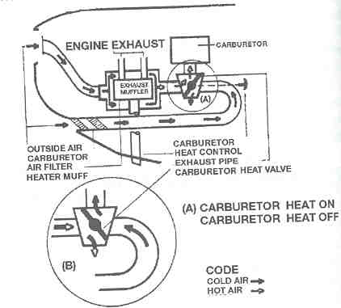
Prevention of Carb Icing
Carb icing does not occur in engines that have fuel injectors
Carb heat directs hot air into the carburetor intake.
This results in initial drop in RPM
If ice is present, its melting will give a short period of engine roughness.

Slide 64
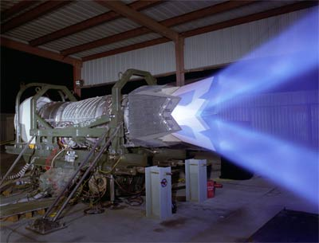
The exhaust system

Slide 65
Exhaust System
Collects and disposes of the high temperature, noxious gases discharged by the engine
Main function is to prevent the escape of these potentially destructive gases into the airframe and cabin
Two types for piston engines:
  short stack system
  collector system.

Slide 66
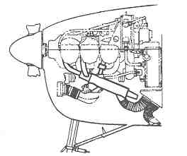
Short Stack Exhaust System
Used on low powered, non-turbocharged engines
Simple design of:
  a downstack from each cylinder,
  an exhaust collector tube on each side of the engine, and
  an exhaust ejector on each side of the cowling.
Notes:
Shrouds encircle each collector tube
Outside air passing through one of these is heated by the high exhaust temperatures and carried to the cabin to provide cabin heat
The other carries heated air to the carburetor hot air system

Slide 67
Collector Exhaust System
Used on most large engines and on all turbocharged engines
Individual exhaust headers empty into a collector ring that collects the exhaust from all the cylinders
One outlet from this rings routes the hot exhaust gas to the turbocharger
An exhaust tailpipe carries the gases away

Slide 68
Review
What is the most commonly used fuel in general aviation?
When do you lean the mixture?
How do you prevent carburetor icing?
Notes:
100LL
At cruise power, i.e. Around 75% under maximum power
For any flight at altitudes over 5,000 feet
For take-off at high-altitude aerodromes
After climbing to a higher altitude
Fuel injector
Carb heat

Slide 69
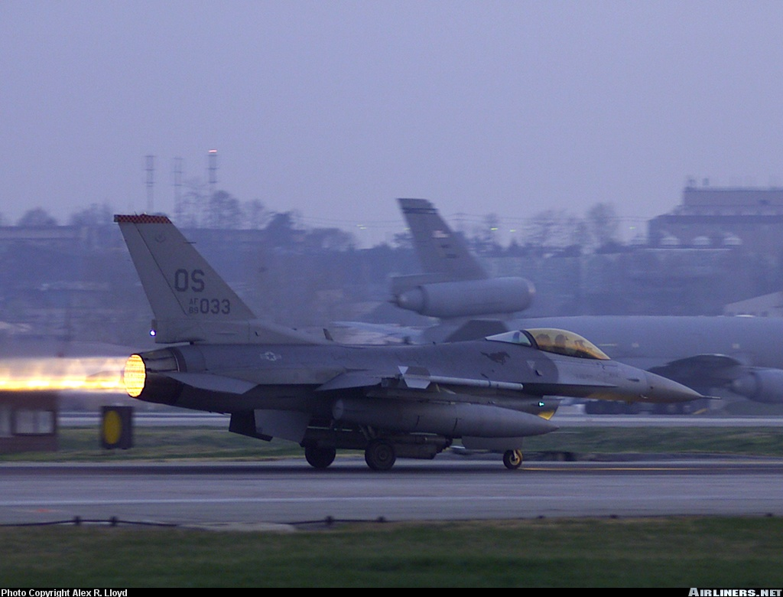
Ignition Systems

Slide 70
Ignition System
The function of the ignition system is to supply a spark to ignite the fuel/air mixture in the cylinders
It consists of:
  two magnetos
  two spark plugs per cylinder
  ignition leads
  a magneto switch

Slide 71
The Magneto
If a coil of wire is rotated in a magnetic field, current will be induced in the coil
A magneto uses this principle to generate electrical current independently of the aircraft electrical system
Serves three functions:
  generates a low tension current
  transforms this to a high tension current
  distributes the current to the individual spark plugs at the exact time it is desired to have them fire
Notes:
The high-tension current is directed through a collector ring to the distributor
The distributor has a rotating arm, which aligns with separate segments as it rotates
Each segment is connected to one spark plug
Each segment is connected to an individual spark plug and distributes the current to the right plug at the exact time it is required to fire

Slide 72
Dual Ignition
Modern aero engines are fitted with two spark plugs per cylinder and two magnetos
One magneto fires one of the spark plugs for each cylinder, while the second magneto fires the second spark plug for each cylinder
Purpose is two fold:
  Safety: if one system fails, the engine will still operate
  Performance: creates a more even combustion

Slide 73
Magneto Switch
The magneto switch has four settings:
  Left
  Right
  Both
  Off (it also has a start position)
To check the magnetos, the pilot watches the RPM’s as they turn the switch
In the event of rough engine operation in flight, switch to smoothest operating magneto

Slide 74
Shielding
The parts of the ignition system are surrounded with a metal covering, which is grounded
Is used to prevent interference with the radio and electrical system

Slide 75
Ignition Timing
The magneto must be timed to allow every cylinder to fire at the correct time
Firing too early can result in:
  Loss of power
  Overheating
  Detonation
  Pre-ignition
  Piston burning
  Scored cylinders
  Broken rings
Notes:
No firing during intake stroke

Slide 76
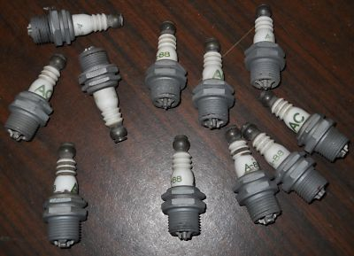
Electrical system

Slide 77
Electrical System
Includes everything that operates electrically, except the magnetos
The ignition system is not connected with the airplane’s electrical system
Supplies power to start the airplane.
Also to operate a multitude of controls including:
  flaps,
  undercarriage,
  all radios,
  lights, etc.

Slide 78
Components
Storage Battery:
  stores electrical energy required for engine starts
Master Switch:
  overall on/off switch for the electrical system
Starter Motor:
  turns the engine over after it receives current from the battery
Generator/Alternator:
  supplies current to the system and the battery
  once motor is started, the alternator produces current to operate the aircraft electrical system

Slide 79
Components
Voltage Regulator:
  prevents the system from being overloaded and the battery from overcharging
Bus Bar:
  Receives current from the battery and the alt/gen and distributes it to various circuits
Circuit Breakers:
  prevents component damage resulting from system overloads.

Slide 80
Components
Ammeter/Voltmeter:
  indicates current and voltage storage and drain of the system
Alternator/Generator Warning Light:
  indicates an alternator or generator failure
  aircraft without ammeter/voltmeters have this

Slide 81
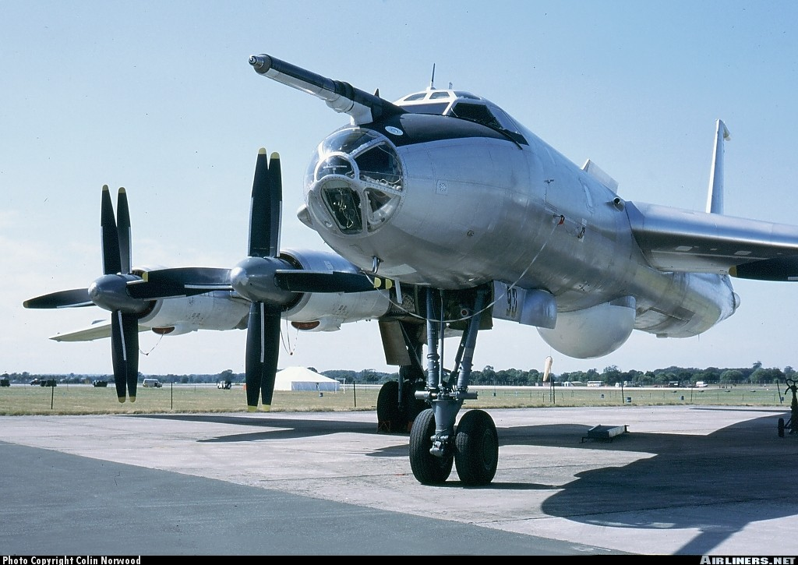
Propellers

Slide 82
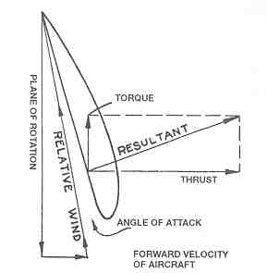
The Propeller
The function of the propeller is to convert the turning movement of the crankshaft into thrust (forward motion)
As it rotates, it moves forward along a corkscrew or helical path
It pushes air backward with the objective of causing a reaction, or thrust, in the forward direction

Slide 83
The Propeller
A jet engine moves a small mass of air backward at a relatively high speed
A propeller moves a large mass of air backward at a relatively slow speed
When installed in front of the engine and pull the aircraft forward are called tractors
When installed behind the engine and push the aircraft forward are called pushers

Slide 84
The propeller blade is an airfoil section, similar to the airfoil section of a wing
The blade meets the air at an angle of attack as it rotates.
This produces both lift and induced drag
In the case of the propeller, the forces are designated as thrust and torque respectively

Slide 85
Pitch
The distance in feet a propeller travels forward in one revolution
The angle at which the blade is set governs the pitch
Coarse pitch means the blade is set at a large angle
Fine pitch means the blade is set at a small angle

Slide 86
Coarse Pitch
Blades have large angle of attack
Travels forward a large distance with each revolution
Provides greater power RPM
Good for high speed cruise and high altitude flights
Better fuel economy

Slide 87
Fine Pitch
Blades have small angle of attack
Produces less torque (less drag) and therefore will turn faster around the axis, producing more thrust for a given engine RPM
Higher blade RPM resulting in greater forward pull
Better performance for takeoff and climb

Slide 88
Types of Propellers
Fixed Pitch:
  constant blade angle
  No pitch setting control
  angle chosen to give the best performance for all flight conditions
Adjustable Pitch:
  blade angle may be adjusted on the ground
Controllable Pitch:
  blade angle can be adjusted by the pilot to various angles during flight
Constant Speed:
  Engine speed is set and blades automatically adjust to keep speed constant
  Controlled by throttle

Slide 89
Propeller Control Systems
Mechanical - controlled by linkages
Hydraulic - a fluid under pressure pushes or pulls on a cam that uses gears to turn the propellers
Electrical - operated by an electric motor

Slide 90
Feathering
Turning the propeller blades to an extreme coarse pitch
Used in the event of an engine failure to stop the propeller from wind milling, which creates lager amounts of drag and can damage the engine

Slide 91
Thrust Reversing
Changing pitch past the feathered position to a negative pitch angle
This produces thrust in the opposite direction (negative thrust) and is used to slow the aircraft after landing or maneuvering on the ground
Reverse pitch is usually only available on turboprop aircraft

Slide 92
Review
What does dual ignition mean?
What are the types of propellers?
What is feathering?
Notes:
Two spark plugs per cylinder in order to half more efficient burning and as a backup
Fixed pitch
Adjustable pitch
Controllable pitch
Constant speed
Turning the blades to extreme coarse pitch setting to prevent propeller from wind milling and producing excess drag during an engine failure

Slide 93
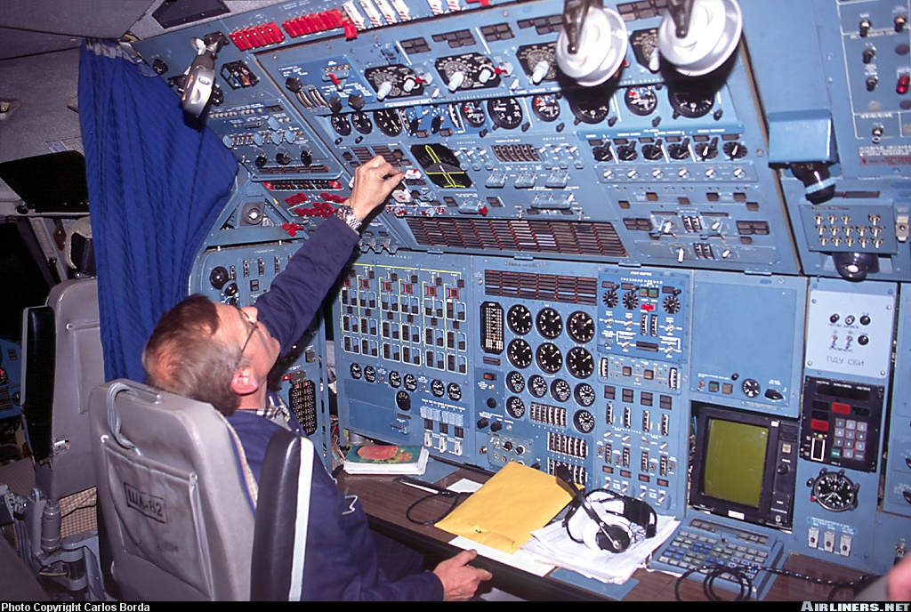
Engine Instruments

Slide 94
Basic Engine Instruments
Although an aircraft has many complex instruments, the basic engine instruments are the most important
These gauges monitor essential engine parameters
They can indicate the early warning signs of potential problems and possible engine failure

Slide 95
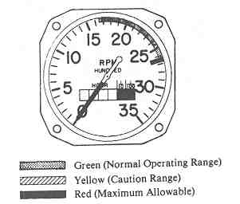
Colour Coding
Green – normal operating range
Yellow – caution operating range
Red – danger operating range

Slide 96
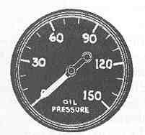
Oil Pressure Gauge
Monitors oil pressure supplied by oil pump
High pressure can force oil into the combustion chamber where it will burn
Low pressure leads to poor lubrication leading to engine failure

Slide 97
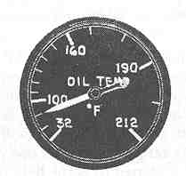
Oil Temperature Gauge
Monitors temperature of oil
High oil temperature along with low oil pressure is an indication of an oil leak
Notes:
Monitors temperature of oil. Oil temperature and pressure are related, but it should be remembered that oil acts as a coolant as well as a lubricant.

Slide 98
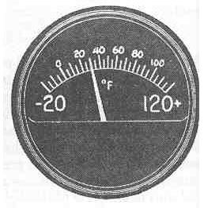
Carburetor Air
Temperature Gauge
Enables pilot to monitor the temperature of intake air or air/fuel mixture into the carburetor
If icing exists, the carburetor heat control unit can be activated by the pilot

Slide 99
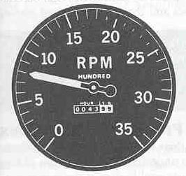
Tachometer (RPM Gauge)
Monitors the number of hundred revolutions per minute the crankshaft is turning
On aircraft with fixed pitch propellers, RPM is controlled by the throttle

Slide 100
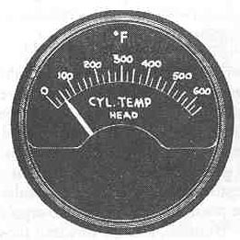
Cylinder Head
Temperature Gauge
Records the temperature of one or more of the engine cylinder heads
Extremely high cylinder head temperatures are signs of engine overheating or detonation

Slide 101
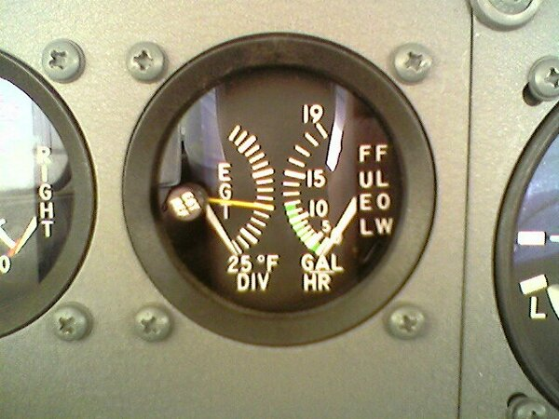
Exhaust Gas Temperature (EGT)
Records the temperature of the exhaust gas
Used in leaning the engine for max power or economy

Slide 102
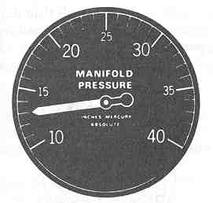
Manifold Pressure Gauge
Monitors engine power controlled by throttle
Usually beside the tachometer because both indicate engine power output
A drop in manifold pressure usually indicates carburetor icing
Notes:
On an aircraft with a constant speed prop, manifold pressure is controlled by the throttle

Slide 103
Review
What does the tachometer monitor?
What is straw coloured fuel?
How are engines cooled?
Notes:
Reads the speed at which the crankshaft is turning in hundreds of revolutions per minute
Jet engine fuel – kerosene
Air cooled
-fins
-fans
-augmenter tubes
-cowl flaps
Liquid cooled

Slide 104
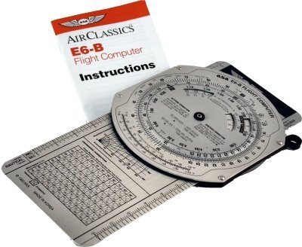
E6B practice

Slide 105
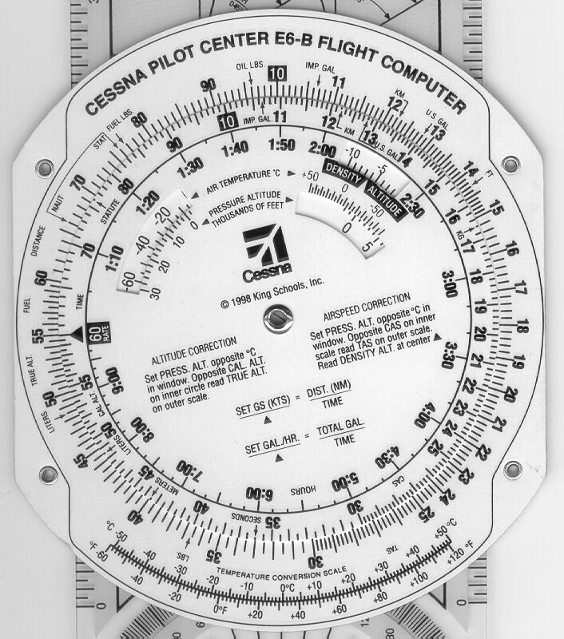
Formula is on the Front
DIST
TIME
GAL
TIME
Rate Marker
Increments of time mins vs. hrs
Press/Dens
Alt correct
Temp conv

Slide 106
TIME SPEED DISTANCE
  ______ 120 80
  ______ 85 30
  ______ 90 24
  ______ 100 45
  ______ 75 90
:40
:21
:16
:27
:72 or 1:12

Slide 107
TIME SPEED DISTANCE
  :15 ______ 24
  :20 ______ 35
  :06 ______ 15
  :30 ______ 45
  :03 ______ 8
96
105
150
90
160

Slide 108
TIME SPEED DISTANCE
  :25 90 ______
  :45 100 ______
  :30 120 ______
  :10 85 ______
  :15 115 ______
37.5
75
60
14
29

Slide 109
AIR TIME FUEL RATE FUEL REQUIRED
Time Lbs. /hr. U.S. gal/hr. Lbs. U.S. gal
  :30 30 ______ ______ ______
  1:45 50 ______ ______ ______
  2:30 ______ 5.0 ______ ______
  :45 ______ 7.0 ______ ______
  ______ 40 ______ 120 ______
  3:20 ______ 6.5 ______ ______
5 15 2.5
8.3 87.5 14.5
30 75 12.5
42 31.5 52.5
3:00 6.6 20
39 130 21.6

Slide 110
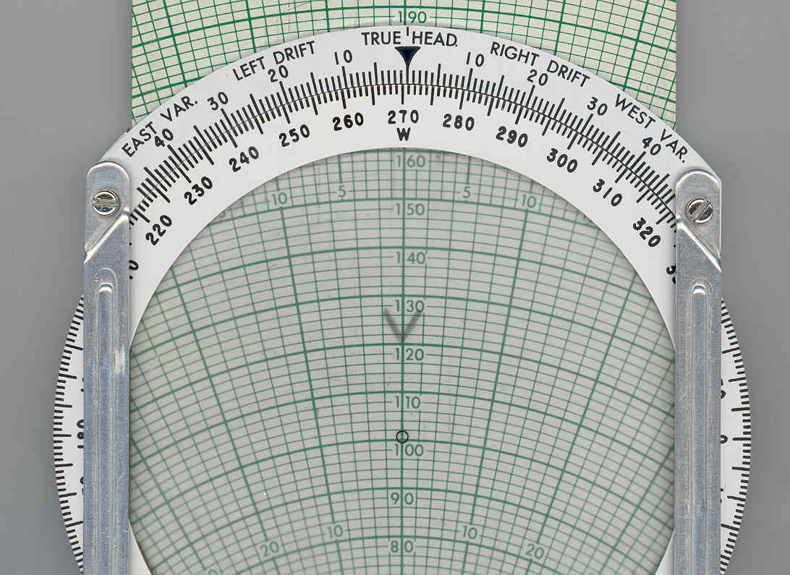
SET
WIND
STRENGTH
AND
DIRECTION

Slide 111
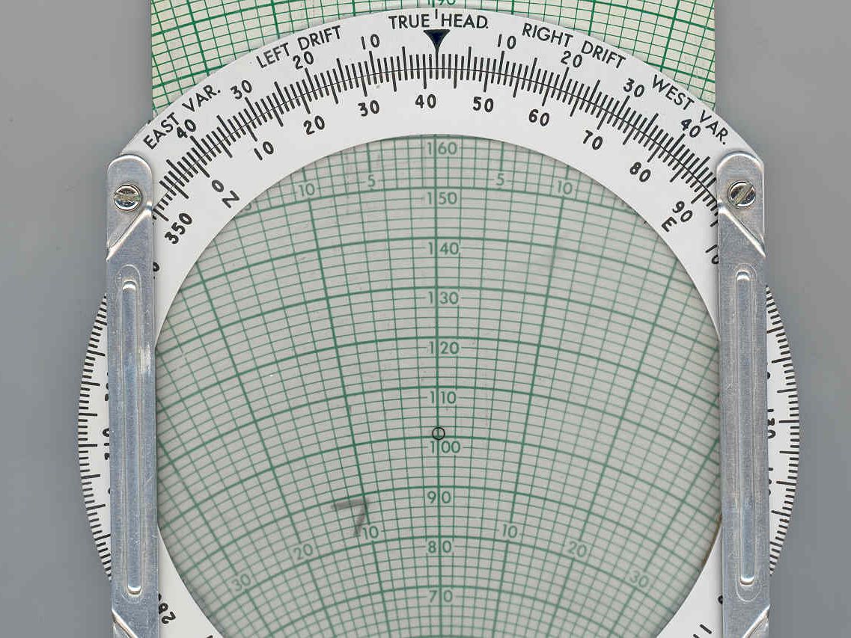
ORIENT
WIND
TO
TRACK

Slide 112
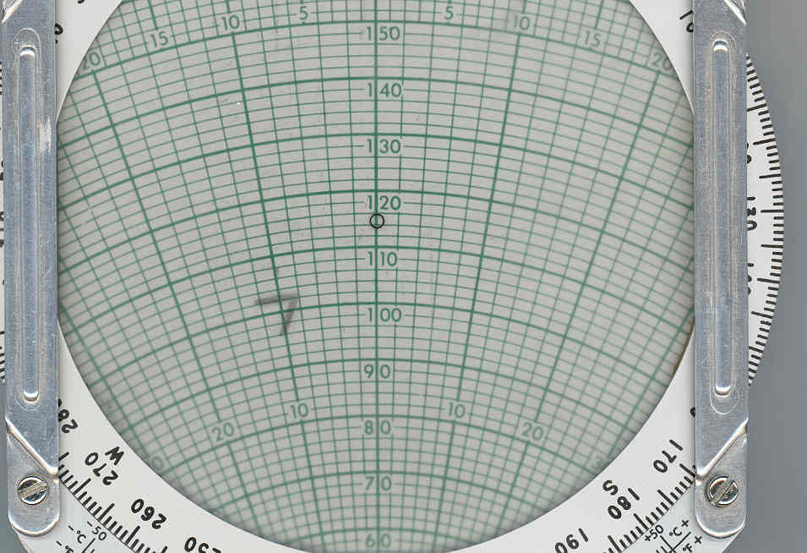
SLIDE
WIND
ONTO
AIRSPEED
MAGNITUDE
102

Slide 113
Summary
Today we covered:
  Basic Construction and Four Stroke Cycle
  Cooling, Fuel and Lubrication Systems
  Carburetor and Exhaust System
  Fuel Problems, Ignition and Basic Electrical System
  The Propeller and Engine Instruments
  CR-3 or E6-B Flight Computer

