Slide 1
Theory of Flight
Part 2
References: FTGU 29th Pages 3-45, Pilot’s Handbook of Aeronautical Knowledge Chapters 1-3
Notes:
Writing in regular script down here is to be taught
Writing in italics is for extra information

Slide 2
Review
What are the main parts of the aircraft?
How does a wing create lift?
What is a slot and what does it do?
Notes:
Wings, fuselage, empennage, landing gear, power plant
Faster moving air over top of wing creates a lower pressure causing higher pressure under wing to move up and push up wing
Permanent fixture in leading edge of wing that re-energizes airflow at high angles of attack to create lower stall speed

Slide 3
Topics to be covered
Aircraft controls
Stability
Aircraft performance
Stalls, spins, spiral dives and load factor
Aircraft instruments

Slide 4
Aircraft Control design

Slide 5
Aileron drag
When banking to make a turn, the downgoing aileron (outside and upgoing wing):
  Causes more drag because it is depressed into the airflow
Will skid outward on the turn towards the outside of the turn
Prevented by incorporating differential and fries ailerons

Slide 6
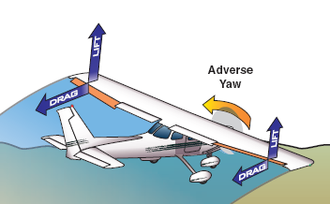
Adverse Yaw (caused by aileron drag)
In a turn, the outside wing travels faster than the inside wing, creating more lift (and therefore more induced drag)
This creates an imbalance that causes the nose to swing to the outside of the turn and is called adverse yaw
This can be corrected through rudder inputs and reduced by modifying the ailerons
Source: Pilot’s Handbook of Aeronautical Knowledge

Slide 7
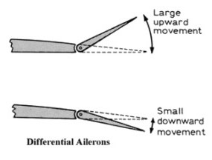
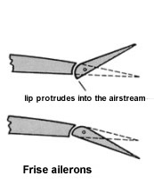
Aileron Designs
Differential Ailerons
Frise Ailerons
Notes:
Differential ailerons were designed to minimize aileron drag. The down-going aileron does not have the same range of travel as the up-going aileron, reducing the difference in drag created and therefore reducing the yaw effect.
Frise ailerons have the same effect on aileron drag, using a different design. The control surface is mounted so that when deflected a part of the up-going aileron descends below the wing into the high-pressure airflow beneath the wing, creating drag which balances the extra drag created by the down-going aileron on the opposite wing.

Slide 8
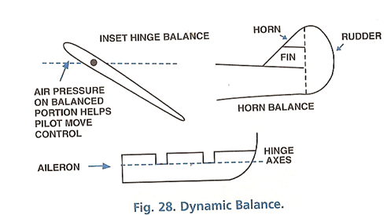
Balanced controls
When part of the control surface is placed ahead of the hinge
Aids in countering adverse yaw in aileron design
Source: From the Ground Up
Dynamic Balance
Notes:
Controls sometimes have modifications in the form of balances to assist the pilot to move them
By having some of the control surface in front of the hinge, the air striking the forward portion helps to move the control surface in the required direction. The design also helps to counteract adverse yaw when used in aileron design.

Slide 9
Balanced Controls
A mass (or weight) is placed in front of a hinge or control surface
This gives the surface better stability in flight
The centre of gravity of a control is placed so that the surface is balanced without any airflow
Mass Balance
Static Balance
Notes:
Mass Balance:
Serves to reduce the risk of flutter on the control surfaces
Static Balance:
The exact distribution of weight on a control surface is very important. For this reason, when a control surface is repainted, repaired or component parts replaced, it is essential to check for proper balance and have it rebalanced if necessary. To do this, the control surface is removed, placed in a jig and the position of the centre of gravity checked against the manufacturer’s specifications. Without any airflow over the control surface, it must balance on its specified C-of-G.
Flutter:
Caused by elastic vibrations which are produced at high speeds. Flutter can occur at high speeds and can lead to failure of the affected component.

Slide 10
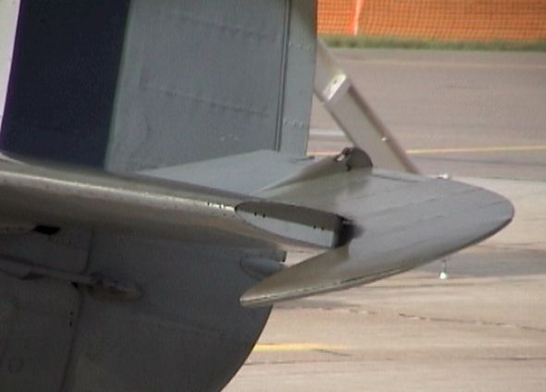
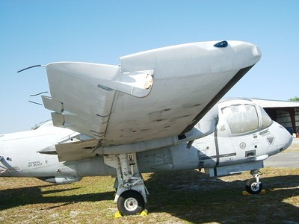
Balanced Controls
Horn Balance
Mass Balance

Slide 11
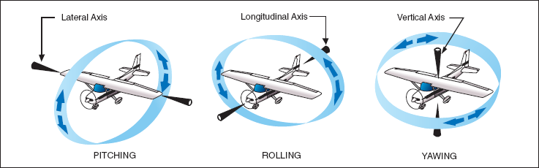
The Axes of the Aircraft
Notes:
An aircraft in flight rotates around 3 axes. These axes pass and meet through the centre of gravity of the aircraft (the central balance point of the aircraft’s total weight)
Longitudinal axis:
Lengthwise from nose to tail
Movement around this axis is called roll
Controlled by ailerons by moving stick or yoke side to side
Lowers aileron on one wing and raises the other. The downgoing aileron increases camber producing more lift and the wing rises. The upgoing aileron spoils the airflow, decreasing lift and the wing descends
Lateral axis:
Crosswise from wing tip to wing tip
Movement around this axis is called pitch
Controlled by elevator by moving stick or yoke forward or backward
When you push forward, the elevator deflects downward, increasing camber which increases lift and raises the tail, forcing the nose down
Vertical or normal axis:
Vertically through centre of gravity
Movement around this axis is called yaw
Controlled by rudder by pushing left and right rudder pedals
Pushing left rudder pedal will deflect rudder left into the airflow. The pressure of the airflow against the rudder pushes tail right forcing nose to the left

Slide 12
Review
What are the axis of the aircraft?
What is adverse yaw?
What are the three types of balanced controls?
Notes:
Longitudinal, lateral, vertical
When outside wing produces more lift than inside wing, it causes the aircraft to yaw in the opposite direction of the turn
Mass, static and dynamic balance

Slide 13
Stability

Slide 14
Stability
Tendency of an aircraft to return to its original position once disturbed without intervention by the pilot
Two main types of stability:
  Static
  Dynamic
Inherent stability: stability characteristics built into the design of the aircraft

Slide 15
Stability
Static stability is the initial tendency for an aircraft to return to its original position once disturbed
Dynamic stability is the overall tendency of the aircraft to return to its original position through a series of damped oscillations
Static Stability
Dynamic Stability

Slide 16
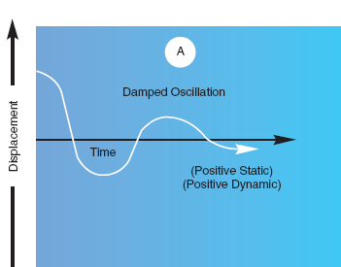
Positive Stability:
  Will create forces or moments which will eventually return to its original position
Neutral Stability:
  Stabilizing forces are absent. Aircraft will not return to its original position but will not depart further away either
Negative Stability: (Instability)
  Will generate forces or moments which will displace it further away from its original position
Source: Pilot’s Handbook of Aeronautical Knowledge

Slide 17
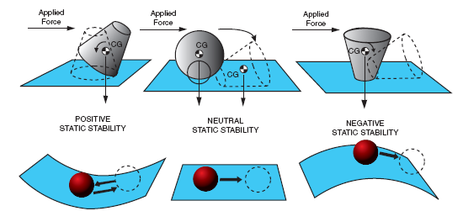
Source: Pilot’s Handbook of Aeronautical Knowledge

Slide 18
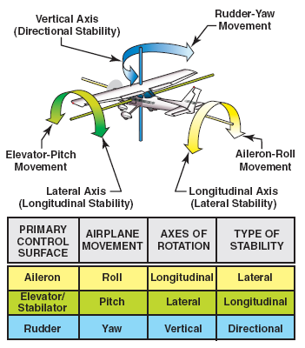
Axes of the Aircraft
Source: Pilot’s Handbook of Aeronautical Knowledge

Slide 19
Longitudinal Stability

Slide 20
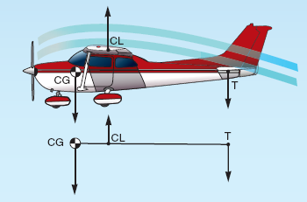
Longitudinal Stability
Pitch stability
Around the lateral axis
Affected by 2 factors:
  Location of the CofG
  Size and location of the horizontal stabilizer
Source: Pilot’s Handbook of Aeronautical Knowledge
Notes:
Horizontal Stabilizer:
When, after a deviation, the angle of attack of the wing increases, the centre of pressure moves forward forcing the nose of the aircraft up and the tail down. When the tail descends, the horizontal stabilizer meets the air at a greater angle of attack, generates more lift and therefore tends to raise the tail, therefore promoting stability.
Center of Gravity:
If the aircraft is loaded so that the centre of gravity is too far aft, the aircraft will tend to fly with a nose-high attitude. The inherent stability of the aircraft will be neutralized and, while it will be possible to correct by moving the elevator down, the aircraft will be uncontrollable in some extreme situations.

Slide 21
Lateral stability

Slide 22
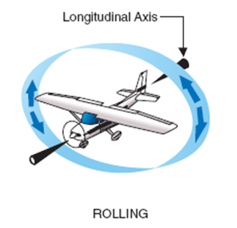
Lateral Stability
Roll stability
Around the longitudinal axis
Affected by factors:
  Dihedral
  Keel effect
  Sweepback
  Distribution of weight

Slide 23
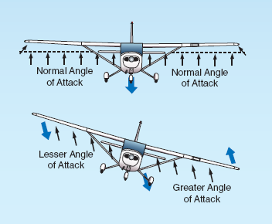
Dihedral
Dihedral angle is the angle that the wings make with the horizontal
If a wing is displaced, the down going wing creates a higher angle of attack and lifts the wing
Source: Pilot’s Handbook of Aeronautical Knowledge
Notes:
Dihedral: The wingtips are farther from the ground than the wing roots while the airplane is at rest
Anhedral: The wingtips are closer to the ground than the wing roots while the airplane is at rest
If the aircraft is disturbed, it will slip towards the low wing. The low wing will generate more lift and tend to roll the aircraft upright to regain straight and level flight.

Slide 24
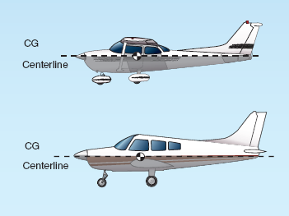
Keel Effect
In aircraft that have a low center of gravity, a pendulum effect is created
When the aircraft is rolled, the weight pulls it back to the centre
Source: Pilot’s Handbook of Aeronautical Knowledge
Notes:
Centre of gravity of most high-wing aircraft is quite low

Slide 25
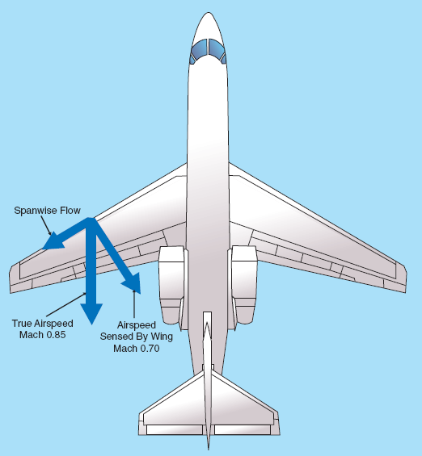
Sweepback
In faster aircraft, the wing is sweptback for aerodynamic efficiency
This also increases roll stability
A dropped wing will swing perpendicular with the relative airflow, creating more lift and restoring it to level flight
Source: Pilot’s Handbook of Aeronautical Knowledge

Slide 26
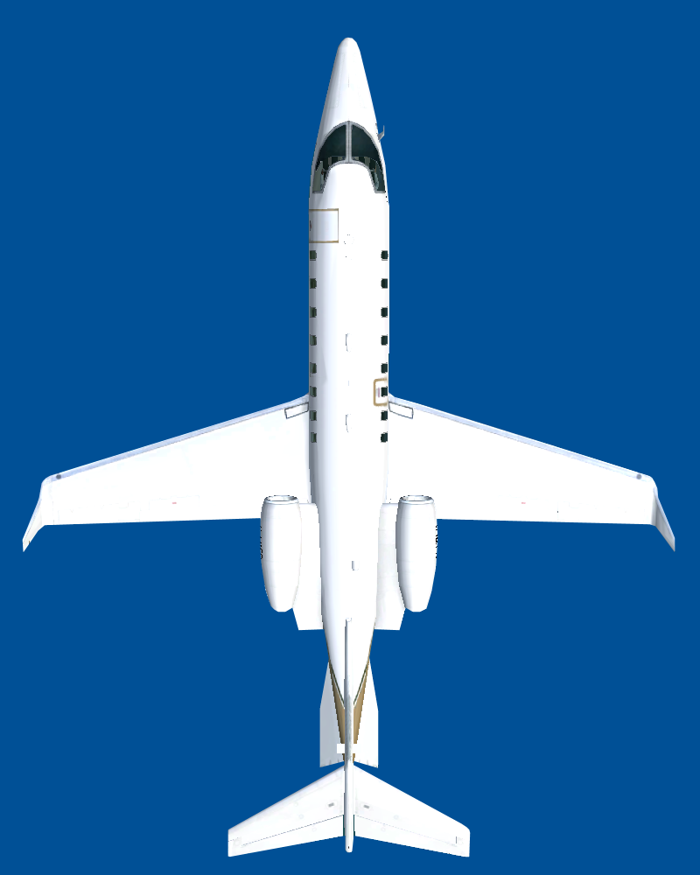
Sweepback

Slide 27
Distribution of Weight
Proper distribution of weight will aid in keeping the aircraft level
If too much weight is on one side, the aircraft may not have enough aileron authority to maintain level flight

Slide 28
Directional stability

Slide 29
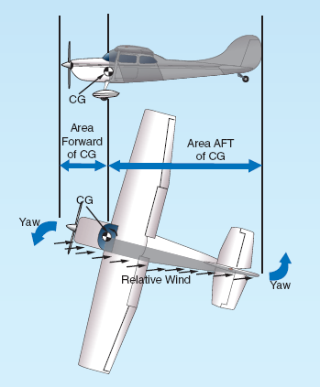
Directional Stability
Yaw stability
Around the vertical or normal axis
Affected by the size and location of the fin
Source: Pilot’s Handbook of Aeronautical Knowledge
Notes:
Secondary element affecting directional stability is sweepback:
When an unwanted yaw movement occurs, the advancing wing will show more of its span to the relative airflow than the retreating wing therefore creating more drag and helping it to return to its original position

Slide 30
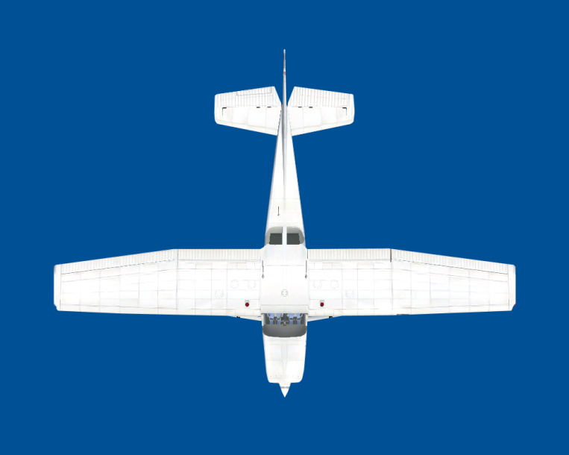
Directional Stability
Notes:
The aircraft always tends to fly straight into the relative wind. If the aircraft is subjected to a yawing moment, the airflow will hit the side of the fin and generate a force which will push the tail (and thus the aircraft) back in line with the relative wind.

Slide 31
Review
What are static and dynamic stability?
What is dihedral and what does it do?
What factors affect longitudinal stability?
Notes:
Static stability is the initial tendency for an aircraft to return to its original position once disturbed
Dynamic stability is the overall tendency for an aircraft to return to its original position
The angle the wings make with the horizontal
When one wing is displaced downwards, it creates more lift and brings it back up
Center of gravity
Wing position
Location and size of horizontal stabilizer

Slide 32
Flight performance Factors

Slide 33
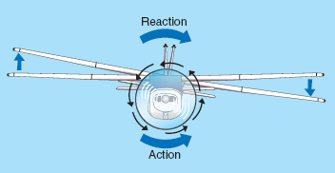
Left Turning Tendencies
In North America, propellers turn clockwise when viewed from the pilot seat
The reaction from this spinning causes the plane to roll counter-clockwise to the left
Source: Pilot’s Handbook of Aeronautical Knowledge
Torque

Slide 34
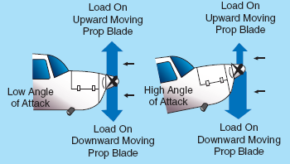
Left Turning Tendencies
At high angles of attack, the down going blade meets the air at a higher angle of attack than the up going blade
More lift is produced on the right side
This creates an imbalance of force and the aircraft yaws to the left
Source: Pilot’s Handbook of Aeronautical Knowledge
Asymmetric Thrust (P-Factor)

Slide 35
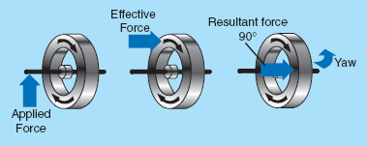
Left Turning Tendencies
When the propeller is spinning, it acts like a big gyroscope
When a force is applied to a gyroscope, it acts 90 degrees in the direction of rotation
Source: Pilot’s Handbook of Aeronautical Knowledge
Precession
Notes:
Rigidity in space: a rotating gyro tends to stay in the same plane of rotation and resists any change in that plane

Slide 36
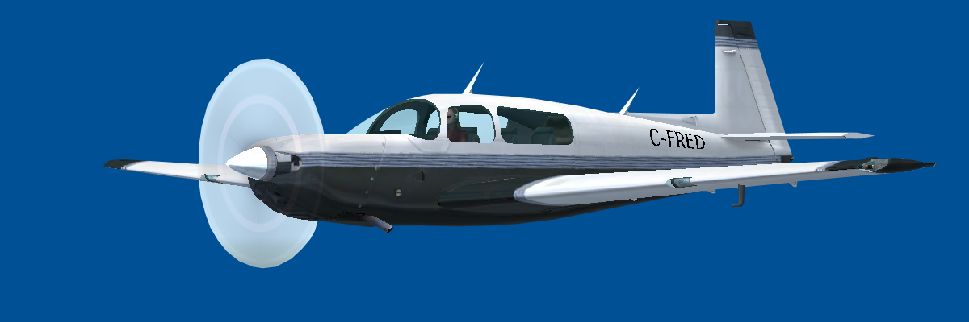
Precession
When force applied to spinning gyro, force acts as if it was 90° in direction of rotation
Notes:
Result:
Quick Nose-Up = Sharp yaw right
Quick Nose-Down = Sharp yaw left
To correct: Use opposite rudder
Tail-wheel aircraft prone to precession when nose pushed forward on take-off

Slide 37
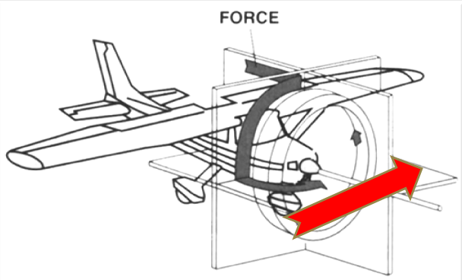

Slide 38
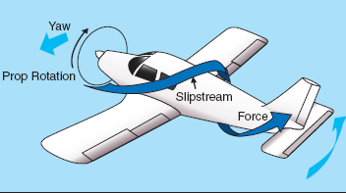
Left Turning Tendencies
As air is pushed back from the propeller, it flows back in a corkscrew pattern
Source: Pilot’s Handbook of Aeronautical Knowledge
Slipstream
Notes:
Increased pressure on one side and decreased pressure on the other side
Tail is pushed sideways causing aircraft to yaw

Slide 39
Flight performance

Slide 40
Climbing
The ability for an aircraft to climb is dependant on the ability to create excess thrust
There are three types of climbs that we use:
  Best rate of climb
  Best angle of climb
  Normal climb

Slide 41
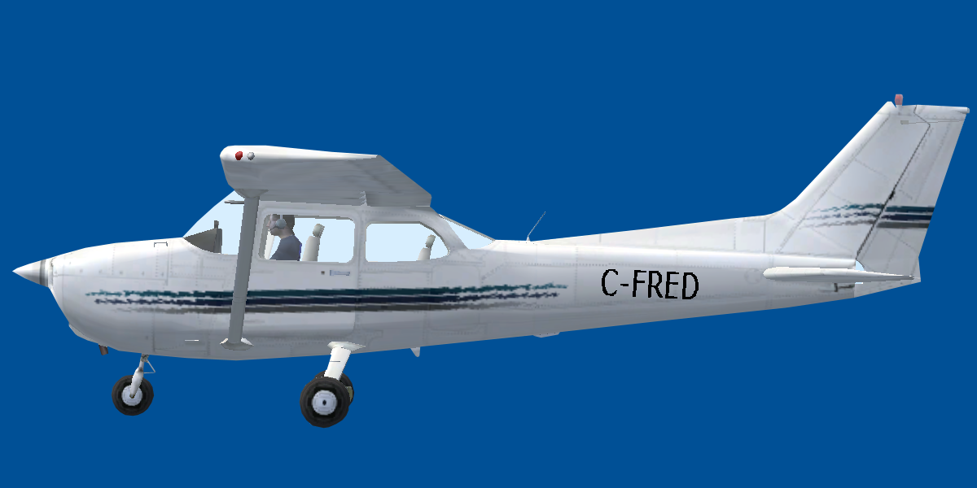
Climbing
Angle of Attack:
  Increase: More lift, less speed
  Decrease: Less lift, more speed
Thrust
Lift
Drag
Weight

Slide 42
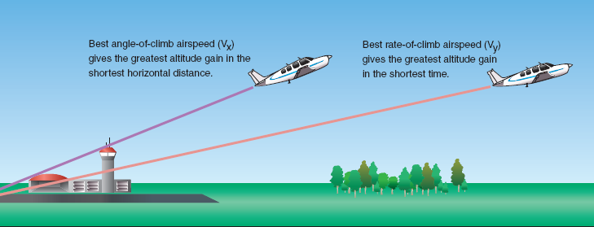
Best Angle vs. Best Rate
Source: Pilot’s Handbook of Aeronautical Knowledge
Notes:
Best Rate of Climb (Vy): The speed at which the greatest amount of altitude is gained in a given time.
The rate of climb is not affected by the wind; it is based purely on the performance of the aircraft and is unrelated to groundspeed.
This speed is NOT to be used to clear obstacle.
Best Climb Angle (Vx): This speed will give the greatest increase in height in the least distance over the ground.
The angle is affected by the wind; a strong headwind will make for a steeper climb angle, because the rate of climb will be the same but the groundspeed will be reduced.
This is the speed to use to clear obstacles.
Normal Climb: For any prolonged cruise climb.
Usually 5-10 kts faster than best rate. Provides better engine cooling, easier control and better visibility over the nose

Slide 43
Gliding
No power from an engine to produce thrust and gravity pulls the aircraft down
To maintain equilibrium, lift must act slightly forward to pull the aircraft through the air
Best glide speed for range: Speed at which the most distance will be covered for a given loss of height
Best glide speed for endurance: Speed at which the most time aloft will be given for a given loss of height

Slide 44
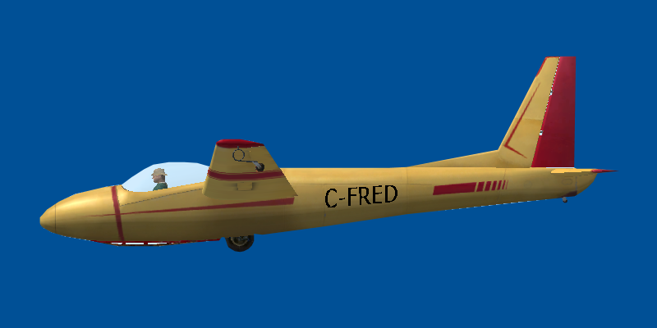
Gliding
Gliding = 3 forces (Weight, Lift, Drag)
Glide Reaction
= Resultant of lift
and drag, opposes
weight
Lift
Drag
Thrust = Horizontal
component of weight
Weight

Slide 45
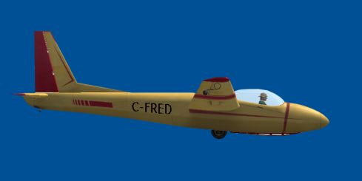
Gliding
Best Range Speed
Furthest distance per altitude lost
Best Endurance Speed
Most time in air per
altitude lost
- Longer Time
- Shorter Distance
- Shorter Time
- Longer Distance
Notes:
Range:
Best L/D or best glide speed
Endurance:
Minimum sink speed in a glider

Slide 46
Review
What are the four left turning tendencies?
What is the difference between the best rate and angle of climb?
If you were gliding and wanted to stay aloft for a long period of time, what speed would you fly?
Notes:
Torque
Asymmetric thrust
Precession
Slipstream
Best rate: height over time
Best angle: height over distance
Speed of best endurance

Slide 47
Forces in a Turn
Lift acts 90 degrees to the wing
When the plane banks the lift vector is tilted
Vertical lift force: Acts straight up and maintains altitude
Horizontal lift force: Acts to the inside and pulls the aircraft into the turn, known as centripetal force
An apparent force is felt by the pilot that pulls them to the outside of the turn, this is called centrifugal force and is a product of inertia
Notes:
The lift force always acts at 90° from the span. In a banked turn, lift therefore acts at an angle from the vertical corresponding to the angle of bank of the aircraft. Consequently, the vertical components of lift and weight are no longer in equilibrium. Unless the angle of attack is increased to generate more lift, the aircraft will accelerate downwards (loosing altitude).
The lift vector can be separated into two components:
· one component acts vertically and keeps the aircraft in the air (opposing weight), and;
· one component acts horizontally which keeps the aircraft turning (“centripetal force”).

Slide 48
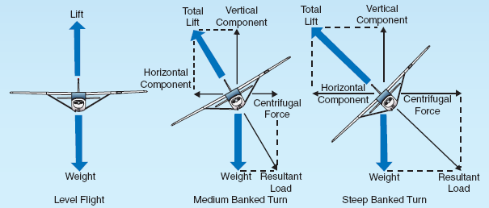
Forces in a Turn
Source: Pilot’s Handbook of Aeronautical Knowledge
Notes:
Centrifugal Force: Illusory force opposing centripetal force, the result of the body’s reaction to the forces maintaining the aircraft in the turn. It appears to act opposite to the centripetal force, that is, towards the outside of the turn.
Weight: vector is directed towards the centre of the Earth.
As the angle of bank increases, the total lift is redirected to the horizontal component (centripetal force) sharpening the turn. Therefore, less lift is available to counteract gravity. Thus, to maintain altitude, the total lift generated must be increased relative to straight and level flight. This extra lift is generated by increasing the angle of attack, by the pilot exerting an aftward pressure on the controls.

Slide 49
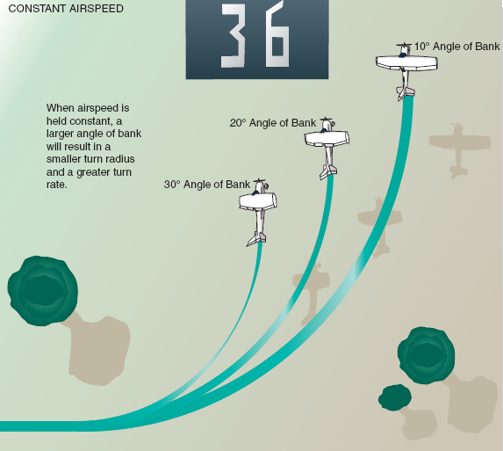
Effect of Bank Angle in a Turn
If Bank angle is increased in a turn, the following occurs:
  Higher rate of turn
  Smaller radius of turn
  Higher loading on the wings
  Higher stall speed
Source: Pilot’s Handbook of Aeronautical Knowledge

Slide 50
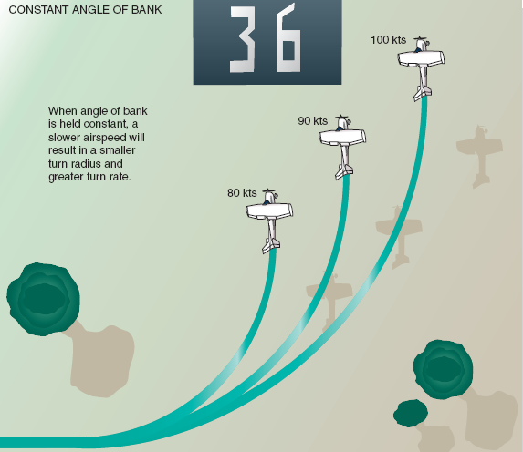
Effect of Airspeed in a Turn
When airspeed is increased in a turn the following occurs:
  Slower rate of turn
  Larger radius of turn
Source: Pilot’s Handbook of Aeronautical Knowledge

Slide 51
Climbing and Descending Turns
The lower wing meets the airflow at a higher angle of attack creating more lift
Upper wing moves faster and also creates more lift
Two forces compensate one another so angle of bank remains the same
Lower wing meets the relative airflow at a smaller angle of attack and creates less lift
Upper wing moves faster and creates more lift
Two forces act to cause angle to increase
Descending Turn
Climbing Turn

Slide 52
Uncoordinated turns
Not turning at a rate appropriate to the bank being used
Aircraft yaws to the outside of the turn
  Decrease bank angle
  Increase rate of turn
  Both
Rate of turn too great for bank angle used
Pulls the aircraft to the outside of the turn
  Increase bank angle
  Decrease rate of turn
  Both
Slipping
Skidding

Slide 53
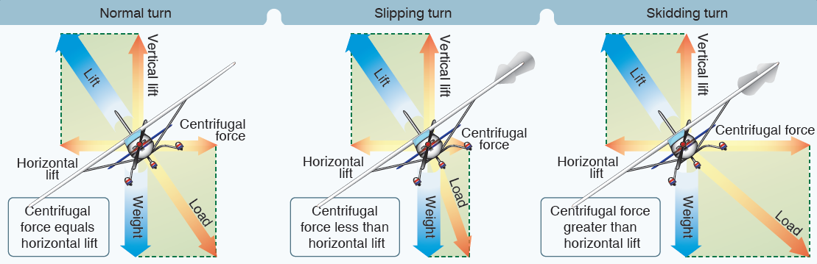
Source: Pilot’s Handbook of Aeronautical Knowledge

Slide 54
Load Factor
Dead load: The weight of the aircraft on the ground
Live load: The change in apparent weight of the aircraft due to acceleration and turns (the amount of force acting on the wings) in the air
Load factor: Live load over dead load; expressed in G’s
When in level flight, the lift of the wings is equal to the weight: Load factor of 1G
Notes:
Dynamic loading: additional load added to the dead weight due to acceleration and/or change of direction of the aircraft
Gust loading: when the speed or direction of the relative airflow changes abruptly, the aircraft structure undergoes rapid and significant changes in loading

Slide 55
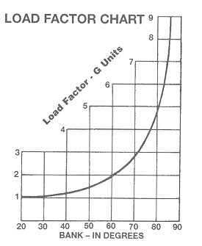
Turns
Load Factors in Turns
  Angle of bank increase
    Load factor increase
60° bank = 2 G's
Dangers
  High load factor
    Possible structural failure
    (overload)
  Increased load factor
    Increased stall speed
Notes:
In a 60 degree turn, the wings must produce twice the amount of lift to support the weight of the aircraft, therefore the load factor is 2

Slide 56
Review
Which force pulls the aircraft into the turn?
If you are in a turn and increase your angle of bank, what will happen to your turn radius and turn rate?
If you are in a turn and decrease your airspeed, what will happen to your turn radius and turn rate?
Notes:
Horizontal component of lift: centripetal force
Smaller radius
Faster rate of turn
Faster rate of turn
Smaller radius

Slide 57
Stall
A stall occurs when the wing cannot produce sufficient lift to maintain flight
In order to produce enough lift, the airflow over the wing must be smooth
When the angle of attack increases to a certain point, the airflow becomes turbulent and separates from the wing
This angle is known as the critical angle of attack
Notes:
Symptoms:
Loss of horizon
Reduced wind noise
Dropping of indicated airspeed
Slack controls
Buffeting (vibrations-may be absent during flight in precipitation)

Slide 58
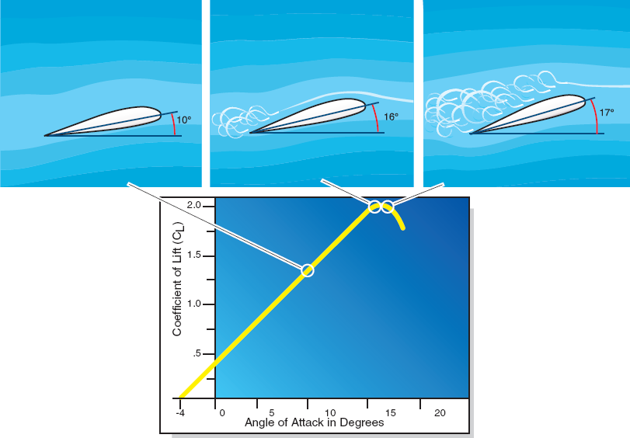
Stall
Source: Pilot’s Handbook of Aeronautical Knowledge
Notes:
When the angle of attack increases, the centre of pressure moves towards the front of the wing until the angle of attack reaches the critical angle. At this point, the centre of pressure moves abruptly aft on the wing, which is now stalled.
A wing will generally stall at an angle of attack around 18 degrees, but this varies according to the shape of the airfoil.

Slide 59
Factors Affecting the Stall
Weight
  As weight increases, stalling speed increases
C of G location
  The further forward the C of G is, the higher the stall speed
Turbulence
  Vertical gust can cause the critical angle of attack to be exceeded
Turns
  Increasing the angle of bank increases loading and stall speed
Flaps
  Deploying flaps will decrease stall speed
Contaminants
  If the wing is dirty or has ice on it, it will disrupt airflow and increase stall speed
Notes:
Weight: For a given configuration or speed the only way to increase lift is to increase the angle of attack. If the aircraft carries more weight, the airplane will be flying at a higher angle of attack in order to create enough lift to support it. Since the separation between the operating angle of attack and critical angle of attack is smaller, the aircraft will stall at a higher speed.
C-of-G: If the centre of gravity shifts towards the front of the aircraft the stall speed increases and the aircraft gain stability. If the centre of gravity shifts aftward, the stall speed decreases and the aircraft looses some of its stability. The download on the horizontal tail surfaces increases as the airplane’s centre of gravity moves forward. The download can be considered as part of the airplane’s weight since it acts in the same direction as the weight force, and stalling speed increases as the weight increases.
Turbulence: The stall speed increases when entering in an upward current because vertical airflow causes momentary changes in the relative airflow and therefore the angle of attack, possibly causing it to exceed the critical angle.
Turns: In order to maintain altitude in a turn lift must be increased by increasing angle of attack. In a turn the load factor increases, causing an increase in stall speed. Just as if the weight was increased.
Flaps: By increasing the lifting capacity of the wing for a given angle of attack, flaps decrease the stall speed.
Climatic Conditions: Snow, frost and ice increase the stall speed by sharply reducing the lift generating capacity of the wing by deforming the airfoil shape decreasing the stall angle. They also create a large increase in drag.

Slide 60
Load Factor and Stall Speed
As load factor increases, stall speed increases
Formula to determine stall speed:
Where: V_{STurn} = stall speed in the turn
V_{S} = stall speed in level flight
n = load factor
Notes:
Wing loading: total weight of the aircraft divided by the surface area of the lifting surface (lb/pi2)
In a coordinated level turn, the greater the increase in bank angle, the greater the increase in load factor. The centrifugal force which appears in the turn and the mass of the aircraft create a resultant called ‘apparent weight’ or ‘G’. The centrifugal force increases with the angle of bank and the load factor (G) increases in proportion.

Slide 61
Load Factor and Stall Speed
Referring to the table below, we can calculate the stall speed of a Cessna 172 in a 30 degree turn:
Degree of Bank (°) | Load Factor (G’s) | Square Root
15 | 1.04 | 1.02
30 | 1.15 | 1.07
45 | 1.41 | 1.19
60 | 2.00 | 1.41
75 | 3.86 | 1.96
Notes:
The greater the angle of bank in a turn, the greater the load factor; this implies an increase in stall speed. The greater the weight of the aircraft, the more the load factor and stall speed will increase; this means that high-bank turns at high weight can cause structural damage and possibly a premature stall, and are more dangerous close to the ground.
Maximum Load Factor
The greatest load factor for which the aircraft has been designed. This limit should never intentionally be exceeded; to do so risks permanently damaging or deforming the structure of the aircraft. The Average Maximum Load Factor for light aircraft in the Normal category is +3.8 G and –1.52 G.

Slide 62
Additional Notes on Stalls
An aircraft will stall if the critical angle of attack is exceeded, regardless of airspeed or attitude
An aircraft will stall at the same indicated airspeed regardless of altitude

Slide 63
Review
When will an aircraft stall? (Hint...angle)
What factors affect stall speed?
What is the formula used to determine stall speed?
Notes:
When wing reaches critical angle of attack
Weight
Center of gravity
Turbulence
Turns
Flaps
Contaminants
Vs (turn) = Vs root n
n=load factor

Slide 64
Spin
Defined as auto-rotation that develops after an aggravated stall
If yaw is introduced during a stall, the inside wing will produce less lift and stall, causing it to drop
As the wing drops, it’s angle of attack is increased, causing it to stall further and increase drag, which creates more yaw
The nose then drops and auto-rotation sets in
Notes:
Characteristics of spin:
-speed high but constant
-wings stalled
-radius of turn constant
-rate of descent constant
-load factor (G) constant

Slide 65
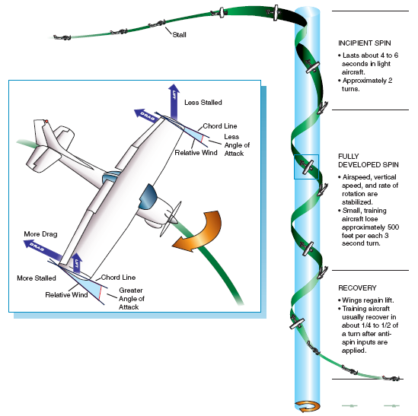

Slide 66
Spiral Dive
Steep, uncoordinated descending turn with an excessive nose down attitude
Characteristics of a spiral dive are:
  Steep nose down attitude
  Excessive angle of bank
  Rapidly increasing airspeed
  Increasing G loading
To differentiate from a spin, here are the characteristics of a spin:
  Airspeed is constant and low
  G loading is constant
Notes:
Characteristics of spiral dive:
Speed increasing
Wings not stalled
Radius of turn decreasing
Rate of descent increasing
Load factor (G) increasing

Slide 67
Review
What are the characteristics of a spin?
What are the characteristics of a spiral dive?
What is load factor?
Notes:
High, constant speed
Stalled wings
Constant radius of turn
Constant rate of descent
Constant load factor
Increasing speed
Wings not stalled
Radius of turn decreasing
Rate of descent increasing
Increasing load factor
Live load/dead load of the aircraft

Slide 68
Flight instruments

Slide 69
Pitot-static instruments

Slide 70
Pitot/Static System
Pitot tube: Provides dynamic pressure to the instruments, consists of a tube that is inline with the direction of flight
  Only the airspeed indicator is connected to the pitot tube
Static port: Provides static pressure to the instruments and is a hole located on the aircraft that is out of the way of direct airflow or turbulence
  The altimeter, vertical speed indicator and airspeed indicator are connected to the static port
Notes:
Pitot tube measures total pressure. Located on the leading edge of the wing outside the slipstream, facing into the direction of flight. On a glider, the pitot tube is often mounted on the nose.
Static port allows the internal pressure of each instrument to adjust to the ambient barometric pressure outside the aircraft.
Ports are located on both sides of the fuselage, sheltered from turbulence and the air striking the aircraft from the front.

Slide 71
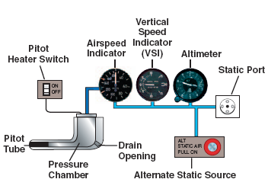
Pitot/Static System
Notes:
Blockage of Pitot:
Complete blockage: ASI acts like an altimeter
Partial blockage: ASI reads low or 0
Blockage of static:
Complete blockage: Altimeter freezes
VSI freezes at zero
ASI over-reads in a descent and under- reads in a climb
Partial blockage: Altimeter lags
VSI lags
ASI same as complete blockage
If no alternate static source is available and that you absolutely need the altimeter and the ASI working in order to terminate your flight safely, you may consider breaking the glass of the VSI so as to create an emergency alternate static source port

Slide 72
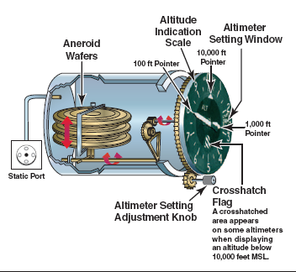
Altimeter
Measures the height of the aircraft above sea level (ASL)
Has a stack of aneroid capsules (or wafers) that are calibrated for a standard day
As the aircraft climbs into less dense air, the capsules expand and move linkages that move the needles
Notes:
Measures the atmospheric pressure caused by the weight of the column of air above the altimeter. This weight changes as the aircraft climbs or descends, and the instrument indicates this is a change in altitude
Indicated altitude: reading on the altimeter when it is set to the current barometric pressure
Pressure altitude: reading on the altimeter when it is set to standard barometric pressure (29.92”Hg)
Density altitude: pressure altitude corrected for temperature
True altitude: exact height above mean sea level
Absolute altitude: actual height above the earth’s surface

Slide 73
Altimeter Errors
Pressure Error:
  Pressure changes with location and the altimeter setting must be changed along the route of flight
Temperature Error:
  Capsules are calibrated for 15°C and will be affected when the temperature differs
Mountain effects/gusts:
  Mountain ranges act like a venturi speeding up the wind and lowering pressure
Notes:
Pressure: Atmospheric pressure varies from one area to another, even for the same height above sea level. If the altimeter is not properly set to the local altimeter setting, it will display an incorrect altitude. If the atmospheric pressure is lower than the altimeter setting in use, the instrument will read high; if the atmospheric pressure is higher than the altimeter setting in use, the instrument will read low.
From high to low, look out below; from low to high, watch the sky.
Temperature: The altimeter is calibrated to display the correct altitude when used in an ICAO standard atmosphere. This implies a temperature of 15°C. If the temperature is colder than the ICAO standard, the real altitude will be lower than the indicated altitude. (Read HIGH) Since cold air is denser, it tends to accumulate at lower levels. This causes a steep pressure gradient. If the temperature is warmer than the ICAO standard, the real altitude will be higher than the indicated altitude. (Reads low) Warm air is less dense, which tends to create a shallow pressure gradient. If an aircraft flies from a warm region to a colder region, the altimeter will read high, creating a potential hazard.
Mountain Effect: A local area of lower pressure is created by the acceleration of air flowing through the mountain range (Venturi Effect), by the Mountain Wave and by lower temperatures. The altimeter will read high.

Slide 74
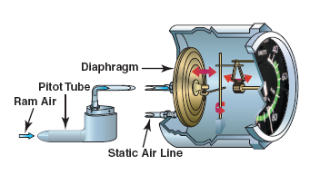
Airspeed Indicator
Indicates how fast the plane is going through the air (not over the ground)
Operates by taking the difference of static and dynamic pressure
Indicates the dynamic pressure created by forward motion of the aircraft
Notes:
This instrument is composed of an aneroid capsule into which the total pressure is channeled. The static pressure port is linked to the sealed case of the instrument; this keeps the pressure inside the casing equal to the external pressure. The static pressure collected by the pitot port and the static pressure from the static port cancel each other and the aneroid capsule is affected only by the dynamic pressure. The capsule expands when the pressure increases (i.e. when the airspeed increases) and contracts when the pressure decreases (i.e. when the airspeed decreases) This expansion is transmitted to the needle on the face of the instrument by a mechanical linkage of levers.
Calibrated in knots (kts) or statute miles per hour (mph)
Airspeed indicator displays the Indicated Airspeed (IAS)
True Airspeed (TAS) is indicated airspeed corrected for temperature, density, and instrumentation errors. It is the actual airspeed flowing over the wings of an aircraft.

Slide 75
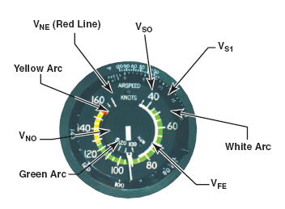
Markings
White arc – Flap operation speed range
Green arc – Normal operation range
Yellow arc – Cautionary speed range (calm air)
Red line – Maximum speed (never exceed)
Notes:
Never Exceed Airspeed (VNE): Maximum speed at which the aircraft can be flown in calm air. An airspeed over the VNE may cause structural damage through flutter or loss of control. End of the yellow arc.
Maximum Normal Operations Speed (VNO): Maximum design cruising speed, which should not be exceeded in turbulent air. The maximum safe speed for operations in the Normal category. The end of the green arc and start of the yellow arc.
Maneuvering Speed (VA): Maximum speed at which the controls can be fully deflected without exceeding the maximum load factor.
VA=stall speed x root of maximum load factor
Maximum Flap Extension Airspeed (VFE): Maximum airspeed at which the aircraft can be flown with flaps extended. Greater airspeed may damage the flaps. End of the white arc.
Stall Speed (VS): Clean configuration full weight and power off stalling speed. Start of the green arc.
Landing configuration stall speed (VSO): Landing configuration stalling speed. That is flaps extended, landing gear extended, power off and full weight configuration. Start of the white arc.

Slide 76
Markings
Vso – Stall speed in landing configuration
Vs – Stall speed clean
VFE – Flap operation speed
VNO – Normal operation speed
VNE – Never exceed speed
Notes:
Never Exceed Airspeed (VNE): Maximum speed at which the aircraft can be flown in calm air. An airspeed over the VNE may cause structural damage through flutter or loss of control. End of the yellow arc.
Maximum Normal Operations Speed (VNO): Maximum design cruising speed, which should not be exceeded in turbulent air. The maximum safe speed for operations in the Normal category. The end of the green arc and start of the yellow arc.
Maneuvering Speed (VA): Maximum speed at which the controls can be fully deflected without exceeding the maximum load factor.
VA=stall speed x root of maximum load factor
Maximum Flap Extension Airspeed (VFE): Maximum airspeed at which the aircraft can be flown with flaps extended. Greater airspeed may damage the flaps. End of the white arc.
Stall Speed (VS): Clean configuration full weight and power off stalling speed. Start of the green arc.
Landing configuration stall speed (VSO): Landing configuration stalling speed. That is flaps extended, landing gear extended, power off and full weight configuration. Start of the white arc.

Slide 77
Airspeed Errors
Indicated airspeed (IAS) – Read on ASI
  Position error – Due to position on the aircraft
Calibrated airspeed (CAS)
  Compressibility error – Air compressing in high speed flight
Equivalent airspeed (EAS)
  Density error – Non-standard pressure and temperature
True airspeed (TAS) – Actual speed of the aircraft through the air
ICE T...Pretty Cool Drink
Notes:
IAS: uncorrected airspeed, as displayed on the dial of the ASI
CAS: IAS corrected for instrument and position error
TAS: CAS corrected for density and temperature errors
Density: The varying density of the atmosphere affects the accuracy of the airspeed indicator. Air which is less dense (i.e. at altitude) will cause the airspeed indicator to display a speed lower than the true airspeed, because there are fewer particles of air per volume entering the aneroid capsule, meaning the capsule will inflate less quickly for a given speed. Calibrated airspeed corrected for density gives True Airspeed
Position: The eddies which form on the wings and struts as they pass through the air are in part responsible for this error. The other part is the angle of attack at which is flying the aircraft. The pitot tube is fixed and therefore error is induced by its position to the relative wind. These eddies are the reason why the pitot tube is mounted as far as possible in front of the leading edge of the wing. The remaining error is recorded in an airspeed correction table in the Operator’s Handbook. Indicated airspeed corrected for position errors gives calibrated airspeed.
Lag: The mechanical error caused by friction between the moving pieces inside the instrument.
Icing: Ice formation on the Pitot tube or static port will cause display errors.
Water: Water inside the pressure system can cause erratic readings on the ASI.

Slide 78
ICET
NDICATED airspeed
P C D
OSITION
ALIBRATED airspeed
OMPRESSIBILITY
QUIVALENT airspeed
ENSITY
RUE airspeed

Slide 79
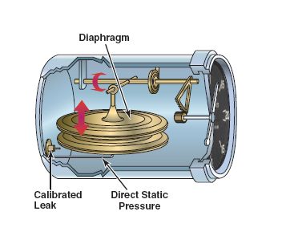
Vertical Speed Indicator
Indicates the rate of climb or descent in feet per minute
Comprised of a diaphragm connected to the static port
Diaphragm is inside a housing with a calibrated leak
Measures the change in pressure between the diaphragm and the housing
There is a lag time of up to 6-9 seconds
Notes:
Capsule expands in a descent and contracts in a climb

Slide 80
Variometer
A very sensitive rate of climb indicator that is used to find thermals. Works on the same principle as the altimeter: the higher the altitude the less the static pressure.

Slide 81
Review
Which instrument(s) are connected to the pitot tube?
How does an altimeter work?
What are the different types of airspeed and what do they mean? (Hint...drink)
Notes:
Airspeed Indicator
As aircraft climbs into less dense air, the capsules expand moving needles upwards
Indicated – what is on the instrument
Calibrated – indicated corrected for pressure
Equivalent – calibrated corrected for compressibility
True – equivalent corrected for density

Slide 82
Gyro instruments

Slide 83
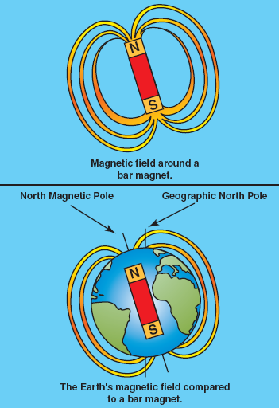
Magnetic Compass
Comprised of two north seeking magnets that float inside a fluid filled chamber
Since the earth is a big magnetic, the compass will always point to magnetic north
Notes:
Built around two north-seeking magnets. These magnets are fixed on a float, to which is also attached a compass card. This assembly is mounted on a pivot and is free to rotate. The whole assembly is mounted within the compass bowl which is filled with alcohol or white kerosene to dampen oscillations of the magnetic system caused by turbulence. The Lubber Line indicates the direction in which the aircraft is flying. It must be precisely aligned parallel to the longitudinal axis of the airplane.
Deviation
Deviation is the angle between the direction indicated by the compass and the magnetic meridian. This error is caused by the effect of the engine and airframe on the magnetic field detected by the compass.

Slide 84
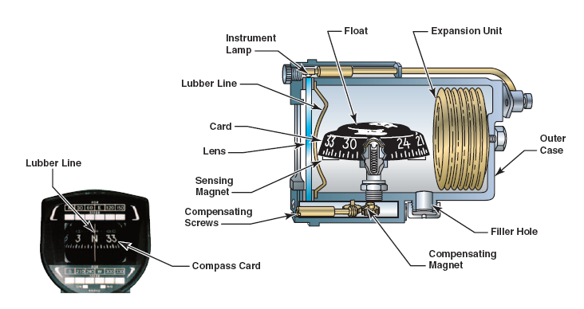
Magnetic Compass
Notes:
The numbers representing headings are inscribed in tens and in hundreds
The pilot reading the number 33 knows he is flying on a heading of 330 degrees or North-West
The cardinal directions are indicated by the letters N S E W
Headings are painted on the opposite side of the compass card to permit the pilot to read them on the face of the instrument
The compass seems to turn the wrong way in a turn
Verifying Compass Headings:
Ground:
Line up on a runway, stop the aircraft, allow the compass to settle and check the compass reading against the runway direction
Flight:
Over-fly a runway in straight and level flight, avoiding any abrupt movement of the controls and check that the compass reading corresponds to the runway direction

Slide 85
Gyroscopes
Wheel or rotor that spins at high speed
They can be mounted in gimbals or within a fixed plane
All gyroscopes experience the effects of Rigidity in space and Gyroscopic Precession
  Heading indicator, artificial horizon, turn and bank indicator
Notes:
Gyroscope: a rotor, spinning at high speed in a universal mounting called a gimbal, so its axle can point in any direction
Gyroscopic inertia: the tendency of a body in rotation to maintain its plane of rotation unless a force is applied

Slide 86
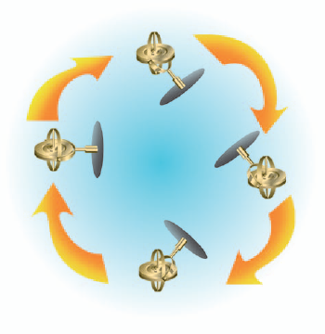
Rigidity in Space
If a gyroscope is placed within a universal gimbal and spun, it will rotate along the same plane regardless of how the gimbal moves
Also known as gyroscopic inertia

Slide 87
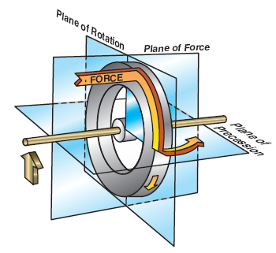
Gyroscopic Precession
If a gyroscope is tilted or has a force applied to it, the force will be “felt” 90 degrees in the direction of rotation
The gyroscope will then rotate parallel the direct of the applied force

Slide 88
Review
How does a VSI work?
How does a compass work?
What are the two gyroscopic principles that instruments use?
Notes:
Diaphragm inside a housing. Housing has a calibrated leak. Both connected to static pressure source. Measures change of pressure between diaphragm and housing.
North seeking magnets floating in a liquid will always point to magnetic north. Card attached to magnets to show pilot which direction they are pointing
Precession and rigidity in space

Slide 89
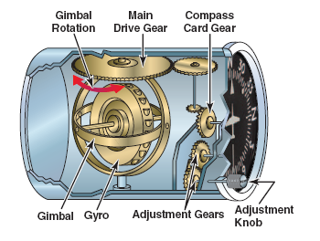
Heading Indicator
Shows the current heading of the aircraft
Relies on the principle of rigidity in space
As the aircraft turn, the gyro remains stationary and the aircraft turns around the gyro
Because of friction and the rotation of the earth (apparent precession), the heading indicator must be reset every 15 minutes
Notes:
Heading Indicator (Directional Gyro, “DG”)
Rotor mounted vertically, turning on a horizontal axis at around 12 000 rpm. The rotor is mounted in an inner gimbal, which turns freely around the horizontal axis. This gimbal is mounted inside a second gimbal. The card of the instrument is attached to this assembly by a system of gears. DG obeys the principle of Rigidity in Space. The position of the rotor and the gimbals is fixed in three-dimensional space; the aircraft turns around the gyroscope.
The Heading Indicator does not seek north and must be periodically calibrated to the compass.
The Heading Indicator must be recalibrated at regular intervals to correct for the following errors:
Precession error: caused by friction between the moving pieces of the instrument. Error of about 3° every 15 minutes.
Apparent precession: of 15°/hour, caused by the rotation of the Earth beneath the gyro. Both, friction and apparent precession must be corrected for every 15 minutes.
Limitations
· climbs, descents and turns must not exceed 85 degrees, and;
· the gyroscope must have about 5 minutes to spin up to operational RPM before the instrument can be used for accurate readings.

Slide 90
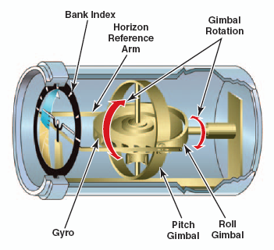
Artificial Horizon /
Attitude Indicator
Provide pitch and bank information
Acts as a “window through the clouds”
Relies on the principle of rigidity in space to rotate and pitch the horizon as the aircraft banks and pitches
Notes:
Horizontally mounted rotor, turning around the vertical axis. The rotor is mounted in a universal gimbal, freely rotating around the pitch and roll axes.
Limitations of the Artificial Horizon
· Electric: Movements in pitch of 85 degrees, 360 degrees of roll
· Pneumatic: 70 degrees of pitch and 90 degrees (vertical) of roll.
Errors of the Artificial Horizon:
· when accelerating the artificial horizon indicates a climbing right turn;
· when decelerating the horizon indicates a descending left turn, and;
· when turning the gyroscope precesses to the side of the turn.

Slide 91
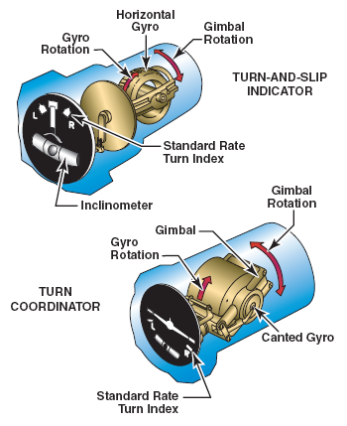
Turn and Slip Indicator
Indicates the rate of turn to the pilot
Relies on the principle of precession
Comprised of a gimbal mounted vertically
When a plane yaws, precession forces the gyro to tilt left or right and move the needle on the face
Notes:
Turn and Bank Indicator
The basic principle behind the turn indicator is gyroscopic precession. When the aircraft turns to the right or left, the rotor « leads » around its axis of rotation and displaces the gimbal. The movement of the gimbal is transmitted through mechanical linkages to the needle on the face of the instrument. A spring returns the gyro to its previous position once the aircraft stops turning.
The ball (Slip Indicator): is affected by gravity and centrifugal force. It is simply a steel ball sealed into a curved glass tube filled with liquid. The needle indicates the direction and rate of turn. It reacts only to yaw. The ball indicates the coordination of the turn; that is, if there is any slipping or skidding. In a turn, if the ball is opposite the needle, the aircraft is skidding, If the needle and ball are on the same side, you are slipping. If the ball is centered, the turn is well-coordinated.

Slide 92
Turn Coordinator
Indicates the rate of turn to the pilot
Relies on the principle of precession
Comprised of a gimbal that is canted 30 degrees
This allows the instrument to react to roll and yaw
Notes:
Turn Coordinator
· electrically powered;
· same principle as the turn indicator but the instrument reacts to both yaw and roll, and;
· the needle is replaced by an airplane figure.

Slide 93
Inclinometer
Located on the bottom of the turn and slip indicator and the turn coordinator
Ball indicates whether the aircraft is slipping or skidding
Balanced by a combination of centrifugal force and gravity
Notes:
Yawstring
Gliders use a yawstring to indicate the coordination of turns. The yawstring a short piece of light string or yarn. If the string is streaming straight back towards the pilot, the glider is well coordinated. If the yawstring is streaming towards the inside of the turn, the aircraft is skidding. If the yawstring is streaming towards the outside of the turn, the aircraft is slipping.
Skidding turn
If the pilot uses excessive rudder in a turn, the aircraft will skid towards the outside of the turn. This can be corrected by releasing some pressure on the rudder pedals, or by increasing the bank angle.
Slipping Turn
In a turn, the pilot does not apply sufficient rudder (or applies opposite rudder) for the bank angle adopted, which causes the aircraft to fall into the inside of the turn. This can be corrected by increasing the rudder applied in the direction of the turn or by reducing the bank angle.
Coordinated Turn
A coordinated turn is performed by the coordinated use of the rudder and ailerons. When a turn is correctly executed, the ball will be centered or yawstring will point straight back, and drag will be minimized.

Slide 94
Review
Which instrument(s) use the principle of rigidity in space?
Which instrument(s) use the principle of precession?
What forces move and balance the inclinometer?
Notes:
Heading indicator
Attitude indicator
Turn and slip
Turn coordinator
Inclinometer
Centrifugal force
Gravity

Slide 95
More Review
Where are the elevators and what do they do?
What affects lateral stability?
What factors affect stalls?
Which instrument(s) are connected to the pitot tube?
What is precession?
Notes:
Horizontal stabilizer
Control pitch of the aircraft
Dihedral
Keel effect
Sweepback
Distribution of weight
Weight
Center of gravity
Turbulence
Turns
Flaps
Contaminants
Airspeed indicator
The force on a gyroscope will be felt 90 degrees in the direction of rotation

Slide 96
Summary
Today we’ve covered:
  Aircraft controls
  Stability
  Aircraft performance
  Stalls, spins, spiral dives and load factor
  Aircraft instruments
Your next class will be on meteorology

