Slide 1
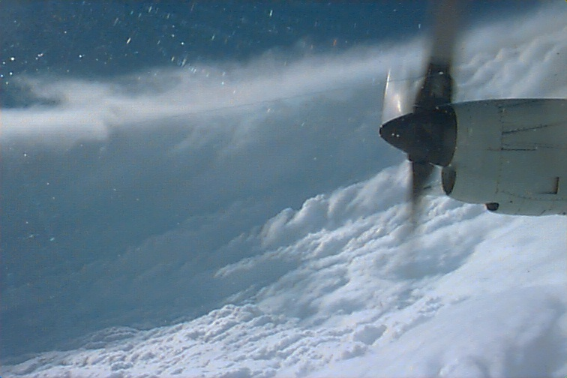
Meteorology
CI Valentine
PO 403
References: FTGU 29th Pages 123 - 140
Notes:
Writing in regular script down here is to be taught
Writing in italics is for extra information

Slide 2
Review
What are the 3 control surfaces on an aircraft?
What are the different types of aircraft stability?
Name the instruments in the aircraft
Notes:
Ailerons, rudders, elevators
-Static stability and Dynamic stability
-Positive, neutral, negative stability
Airspeed indicator
Altimeter
Vertical speed indicator
Turn and bank, turn and slip, turn co-ordinator
Compass
Attitude indicator
Heading indicator

Slide 3
Topics to be covered today
Properties of the Atmosphere
Clouds, Classifications and Families
Atmospheric Pressure and Density
Pressure Systems
Winds
Humidity, Temperature and Stability

Slide 4
The Atmosphere

Slide 5
Composition of the Atmosphere
The atmosphere is composed of several gasses. The most significant of these are:
From a weather standpoint, the most important gas is

Slide 6
WATER VAPOUR
Notes:
Water vapour is only found in lower levels of the atmosphere

Slide 7
Properties of the Atmosphere
Mobility
Expansion
Compression
Most important is EXPANSION
Notes:
Mobility: the capacity of air for motion
Capacity for compression: when a parcel of air decreases in volume as a result of compression, its temperature increases
Capacity for expansion: air is forced to rise by lifting agents into areas of lower pressure. Rising air expands and cools. This cooling process will lower the temperature towards dew point where condensation may occur. If condensation occurs clouds may form and precipitation may fall
Warm air takes up more space (volume) than cold air. It is less dense. The Capacity for Expansion is the most important property of the atmosphere. When for any reason a gas expands, it cool itself by a process said to be adiabatic. This means it cools itself without giving its heat away to another gas or body! The reason why it is cooling (even though no heat is exchanged) is because of expansion, air becomes less dense and therefore molecules are farther away to each other and there is less collisions between them producing less heat.

Slide 8
Divisions of the atmosphere

Slide 9

Divisions of the Atmosphere
Troposphere
The lowest layer of the atmosphere
Most weather occurs here
Temperature and pressure both decrease with height
The top layer is known as the Tropopause
Top always at -56°C
Notes:
Height varies between 28,000 feet at the poles and 54,000 feet ASL over the equator
Pressure and density decrease rapidly with height
Temperature decreases rapidly with height until it reaches -56 degrees Celsius (always where the top of the troposphere is)

Slide 10
Divisions of the Atmosphere
Tropopause
Average height - 30,000’ over the poles to 65,000’ at the equator
Higher in the Summer
Its temperature remains steady at about -56°C
It acts as a cap on weather

Slide 11
Divisions of the Atmosphere
Stratosphere
Pressure continues to decrease with height
Temperature slowly increases to 0°C
Water vapour and air currents are almost nonexistent
The top layer is called the Stratopause
Notes:
Second layer of the atmosphere
Extends upwards from the tropopause to about 160,000 feet ASL
Pressure and density continue to decrease
Temperature constant at -56 for approximately 30,000 feet, then slowly rises up to about 10 degrees due to the ozone layer
Ozone layer is located around 80,000 feet
Water vapour and air currents are practically non-existant

Slide 12
Divisions of the Atmosphere
Mesosphere
Temperature decreases with altitude
The top layer is called the Mesopause
Temperature decreases rapidly to -100°C at the mesopause
Notes:
Third layer of the atmosphere
Temperature starts to drop from about 10 degrees to -100 degrees
Mesopause located at around 275,000 feet
Ionosphere starts in the lower mesosphere and extends upward through the thermosphere

Slide 13
Divisions of the Atmosphere
Thermosphere
Temperature increases to 3000°C
Contains two layers:
Ionosphere
  Reflects low, medium, and high frequency radio waves
Exosphere
  Edge of space
Notes:
Thermosphere:
-highest level of the atmosphere proper
-temperature increases to 3000 degrees Celsius at 40 miles above the surface
Ionosphere:
-reflects low, medium and high frequency waves back to earth, affecting radio communications
Exosphere:
-layer is so sparse that atmospheric pressure decreases almost to the point of total vacuum
-molecules escape the atmosphere with relative ease making precise measurement of the top of this layer difficult
-threshold of space is generally considered to be between 90-100 miles above the surface

Slide 14
The Standard Atmosphere
The International Civil Aviation Organization (ICAO) has developed a standard atmospheric reference for all aviation measurements
The ICAO standard atmosphere characteristics are:
Sea-level Pressure - 29.92” Hg
Sea-level Temperature - 15°C
Adiabatic Lapse Rate - 1.98°C/1000 ft
The air is a perfectly dry gas
Notes:
SL pressure→14.7 lbs per square inch
Lapse rate is often averaged to 2 degrees/1000ft

Slide 15
Review
What are the main components of the atmosphere?
In which layer of the atmosphere does weather occur?
What is the most important property of the atmosphere?
Notes:
Nitrogen, oxygen, other gasses, water vapour
Troposphere
Expansion

Slide 16
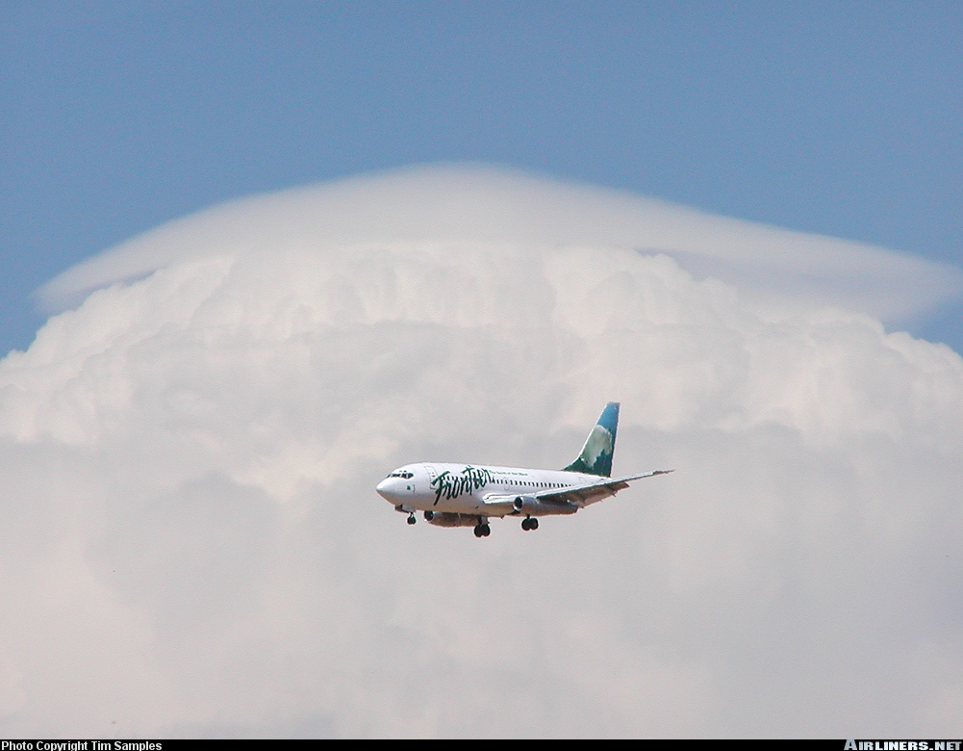
Clouds
Notes:
Height of cloud-base
Knowledge of surface temperature and dew point can help you determine (estimate) the height of the cloud base.
Example:
Surface Temperature 15 °C
Dewpoint 5 °C
Relative humidity Dry (unsaturated)
Elevation 1500 feet
1. Subtract the dewpoint from the temperature. Divide the remainder by the Lapse Rate (3). This will give the height of clouds above ground. As long as the air is not saturated (temperature above dew point) you shall use dry adiabatic lapse rate value.
10°C / 3°C = 3.333 * 1000 ft = 3333 ft AGL
2. To find the height of clouds above sea level, add the elevation to the answer from Step 1.
3333 ft + 1500 ft = 4833 ft ASL
Pay attention to not confuse AGL and ASL value in those problems.

Slide 17
classification

Slide 18
Cloud Formation
Cumulus clouds form in rising air currants and have a lumpy, cotton ball appearance
  They are an indicator of Unstable air
Stratus clouds form in horizontal layers
  They are an indicator of Stable air
Nimbus clouds create percipitation

Slide 19
Families
Four families of clouds:
  High clouds
  Middle clouds
  Low clouds
  Clouds of vertical development
Notes:
Heights in presentation are based on “Temperate Regions” in the FTGU

Slide 20
High Clouds (Cirro)
Bases from 16,500 to 45,000 feet
Composed mainly of ice crystals.
Little effect on flying
Possible moderate turbulence

Slide 21
High Clouds
Cirrus (CI)
Very high, thin delicate wisps
Generally no weather implications
“Cats’ whiskers” or “mares’ tails”
Notes:
Cirrus (CI):
Very high, thin, wavy clouds made up of slender, delicate curling wisps or fibers
May signal the approach of a distant warm front

Slide 22
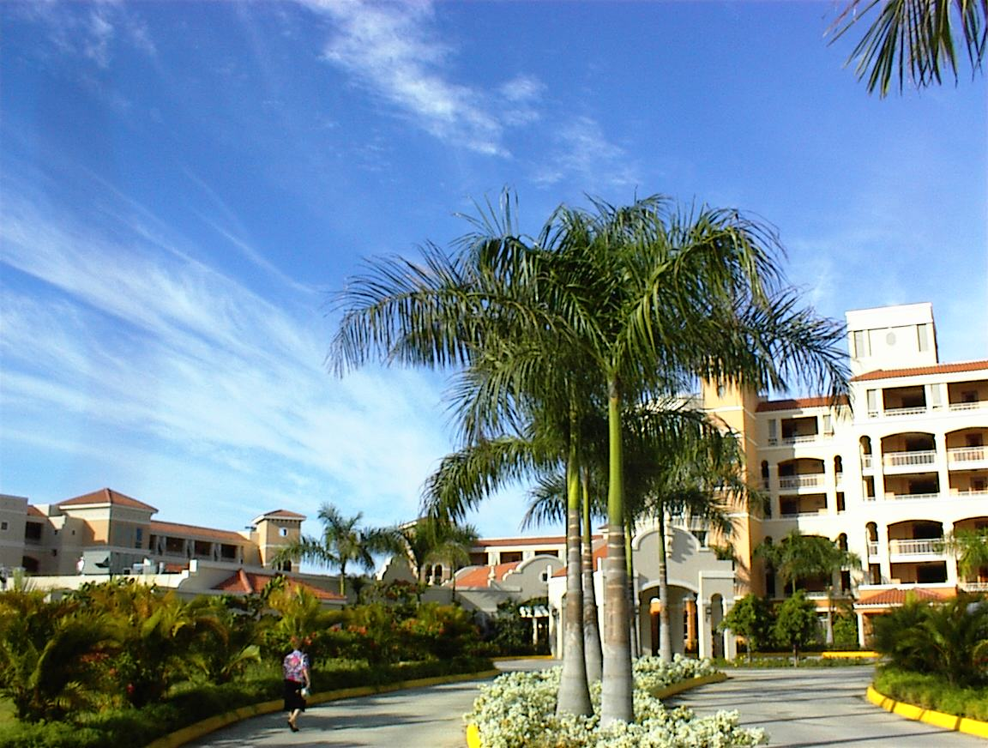

Slide 23
High Clouds
Cirrocumulus (CC)
Thin, cotton ball-like clouds
Indicate high-level instability
Little indication of future weather conditions
“Mackerel sky”
Notes:
Cirro cumulus (CC):
Thin clouds, cotton or flake-like
Rippled like the sand beneath the water’s edge of a sandy beach
Rare
No significant effect on flight
May indicate strong upward vertical currents

Slide 24
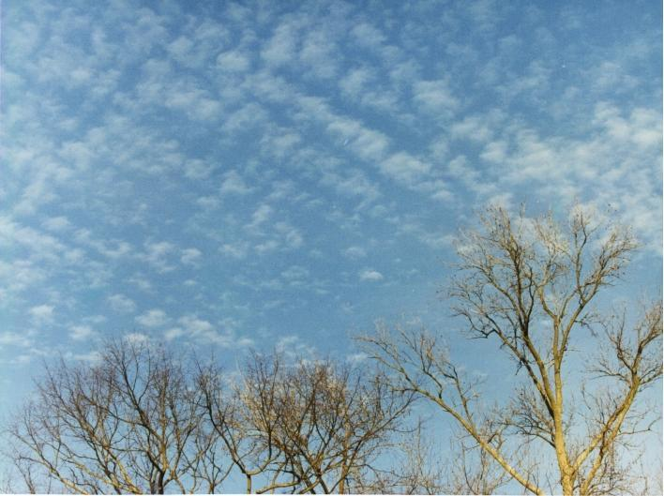

Slide 25
High Clouds
Cirrostratus (CS)
Thin, high sheet of cloud through which the sun or moon is visible
Produces a halo effect
Often indicates an approaching warm front or occlusion (deteriorating weather)
Notes:
Cirro stratus (CS):
Very thin, high sheet of cloud
Indicates possible bad weather approaching
No turbulence or precipitation
No significant effect on flight
Sometimes causes a halo effect around the sun or moon

Slide 26


Slide 27
Middle Clouds (Alto)
Middle clouds have bases from 6,500 to 23,000 feet
Composed of ice crystals or water droplets
Little turbulence associated unless cumulus clouds are embedded in them or altocumulus is forming

Slide 28
Middle Clouds
Altocumulus (AC)
Layers of rounded masses of cloud
Can be in groups or lines
May indicate approaching front
Notes:
Altocumulus (AC):
Light turbulence
Little or no precipitation
Some icing may occur

Slide 29
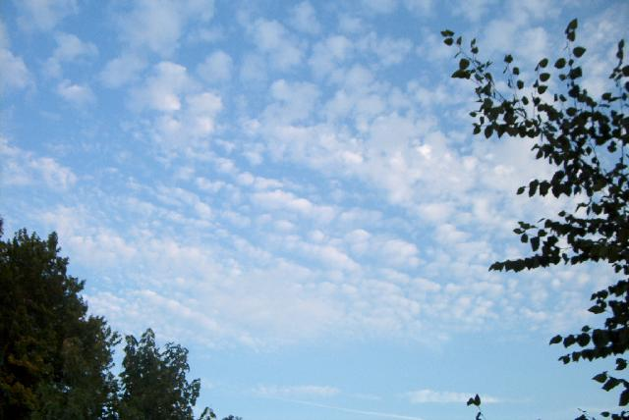

Slide 30
Middle Clouds
Altostratus (AS)
Thick grey clouds that often cover entire sky
Often give light rain or snow
Near approach of warm front
Icing may occur
Notes:
Alto stratus (AS):
Appears beneath cirrostratus layers
Covers a wide area
Light turbulence

Slide 31
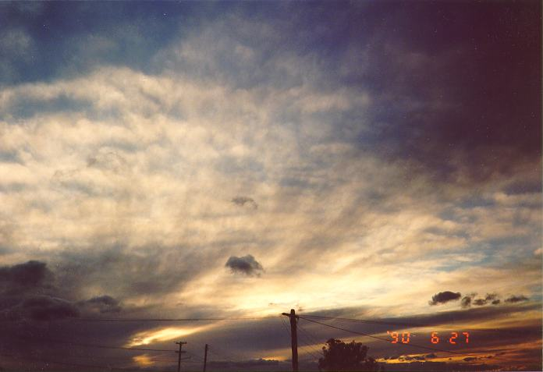

Slide 32
Middle Clouds
Altocumulus Castellanus (ACC)
Altocumulus with a turreted appearance
Instability, turbulence, and showery precipitation
May develop into cumulonimbus
Notes:
Alto Cumulus Castellanus (ACC):
Significant vertical extension evidence of powerful vertical currents
Possible thunderstorms later in the day
Moderate turbulence and icing

Slide 33
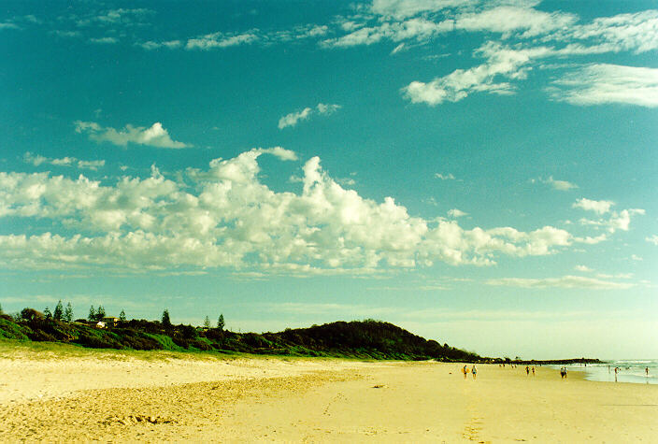

Slide 34
Low Clouds (Strato)
Low clouds have bases from the surface to 6,500 feet
Composed of water droplets (can be supercooled) or sometimes ice crystals.
Light turbulence
Low cloud bases and poor visibility make VFR operations difficult to impossible

Slide 35
Low Clouds
Stratus (ST)
An uniform layer of cloud resembling fog but not resting on the ground
Often produces drizzle
Notes:
Stratus (ST):
Very low, flat base
Normally hundreds of feet thick
Poor visibility, often due to drizzle and fog

Slide 36
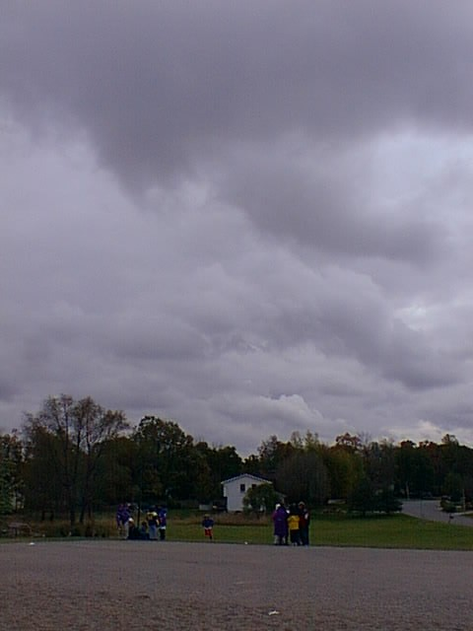

Slide 37
Low Clouds
Stratocumulus (SC)
A thin layer of rounded masses of cloud
May produce light rain or snow showers
Notes:
Strato cumulus (SC):
Thin layer of rounded cloud
Often see in high pressure areas during the winter
Blue sky visible through gaps in the clouds
Base is generally above 2,000 feet
Turbulence below the cloud, smooth air above

Slide 38
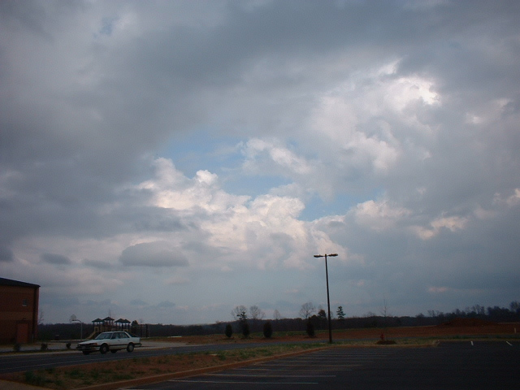

Slide 39
Low Clouds
Nimbostratus (NS)
A thick layer of dark, uniform gray cloud
Usually associated with a warm front
Usually gives continuous precipitation which may be heavy at times
Notes:
Nimbo stratus (NS):
Low layer of flat, grey cloud
Thickened altostratus
Associated with a warm front
Summits to 25,000 feet
Light to moderate turbulence, icing

Slide 40
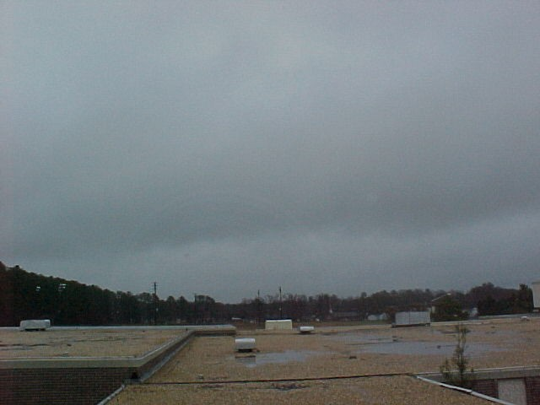

Slide 41
Clouds of Vertical Development
Bases as low as 1,500 feet
Tops as high as 60,000 feet
Composed of water droplets, supercooled water droplets and ice crystals
Isolated or embedded in layers
Notes:
Clouds of vertical development:
Bases from 1500-7000/8000 feet with tops sometimes over 60,000 feet

Slide 42
Clouds of Vertical Development
Cumulus (CU)
  Form during the warm part of the day and dissipate during the evening
  Thick, rounded and lumpy in appearance
  Flat, dark bottoms and while rounded sides
  Looks like cotton balls
  Flight at base is usually bumpy
Notes:
Cumulus:
Thick, rounded and lumpy
Flat base and rounded summit
Form during the daytime and dissipate at night
The height of the cloud base depends on the temperature-dewpoint spread
Light to moderate turbulence
No precipitation

Slide 43
Clouds of Vertical Development
Towering Cumulus (TCU)
  Cumulus clouds that build up into high towering masses
  Can develop into cumulonimbus
  Rough air underneath
  Heavy icing in cloud
Notes:
Towering Cumulus (TCU):
Cumulus clouds that build up into high towering masses
Severe turbulence and icing
Snow showers in winter
Light rain showers in summer
Turbulent beneath clouds and severe icing inside the cloud

Slide 44
More Clouds
Low cloud:
  Stratus Fractus (SF)
    Pieces of stratus cloud
Cloud of Vertical Development:
  Cumulus Fractus (CF)
    Pieces of Cumulus
Notes:
Stratus Fractus (SF):
Stratus broken up by strong winds (ragged cloud)
Normally forms in the precipitation below a nimbostratus layer; may or may not be fused with the upper layer
Cumulus Fractus (CF):
Cumulus which has begun or which has been broken up by the wind

Slide 45
Clouds of Vertical Development
Cumulonimbus (CB)
  Heavy masses of cumulus
  Anvil top (thunderstorm and showery precip.)
  Violent vertical currents within cloud
  Line indicates cold front
  Heavy icing and hail within cloud
  Electrical activity
  May be embedded in stratiform clouds
  Usually gives heavy showers with possible hail
SEVERE HAZARD TO AVIATION!!!
Notes:
Cumulonimbus (CB):
Develop from towering cumulus
Mature clouds have a characteristic of an anvil head and the onset of precipitation
Produce thunder and lightning
Severe icing, turbulence and showers
Hail often forms inside the cloud and sometimes outside as well
Violent surface winds are common surrounding the cloud

Slide 46
Cloud formation

Slide 47
Changes of State
All matter, including water, exists in three states
The processes by which matter changes states are:
VAPOUR
SUBLIMATION
DEPOSITION
EVAPORATION
CONDENSATION
FREEZING
SOLID
LIQUID
MELTING

Slide 48
How do Clouds Form?
Clouds are formed by the condensation of water vapour
For clouds to form, three conditions must be present
  Condensation Nuclei
  High Relative Humidity
  Cooling Process
Notes:
Condensation nuclei: microscopic particles like dust, smoke, sea salt, seeds, pollen, etc. in suspension in the air, on which water vapour condenses to liquid water droplets
Clouds are usually composed of small water droplets, however, at temperatures well below freezing, they are composed of ice crystals, which form through deposition.
At temperatures between freezing and -15°C, composed of supercooled water droplets and ice crystals.

Slide 49
Formations
Formed in two ways:
Air is cooled to saturation point
Water vapour is added to saturation point
Most common is through adiabatic expansion (lifting)

Slide 50
Lifting Agents
The lifting agents involved in adiabatic expansion are:
  Orographic Lift
  Frontal Lift
  Convection
  Convergence
  Turbulence

Slide 51
Lifting Agents
Orographic Lift
  Occurs when air is forced upwards against the side of a hill or mountain
  As the air rises, it expands and cools
Notes:
Dry air forms little cloud
Moist and stable forms stratus clouds
Moist and unstable forms cumulus and cumulonimbus clouds
Orographic wave:
Air flowing across a mountain range usually rises relatively smoothly up the slope of the range. Once over the top, it pours down the other side with considerable force. The air bounces up and down, creating eddies and turbulence. If the air mass has a high moisture content, clouds of very distinctive appearance will develop:
Cap cloud: cloud formation on the summit of the mountain range
Lenticular (Lens shaped) cloud: form on the wave crests aloft and lie in bands that may extend well above 40,000 feet
Rotor clouds: form in the rotating eddies downstream of the mountain range

Slide 52
Lifting Agents
Frontal Lift
  As the frontal surface forces warm air aloft, it expands and cools
  This is responsible for most of the weather at fronts
Notes:
Warm front clouds: CCANS
Cold front: heavy cumulus or cumulonimbus; heavy rain, thunderstorms, turbulence and icing associated

Slide 53
Lifting Agents
Convection
  When air in contact with the earth is heated, it rises and eventually expands and cools
  This is why good soaring thermals are under cumulus clouds
  Produces condensation and cumuliform clouds at top of column of air; further ascent causes rain
Notes:
Convection: upward movement of air
Subsidence: downward movement of air
Convection also occurs when air moves over a surface that is warmer than the air. Air is heated by advection and convective currents develop

Slide 54
Lifting Agents
Convergence
  This occurs when air flows into the centre of a low pressure area
  The excess air is forced upwards to expand and cool
  This is why lows bring poor weather
Notes:
Convergence: inward flow of air accompanied by an upward flow as the excess air escapes. A low pressure is characterized by convergence because the air flows towards the interior. This air will expand, cool and potentially condense. This is one reason why bad weather usually prevails in low pressure area
Divergence: outward flow of air is compensated for by a downward movement of air. That air will subside and warm itself lowering the relative humidity. This is why good weather usually prevails in high pressure region. A high pressure area is characterized by divergence because the air is flowing towards the exterior.

Slide 55
Lifting Agents
Turbulence
  As air flows over a rough surface, vertical currents are created
  If the air is unstable, these currents will continue upwards and eventually expand and cool
  Results in stratocumulus and possibly cumulus clouds if convection occurs at the same time
Notes:
Mechanical turbulence or eddies
Intensity of turbulence is dependent on roughness of surface, strength of wind and instability of air

Slide 56
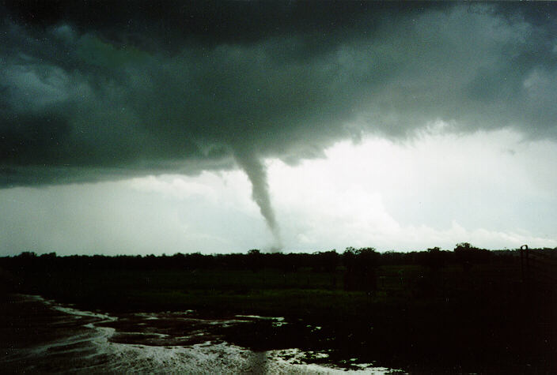
Atmospheric Pressure

Slide 57
Atmospheric Pressure
The surface of the earth is covered by a huge “sea of air”
The weight of this air exerts a force on the earth
There are three main units of pressure used to measure this force

Slide 58
Units of Measure
Inches of Mercury (“Hg)
  Length of a column of mercury the weight of which will balance a column of air extending from the ground to the top of the atmosphere
Millibar (mb)
  Pressure exerted on an area of 1 square cm by a force of 1000 dynes
Kilopascal (kPa)
  Equals 10 hectopascals (hPa) 1 hPa=1mb
Notes:
Inches of Mercury (“Hg): 29.92”Hg=1013.2 hPa
Millibars (mb): 1mb = 1hPa
Hectopascal (hPa): 1hPa=1mb=0.1kPa
Kilopascal (kPa): 1kPa=10hPa

Slide 59
Review
What are the classifications of cloud?
What are the ICAO standards for the atmosphere?
Name some clouds
Notes:
Cumulus, stratus
Sea-level Pressure - 29.92” Hg
Sea-level Temperature - 15°C
Adiabatic Lapse Rate - 1.98°C/1000 ft
The air is a perfectly dry gas
Cirrus (CI)
Cirrocumulus (CC)
Cirrostratus (CS)
Altocumulus (AC)
Altocumulus Castellanus (ACC)
Altostratus (AS)
Stratocumulus (SC)
Stratus (ST)
Nimbostratus (NS)
Stratus fractus (SF)
Cumulus (CU)
Cumulus fractus (CF)
Towering cumulus (TCU)
Cumulonimbus (CB)

Slide 60
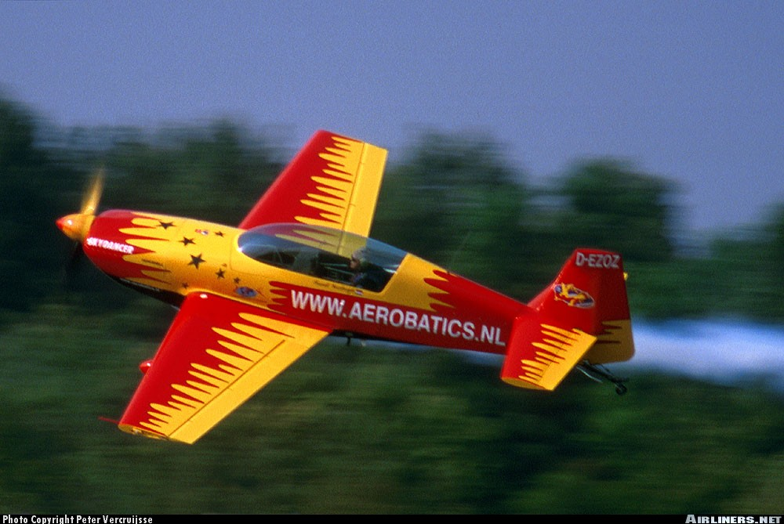
Meteorological Aspects of the Altimeter

Slide 61
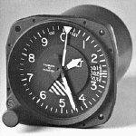
Altimeter Setting
The altimeter setting is used to correct the altimeter for local pressure deviations from the standard
When the correct altimeter setting is used, the altimeter will indicate the altitude Above Sea Level (ASL)
The altimeter setting is expressed in inches of mercury (“Hg)
i.e. - GPHK, Toronto Radio, latest
Muskoka altimeter is 29.85”Hg
Notes:
Station Pressure: Actual atmospheric pressure measured at the elevation of the observing station.
Mean Sea Level Pressure: A common standard of different station pressures, used to obtain a consistent record of pressure distribution. This calculation is made by adding the weight of the station pressure to an imaginary column of air extending from station altitude down to mean sea level.
When correctly set, altimeter will read station elevation on the ground. If altimeter setting is unknown, the pilot can set the elevation and it should give the local altimeter setting
Altimeter setting: To ensure that the altimeter indicates the real height of the aircraft above sea level, it must be calibrated to a standard atmospheric pressure setting; this is called the “altimeter setting”. This setting differ slightly from Mean Sea Level pressure; the difference coming from the fact that the station providing this setting is most of the time not at sea level and as to mathematically compensate for the difference in height.

Slide 62
Meteorological Aspects of the Altimeter
When flying from areas of relatively high pressure to areas of relatively low pressure, the altimeter will indicate a higher altitude then the aircraft’s altitude
When flying from areas of relatively low pressure to areas of relatively high pressure, the altimeter will indicate a lower altitude then the aircraft’s altitude
HIGH TO LOW, LOOK OUT BELOW
LOW TO HIGH, CLEAR BLUE SKY
Notes:
If the altimeter setting is not changed, the altimeter will read according to the initial calibration regardless of the actual surrounding conditions
Pilots must receive updates from stations along their route of flight and re-calibrate the altimeter as they proceed
In standard atmosphere, pressure in the lower levels tends to drop at a rate of 1 inches of mercury per thousand feet. However, the altimeter cannot make out the difference between a pressure change due to an actual change in altitude and a pressure change due to a horizontal displacement of the aircraft to an area of lower or higher pressure. Therefore, the altimeter records any kind of pressure change as a climb or descent accordingly.

Slide 63
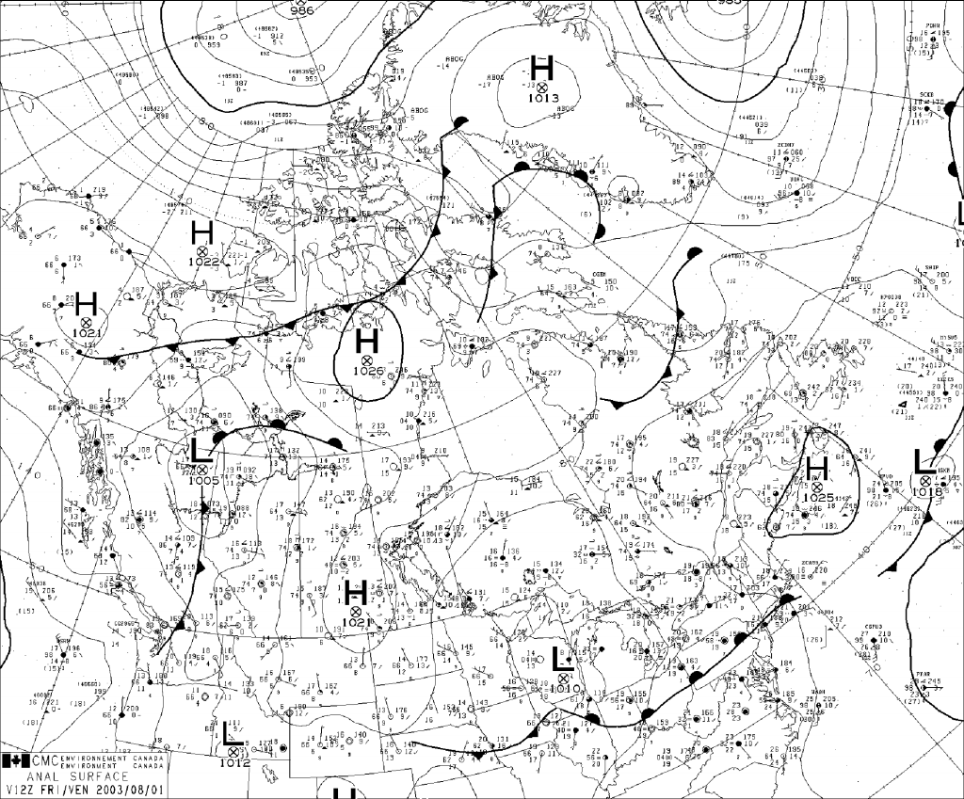
Pressure Systems

Slide 64
Pressure Systems
Differences in pressure are responsible for all the weather that takes place on earth
There are two basic pressure systems that are the source of all weather
  Low pressure area
  High pressure area
Notes:
High pressure areas: usually fine and clear weather, probably cooler
Low pressure areas: East side: rainy and cloudy
West side: fine

Slide 65
Low Pressure
Also called a “cyclone” or “depression”
Relatively low pressure region
Pressure is lowest at the centre
Air flows in an anti-clockwise direction and inwards
Usually bring poor weather
Generally travel easterly
500-700 miles/day
Notes:
Secondary low:
-small cyclonic disturbance associated with a larger low pressure system
-develops within a region dominated by a major low pressure system (the primary low)
-rotates counter-clockwise around the primary low
-generally associated with thunderstorms in summer and strong precipitation or winds in winter

Slide 66
Low Pressure System Winds
Winds blow counter-clockwise and inwards in a low
Area of convergence
  The flow of air into an area and is accompanied by rising air to permit the excess accumulation to escape

Slide 67
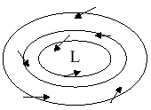
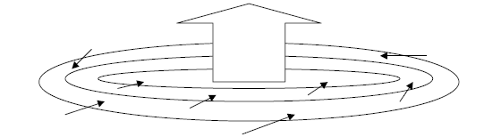

Slide 68
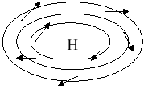
High Pressure
Also known as an “anti-cyclone”
Relatively high pressure region
Pressure is highest at the centre
Winds flow clockwise and outwards
Fair, cool weather
Winds light and variable
Slow moving
(sometimes stationary)

Slide 69
High Pressure System Winds
Winds blow clockwise and outwards in a high
Area of divergence
  A flow of air outwards from a region and is associated with highs
  Sinking air compensates for the flow of air outward

Slide 70
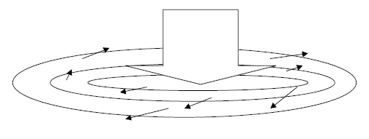

Slide 71
Pressure Systems
There are also several different types of pressure regions that evolve from the main systems. These include:
Trough - An area of low pressure with higher pressure on either side
Secondary Low - An area of lower pressure that forms within a trough
Ridge - An area of high pressure with lower pressure on either side
Col - An area of neutral pressure between two highs and to lows
Notes:
Col: weather normally unsettled or undependable
Winter: fog
Summer: showers or thunderstorms

Slide 72
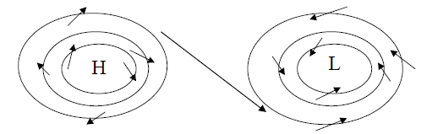
Winds always flow from an area of HIGH pressure to an area of LOW pressure

Slide 73
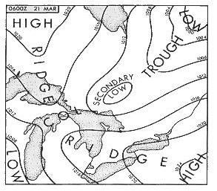
Notes:
Isobar: curved line on a weather map joining areas of equal barometric pressure
Isobars are drawn at intervals of 4hPa, for pressure observations below 1000hPa

Slide 74
Pressure Gradient
The pressure gradient is the rate of change in pressure over a given distance when measured at right angles to the isobars
This determines the wind velocity (the steeper the gradient, the stronger the wind)
Notes:
Isobars close together on a weather map indicate a strong pressure gradient. The pressure gradient determines the strength of the wind. Therefore the closer the isobars, the stronger the winds

Slide 75
Coriolis Force
Coriolis force is caused by the rotation of the earth
Air moving over surface of earth continues to move in a straight line if no force acts on it. The Earth continues to move under this body of air.
This causes air to be apparently deflected to the right in the Northern Hemisphere, causing wind to flow more parallel to the isobars
Notes:
The air flowing from a high pressure area therefore does not move directly towards the centre of the low pressure area but is deflected to the right and flows parallel to the isobars
Centrifugal Force:
Tends to increase the wind speed in high pressure areas and decrease wind speed in low pressure areas. For the exact same pressure gradient, wind will be a little stronger in a high pressure area than it would have been in a low pressure area.

Slide 76
Buy Ballot’s Law
If, in the Northern Hemisphere, you stand with your back to the wind, the area of low pressure will be on your left

Slide 77
Surface Friction
Friction between the air and the ground slows the air down
This causes the air to flow at a greater angle to the isobars
Only extends to aproximately 2000 feet AGL
Notes:
Works against Coriolis force, thus air moving from a high to low tends to cross the isobars at a small angle instead of remaining parallel
At 3000 feet, the wind blows parallel to the isobars at a speed proportionate to the pressure gradient

Slide 78
Winds

Slide 79
Wind
The differences in pressure on the earth are responsible for the horizontal movement of air
This horizontal movement of air is known as wind
Notes:
At low levels, wind is a result of a flow of air from high pressure areas to low pressure areas
At high levels, wind is a result of differences in densities. Colder air is denser than warm air and therefore pressure drops more rapidly with altitude in cold air. So at a higher altitude, for the same level, pressure will be lower in cold air than in warm air creating a pressure gradient due to unequal density.
Surface winds extend up to around 2000 feet. Topography has a significant influence on surface winds due to surface friction

Slide 80
Land Breeze
Occurs at night
Land becomes cooler faster than water causing a high over the land
Wind blows from the land (high pressure area) to the warm water (low pressure)

Slide 81
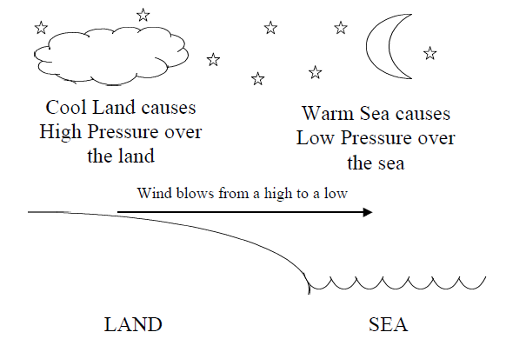
Notes:
Earth cools more rapidly than water, thereby creating a high pressure area over the earth by subsidence.
Relatively warm air over the water, less dense than the cool air over the ground, rises and creates a low pressure area. The cool air flows towards the lower pressure over the water. The wind flows from the shore to the sea.

Slide 82
Sea Breeze
Occurs during the day
Land heats faster than water causing a low over the land
Wind blows from the sea (high pressure) towards the warm land (low pressure)

Slide 83
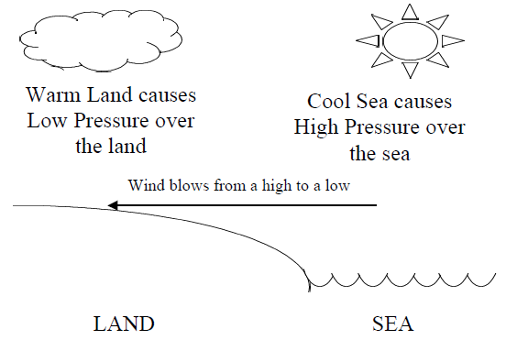
Notes:
The shore heats more rapidly than the water, thereby creating a low pressure area over the ground as the air starts to rise.
The warm air over the ground, less dense than the cool air over the sea, rises and creates a low-pressure area. The cool air over water subsides rising the ground level pressure and flows towards the area of lower pressure.

Slide 84
Mountain Winds
Anabatic winds: winds flowing up the slopes of bare mountain slopes during the day
Katabatic winds: winds flowing down the slopes of mountains during the night
Notes:
Anabatic Winds (valley wind): Bare mountain slopes are heated by solar radiation during the day. With contact the air becomes warmer and less dense, therefore rising up the mountain slope.
Katabatic Winds (mountain wind): During the night the mountain slopes cool. The air in contact with the slope is cooled by radiation and becomes denser, causing it to flow down the slopes towards the valleys. This phenomenon also arises during the day on snow-covered slopes.

Slide 85
Gust
A rapid and brief increase in the wind speed
Often associated with rapid fluctuations in the wind direction
Caused by mechanical turbulence and unequal heating of the Earth’s surface

Slide 86
Squall
Similar to a gust but of longer duration
Caused by passage of a fast moving cold front or thunderstorm
Like a gust, may be associated with rapid change of wind direction
Notes:
Longer duration (minimum 2 minutes)

Slide 87
Diurnal Variation
Daily variation in the wind
Caused by surface heating during day
Causes turbulence in lower levels, which transfers the stronger upper level winds to the surface
This causes surface winds to veer and increase during the day
Surface winds back and decrease during the evening when daytime heating stops

Slide 88
Mechanical Turbulence
Friction between the air and surface features of the earth is responsible for the swirling vortices of air called “EDDIES”
Generally confined to below 3000 feet

Slide 89
Tornadoes
Violent, circular whirlpools of air
Funnel shaped
Associated with severe thunderstorms (forms under cumulonimbus cloud)
Very deep concentrated LOWS

Slide 90
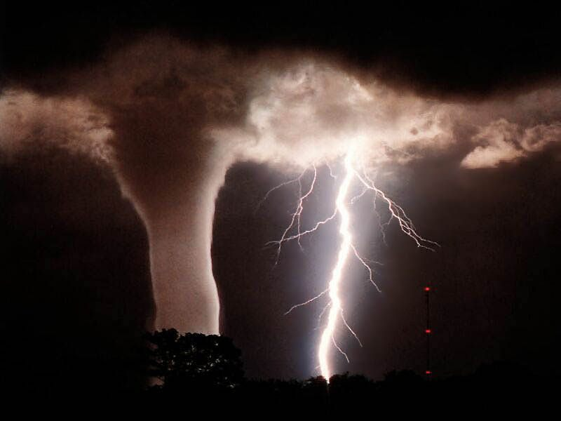

Slide 91
Wind Speed and Direction
Wind speed is reported in knots (nautical miles per hour)
Direction is defined by the direction FROM which the wind blows

Slide 92
Veer
Wind changes direction CLOCKWISE
  E.g. From 270° to 300°
Wind veers and increases speed during the day
Wind veers and increases in speed with increase in altitude
Notes:
Wind veers and increases in intensity with increase in altitude until it becomes parallel to the isobars

Slide 93
Back
Wind changes direction COUNTER-CLOCKWISE
  E.g. From 90° to 60°
Wind backs and decreases speed at night
Wind backs and decreases with decrease in altitude
Notes:
The wind backs and decreases in intensity with decrease in altitude until it crosses the isobar at a small angle in the direction of the low pressure system

Slide 94
Wind Shear
Sudden ‘tearing’ or ‘shearing’ effect encountered when there is a sudden change in wind speed or direction
Can be very violent
Associated with strong temperature inversions

Slide 95
Jet Stream
Narrow band of exceeding high speed winds known to exist in higher levels of the troposphere at altitudes ranging from 20,000 – 40,000 feet
Wind speed is usually between 100-125 knots but may get as high as 250 knots
Flow West to East and may encircle the globe

Slide 96
Review
What is a cyclone?
What is Buy Ballot’s Law?
What is a sea breeze?
Notes:
Low pressure area or depression
If you stand with your back to the wind, the low pressure is on your left
When wind blows from the sea to the land during the day

Slide 97
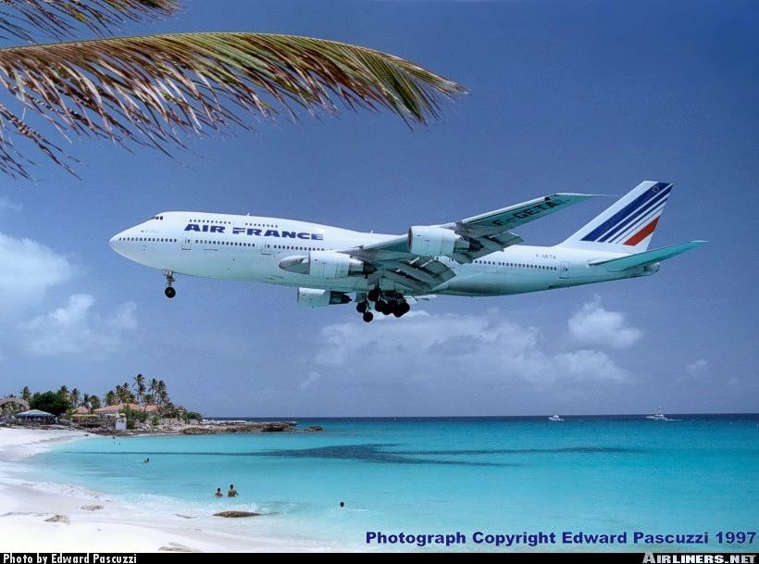
Humidity, Temperature & Stability

Slide 98
Humidity
Humidity
  amount of water vapour present in the air
Relative Humidity
  amount of water in the air compared to the maximum amount of water the air can hold at a the same temperature
Saturated
  A parcel of air holding the maximum amount of water at a given temperature
Dew point
  the temperature to which a given parcel of air must be cooled, at a constant pressure, to become saturated

Slide 99
Supercooled water droplets
  Water droplets that remain liquid at temperatures below freezing due to chemical composition of nuclei
Dew
  Humidity which accumulates on objects through condensation on calm, clear nights
Frost (white and opaque)
  Water vapour sublimates into ice crystals
Frozen dew (hard and transparent)
  Dew that freezes after forming

Slide 100
Temperature
The sun heats the surface of the earth and the surface heats the air
Freezing Point
  Point at which water freezes (0°C)
Boiling Point
  Point at which water boils (100°C)
Notes:
Freezing point is the temperature at which water droplets transform into ice crystals.
Boiling point is the temperature at which water droplets transform into water vapour.
Isothermal: layer of the atmosphere where the temperature does not change with altitude

Slide 101
Temperature
Temperature has an effect on air density:
  Cold air is more dense (heavier)
  Warm air is less dense (lighter)
Isotherms are lines joining places of equal temperature drawn on weather maps
Notes:
Atmospheric density is defined as mass per unit volume
Cold air is more dense because the molecules are moving slowly and are therefore packed very closely together
Warm air is less dense because the molecules are moving about more rapidly and therefore are taking up much more space. This means that there are less molecules per unit volume
Pressure and density are proportionally related. As pressure increases, so does density
Pressure Altitude: altitude indicated when the altimeter is calibrated to the ICAO standard, 29.92”Hg
Density Altitude: Pressure altitude corrected for temperature being different from 15 degrees.
At what altitude will atmospheric conditions be found when non ICAO pressure and temperature conditions exist

Slide 102
Atmospheric Heating
The most important concept to understand when talking about atmospheric heating is:
THE ATMOSPHERE IS HEATED FROM BELOW
The sun’s rays heat the earth, and the earth then heats the air
This is why the temperature decreases with altitude
This is called Radiation Heating
Notes:
Radiation: the heat of the sun reaches the Earth in the form of short-wave radiation. The energy is absorbed by the terrestrial surface resulting in an increase in temperature, which heats the lower levels of the atmosphere. The atmosphere is heated from below

Slide 103
Atmospheric Heating
The atmosphere is also heated by two other methods:
Advection: cold air moves over a warm surface. The cold air is heated by coming into contact with the warm surface
Compression: air subsides (sinks), it is compressed, and as it is compressed, its temperature increases
Notes:
Compression: anti-cyclonic weather systems in which air subsides or air flowing down the side of a mountain causes downward vertical currents. As the air descends, it reaches regions of increased atmospheric pressure and is compressed, causing adiabatic rising of its temperature. This phenomenon is called subsidence.
Adiabatic: relating to or denoting a process or condition in which heat does not enter or leave the system concerned

Slide 104
Heat Distribution
Heat is distributed throughout the atmosphere by several methods
Conduction: occurs when heat is transferred between two objects in contact with each other. This plays a very minor role in weather
Convection: As warm air rises, cold air moves in to take its place and is then heated by the earth
Turbulence: Friction between the moving air and the earth’s surface causes heat to be distributed aloft
Notes:
Conduction: heat spreads gradually through an object, passing from warm areas to cold areas.
Turbulence: mechanical turbulence, which is the result of friction between the air and the ground, causes a mixing process which spreads the surface heat into the air aloft

Slide 105
Atmospheric Cooling
The cooling of the atmosphere also plays a large part in determining the weather. Air is cooled by:
Advection: As warm air moves over a cold surface, it is cooled by contact with that surface
Expansion: As air rises, it expands and therefore cools (most important)
Radiation: When the sun sets, the earth continues to radiate heat, but it is no longer replaced. The earth’s surface cools and so does the air in contact with it

Slide 106
Vertical Distribution of Temperature
Temperature decreases with altitude
Lapse rate: the rate of change of temperature with altitude
Inversion
  An increase in temperature with altitude
  Creates very stable air
Isothermal layer
  temperature remains constant through layer
Notes:
The properties of the surface have a direct influence on the formation of vertical currents. Wet ground or a water surface will cause much less convection than an arid surface. Flight over a forest on a hot and sunny day will generally be less turbulent than a flight over bare ground or fields.
Inversions
Inversions can occur on a clear, still night when the cold ground cools the air above it in the lower levels. The temperature at the top of an inversion so formed may be 15°or 20°C warmer than the temperature at the surface.
Inversions may also occur as cold air, which is denser than warm air, flows into a low lying area such as a valley and becomes trapped there. Warm air, lifted above colder air over a frontal surface, in another cause of an inversion.
Inversion will also be found in the stratosphere. At the tropopause, temperature steady up at -56° in average and remains constant with altitude. This is a zero vertical lapse rate as the temperature does not change with altitude. Then, temperature start to rise with altitude, this is an inversion.

Slide 107
Lapse Rates
Dry Adiabatic Lapse Rate (DALR)
    3.0°C/1000’
Saturated Adiabatic Lapse Rate (SALR)
    1.5°C/1000’
ICAO Standard Lapse Rate
    1.98°C/1000’
Notes:
ICAO standard:
In ICAO conditions, the outside temperature indicated in your airplane will drop 1.98 degrees every 1000 feet you climb upwards. But this is only when pressure is 29.92”Hg and 15 degrees at ground level. In reality, the vertical lapse rate is variable. In the stratosphere, it comes to 0°C/1000’ and even negative in inversions. Air stability will be very dependent on the vertical lapse rate value. This cooling is due to the fact that higher air is farther from the heat source, the ground.
Adiabatic lapse rate:
When air rises, it expands due to pressure decreasing. The expanding air then cools. Since this cooling is adiabatic, there is no exchange of heat outside the air mass and the cooling will be made at a precise rate. One factor affecting the adiabatic lapse rate is the relative humidity of the air mass rising.
The reason why dry and saturated are different is because when water is forced to condense as the air mass is cooled by expansion as it rises, water is releasing latent heat inside the air mass fighting and reducing the cooling effect. The wet will therefore be less then the dry rate.

Slide 108
Air Stability
Stability
  The tendency of air to return to its original horizontal level if disturbed
Instability
  The tendency of air to move farther away from its original horizontal level if disturbed
Notes:
Strong lapse rate implies unstable air. Cool air in upper layers tends to descend, disrupting the warmer air in the lower atmosphere and causing it to rise
When the lower levels of the atmosphere are heated or when the upper levels are cooled
Weak lapse rate implies stable air. If the temperature decreases little with altitude or it there is warmer air at altitude, there will be no tendency for vertical currents to develop
Occurs when lower levels are cooled or upper levels are heated

Slide 109
Summary of Weather Conditions
Characteristics | Stable Air | Unstable Air
Lapse Rate | Weak | Strong
Clouds | Stratus | Cumulus
Precipitation | Steady | Showers
Visibility | Poor | Good
Winds | Steady | Gusty
Turbulence | Light | Moderate to Severe
Notes:
Ground which is being heated will heat the air in contact just above, creating unstable conditions
Ground which is cooling will cool the air above, causing stable conditions

Slide 110
Lapse Rate
Steep lapse rate: indicates unstable air
  Cumuliform clouds, showery precipitation, good visibility, and turbulence
Shallow lapse rate: indicates stable air
  Stratiform cloud, steady precipitation, poor visibility, and smooth air
Generally speaking:
  Heating From Below produces Unstable Air
  Cooling From Below produces Stable Air
Notes:
When an air mass is warmer than its surrounding, it is less dense and starts moving upwards by Archimedes principle (buoyancy)
Vertical lapse rate is temperature taken at different altitude of different air molecules present at those different levels.
Adiabatic lapse rate is the rate of cooling of an air mass rising through the air and cooling itself because of expansion.
The adiabatic lapse rate is greater than the vertical lapse rate, which means that an air bubble warmer than its environment will start rising. This bubble will cool by itself by expansion at a faster rate than the immobile surrounding air. The air would have then achieved stability. The larger the vertical lapse rate, the harder it is for an air bubble to meet outside temperature and the higher it will travel before being able to do so (unstable conditions)

Slide 111
Review
What is the ICAO standard lapse rate?
Name some changes of state of water
Which indicates stable air: steep lapse rate or shallow lapse rate?
Notes:
1.98 degrees celcius per 1000 feet
Evaporation
Sublimation
Deposition
Melting
Condensation
Freezing
Shallow lapse rate

Slide 112
More Review
How is the atmosphere heated?
What direction do winds flow around a low?
Define relative humidity.
Notes:
Radiation from the earth heats the atmosphere
Counter-clockwise and inwards around a low
The amount of water vapour in the air to the quantity that same volume of air could hold if saturated

Slide 113
Summary
Topics Covered Today:
  Properties of the Atmosphere
  Clouds, Classifications and Families
  Atmospheric Pressure and Density
  Pressure Systems
  Winds
  Humidity, Temperature and Stability
Next class we will continue Meteorology

