Slide 1
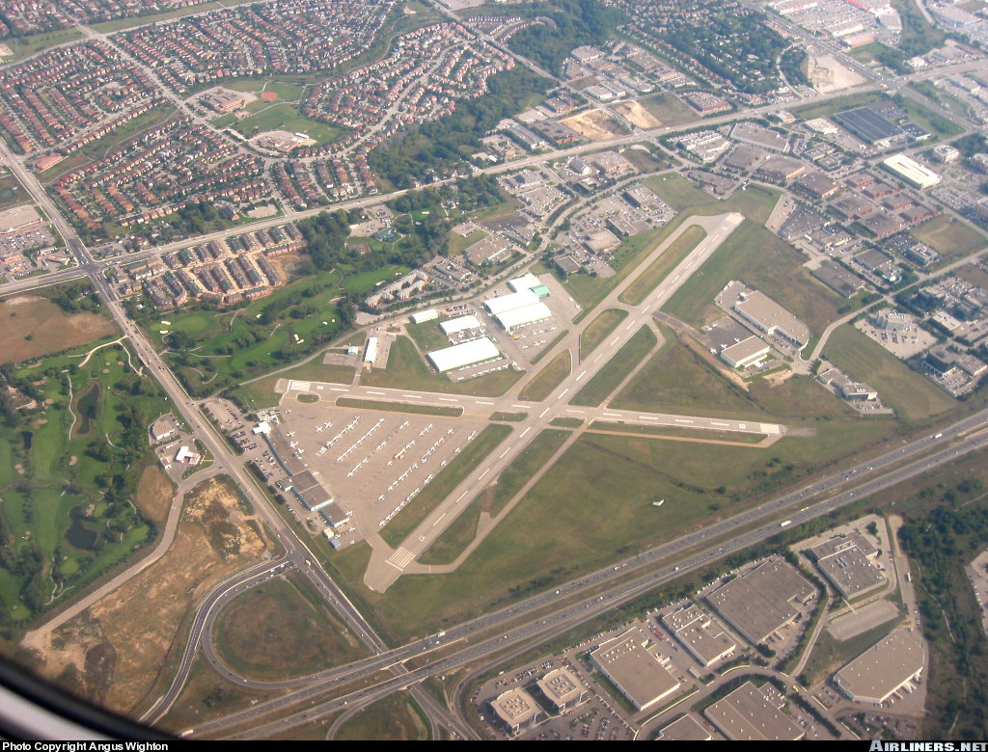
Navigation
CI Valentine
References: FTGU Pages 175 - 255
PO 403

Slide 2
Review
How often are GFA’s published?
Decode this TAF
TAF CYKZ 071742Z 0718/0806 15007KT P6SM FEW020 SCT060 OVC130 PROB40 0719/0724 VRB15G25KT 2SM +TSRA BR BKN020 OVC050CB
FM080000 05003KT P6SM BKN110 TEMPO 0800/0803 P6SM -SHRA BKN015
FM080300 02005KT 3SM SHRA BR OVC008 PROB30 0803/0806 VRB20G35KT
11/2SM +TSRA BR OVC006CB
RMK NXT FCST BY 080000Z=
Notes:
Issued 4 times a day
Terminal Area Forecast for Buttonville Airport
Issued on the 7th at 1742 Zulu
For use on the 7th at 1800Zulu to the 8th at 0600Zulu
Winds forecast to be 150 degrees True at 7 knots
Visibility forecast greater than 6 statute miles
Few clouds forecast at 2000 feet above ground level
Scattered clouds forecast at 6000 feet above ground
Overcast clouds forecast at 13000 feet above ground
40% probability between 7th from 1900-2400 Zulu that:
Winds will be variable direction at 15 knots gusting to 25 knots
Visibility will be 2 statute miles
There will be thunderstorms and heavy rain and mist
Ceiling will be broken at 2000 feet above ground and
Clouds will be overcast at 5000 feet above ground due to cumulonimbus
From the 8th at 0000 Zulu
Winds are forecast 050 degrees true at 3 knots
Greater than 6 statute mile visibility is forecast
Clouds forecast broken at 11000 feet above ground
50% chance during 8th between 0000-0300 Zulu that
Greater than 6 statute miles visibility
Light rain showers
Broken ceiling at 1500 feet above ground
From the 8th at 0300 Zulu
Winds forecast 020 degrees true at 5 knots
Visibility forecast 3 statute miles
Forecast rain showers and mist
Clouds forecast overcast at 800 feet above ground
30% chance during 8th from 0300-0600Zulu
Winds variable direction at 20knots gusting to 35 knots
Visibility 1 and ½ statute miles
Thunderstorms and heavy rain and mist
Ceiling overcast at 600 feet above ground due to cumulonimbus
Next forecast by the 8th at 0000Zulu

Slide 3
Topics to be covered today
Definitions
Latitude and Longitude
Earth’s Magnetism
Compass Errors
Projections

Slide 4
Headings
Heading
  The direction in which the aircraft’s longitudinal axis is pointing, measured clockwise from north
True Heading
  The direction in which the aircraft nose is pointed, measured clockwise from true north
Magnetic Heading
  The direction in which the aircraft nose is pointed, measured clockwise from magnetic north
Notes:
Variation is used to convert heading or bearing from true to magnetic or vice versa

Slide 5
Compass Heading
  The direction that the needle of the compass is pointing
Variation
  The angle between a true meridian and a magnetic meridian at any point
Deviation
  The angle between magnetic heading and compass heading
  Caused by magnetic fields generated by the airframe, engine, and avionics

Slide 6
Definitions
Direction
  Measured in degrees, numbers clockwise from North. North = 0° or 360°, East = 90°, South = 180°, West = 270°
True and Magnetic Direction
  Direction measured in degrees true when read directly from a map or in magnetic degrees when variation is considered
Magnetic Dip
  Angle between the horizontal plane and the plane of the magnet/compass under the influence of a non-horizontal magnetic line of force
Notes:
Compass heading: magnetic heading corrected for deviation errors of the compass

Slide 7
Definitions
Great Circle
  A circle on the surface of the earth whose plane passes through the centre of the earth
  It is the shortest distance between any two points on the earth
Rhumb Line
  A curved line on the surface of the earth that cuts all of the meridians at the same angle
Notes:
Equator is the only line on the surface of the Earth that is both a rhumb line and a great circle at the same time!

Slide 8
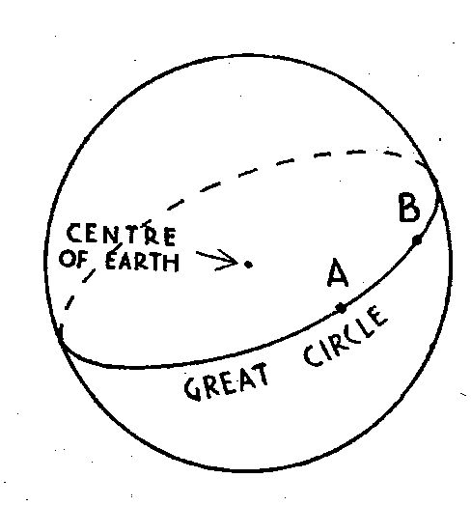
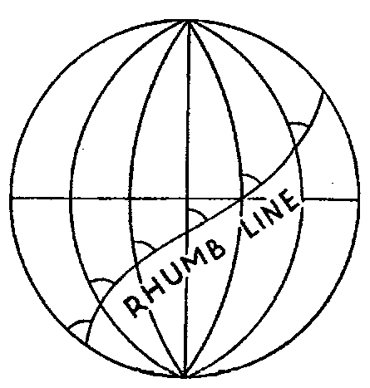

Slide 9
Definitions
Isogonals
  Lines on a map connecting places of equal variation
  Labeled East or West according to position relative to True North
Agonic Line
  A line connecting places of zero variation
  Two agonic lines; one in North America and one on the opposite side of the Earth
Notes:
Isogonic and Agonic lines are not straight lines
They bend and twist due to the influence of local perturbations in the local magnetic field due to magnetic bodies below the Earth’s surface

Slide 10
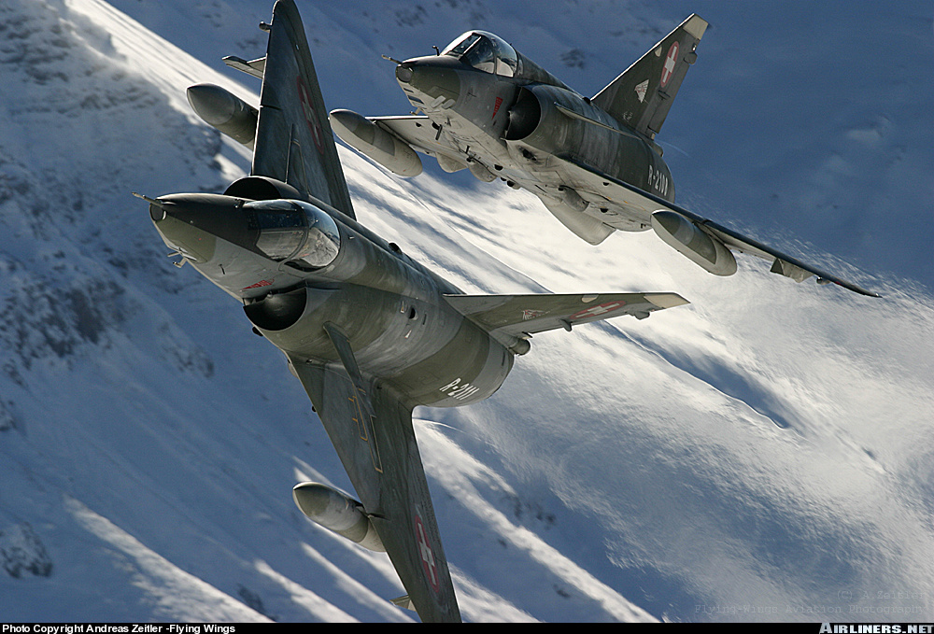
More Definitions

Slide 11
More Definitions
Bearing
  The position of an object relative to the longitudinal axis of the aircraft
Nautical Mile: 6080 feet
  The average length of one minute of latitude
Statute Mile: 5280 feet
Kilometre: 3280 feet
Notes:
1 NM = 1.85 KM
1 NM = 1.15 SM
66NM = 76 SM = 122KM

Slide 12
Speed
Knots (kts)
  Speed in nautical miles per hour
Miles per Hour (mph)
  Speed in statute miles per hour
Kilometres per Hour (km/h)
  Speed in kilometres per hour
Notes:
Speed: the rate of change of position over time compared to an object at rest

Slide 13
Speeds
Indicated Airspeed (IAS)
  The airspeed shown on the Airspeed Indicator
True Airspeed (TAS)
  Speed of the aircraft relative to the air
  Calibrated airspeed corrected for compressibility and density
Groundspeed
  Speed of the aircraft relative to the ground
Notes:
Speed = Distance/Time

Slide 14
Tracks
Track
  The intended path of the aircraft over the ground
Track Made Good
  The actual path of the aircraft over the ground
Drift
  The angle between the heading of the aircraft and the track made good

Slide 15
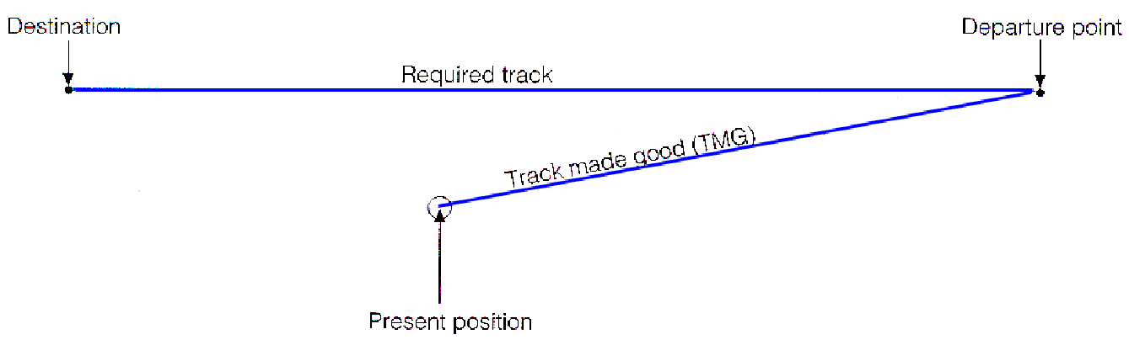
Drift

Slide 16
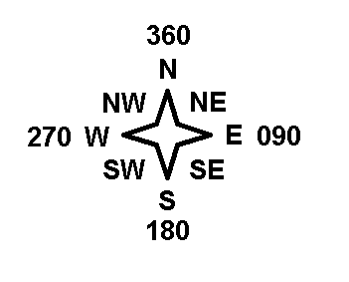
Cardinal Point of the Compass Rose

Slide 17
Heading vs. Bearing
A
B
000°
090°


Aircraft A is on a heading of 000°
The bearing to aircraft B is 090°

Slide 18
Heading vs. Bearing
A
B


090°
180°
Aircraft B is on a heading of 090°
The bearing to aircraft A is 180°

Slide 19
Review
What is the difference between magnetic and compass heading?
What is a rhumb line?
What is the length of a nautical mile?
Notes:
Compass heading is magnetic heading corrected for deviation
Curved line on the Earth’s surface which intercepts all meridians at the same angle. A straight line drawn on a Mercator projection. All parallels of latitude are Rhumb lines
1 NM = 6080 feet
1 NM = 1.85 km
1 NM = 1.15 SM
1 NM is the average length of a minute of latitude

Slide 20
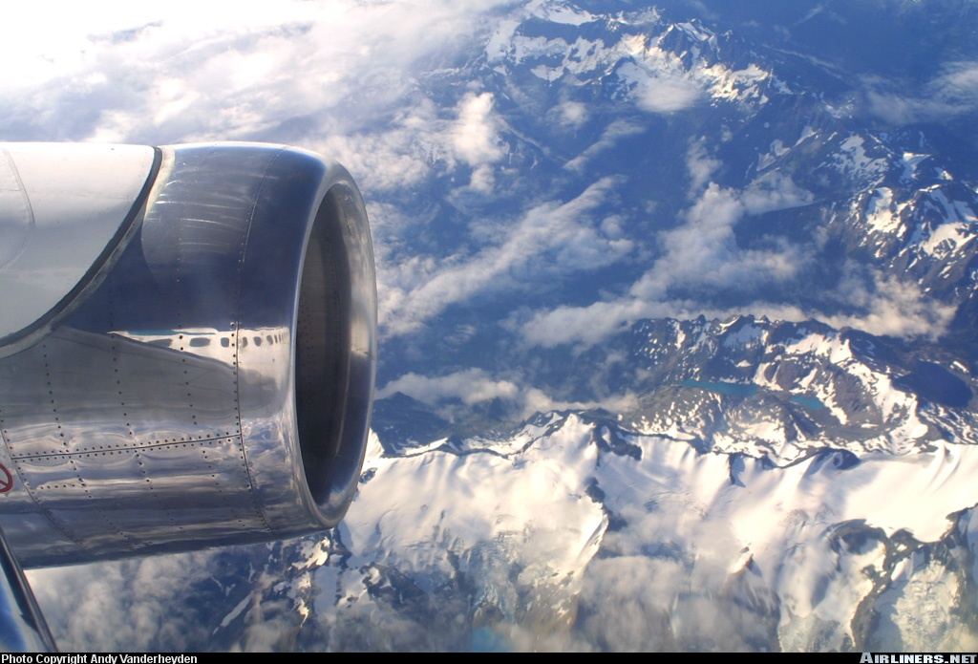
Latitude, Longitude and the Earth’s Magnetism

Slide 21
The Earth
Earth is an oblate spheroid; a sphere flattened at the top and bottom
Surface of the globe is divide into geometrical pattern of intersecting circles called graticule

Slide 22
Earth’s Magnetism
Earth is a giant magnet
Invisible lines of force link the two poles, creating a magnetic field which encircles the planet
Form magnetic meridians
Lines of force are horizontal, parallel with the Earth’s surface at the equator and more vertical near the poles
Notes:
Magnetic North and South poles are not located at the same position as the true North and South poles
Position of the magnetic pole changes very slightly from year to year

Slide 23
Meridians of Longitude
Semi-great circles that join the geographic poles of the earth
They are measured from 0 to 180 degrees East and West of the Prime Meridian, which runs through Greenwich, England
The meridian opposite the Prime Meridian is called the International Date Line; time changes by a day (180°)

Slide 24
Meridians of Longitude
Longitude is measured in degrees, minutes and seconds
There are 60 minutes in a degree and 60 seconds in a minute

Slide 25
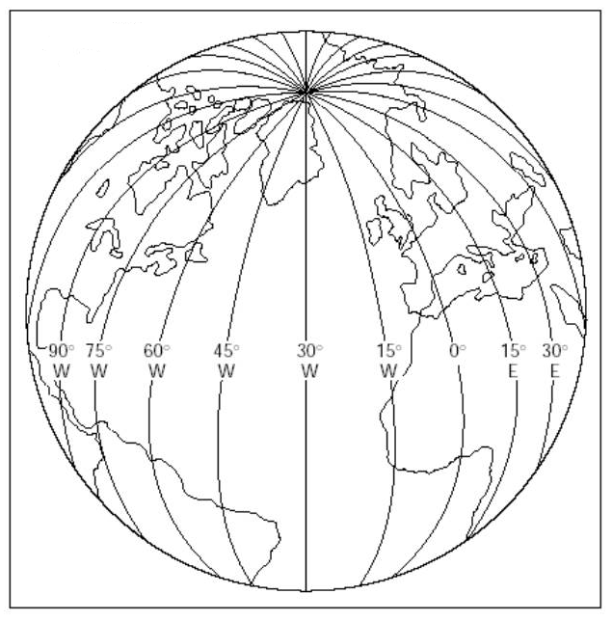

Slide 26
Parallels of Latitude
Circles on the earth’s surface which lie parallel to the equator
They are measured from 0 to 90 degrees north and south of the Equator
Latitude is also measured in degrees, minutes and seconds
Each minute of latitude represents 1 NM in distance

Slide 27
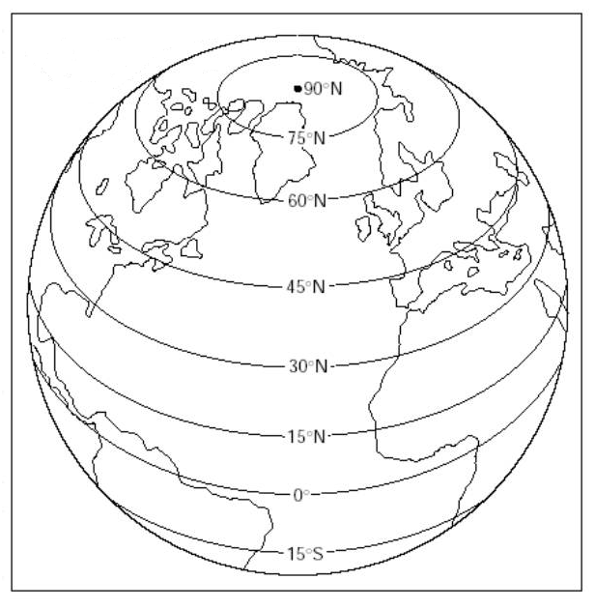

Slide 28
Geographical Coordinates
The location of any object on the earth’s surface can be expressed by its relation to the lines of latitude and longitude
On most maps, the lines representing the meridians and parallels are numbered, and each tick on these lines represents one minute
The latitude of an object is always given first
i.e. N46° 21’ 10” W72° 40’ 46”
Notes:
Montreal Map
Trois-Riviers Airport

Slide 29
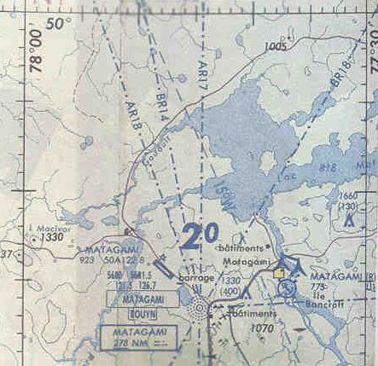
Latitude
Longitude

Slide 30
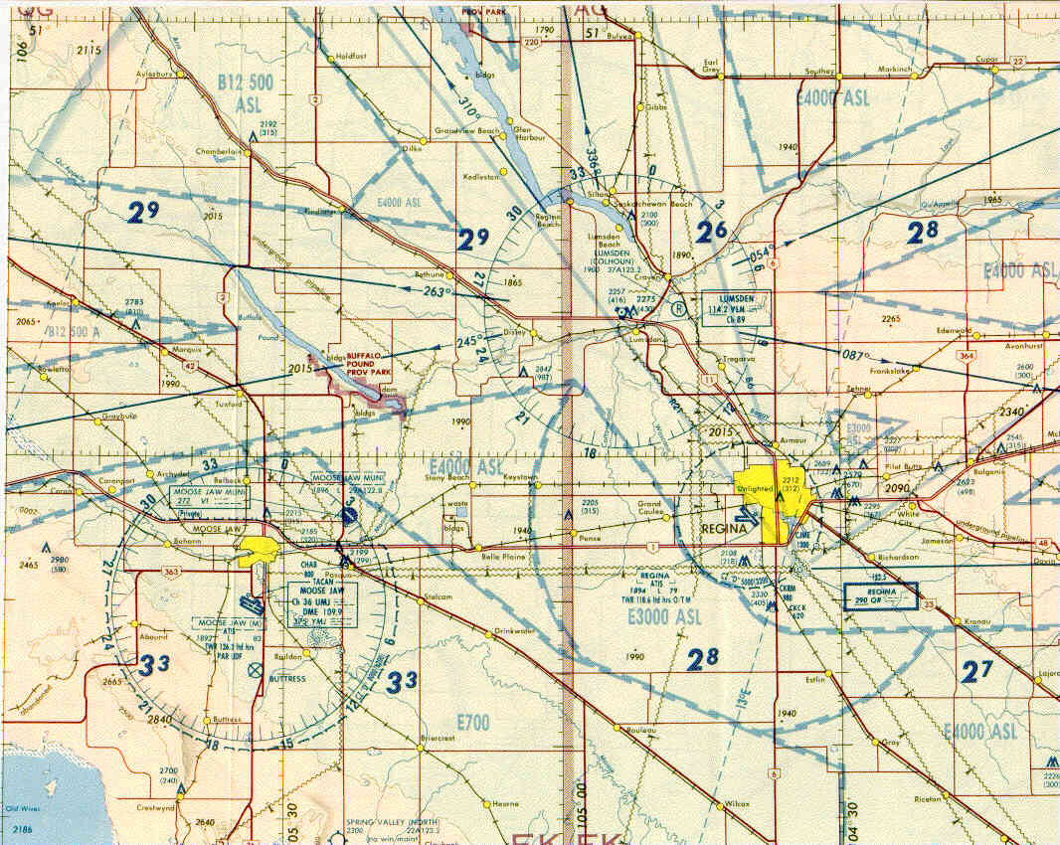
Parallel of Latitude
W104° 40’
50° 30’
N50° 26’
Meridian of Longitude

Slide 31
Time
The interval of time between the sun passing the same point is called a Solar Day
This solar day is divided into 24 hours
The problem with using this system to measure time is that the sun passes different points on the earth at different times

Slide 32
Time and Longitude
24 hrs = 360° longitude
1 hr = 15° longitude
1 min = 15 min longitude
1 sec = 15 sec longitude
360° longitude = 24 hrs
1° longitude = 4 min
1 min longitude = 4 sec
1 sec longitude = 1/15 sec

Slide 33
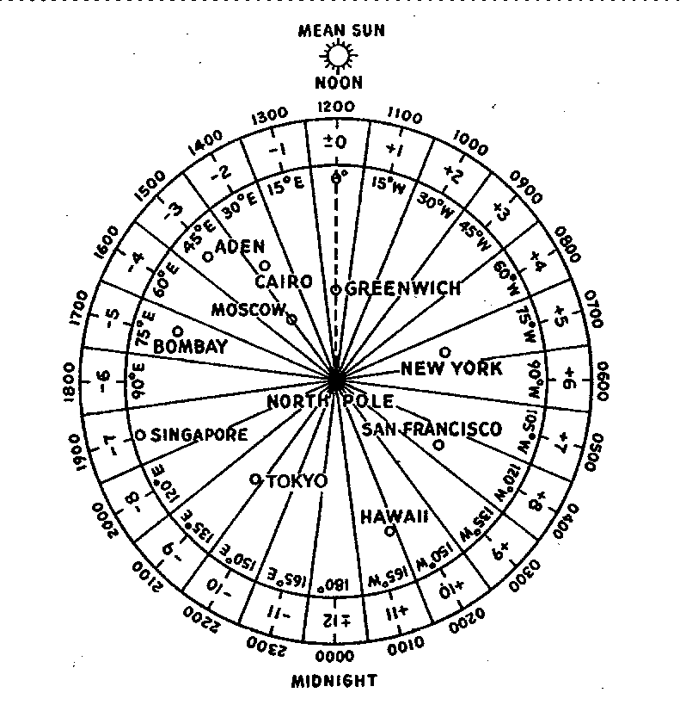

Slide 34
Coordinated Universal Time
To solve the solar day problem, the earth is divided into 24 time zones
These zones are referenced to the time zone with the prime meridian in it
The time in the reference time zone is known as Universal Coordinated time (UTC) or Zulu time
All time zones can be adjusted to match UTC
Winter time is the same as DAYLIGHT SAVINGS TIME

Slide 35
Canadian Time Zones
Canada is divided into six time zones
They are:
Pacific = UTC +8(7)
Mountain = UTC +7(6)
Central = UTC +6(5)
Eastern = UTC +5(4)
Atlantic = UTC +4(3)
Newfoundland = UTC +3:30(2:30)
The numbers indicate how many hours must be added to the local time to get UTC during standard time. The numbers in brackets indicate the hours to be added during daylight savings time.

Slide 36
Magnetic Variation
True north is the geographical top of the earth
Magnetic north is the direction the compass needle lies; is not a fixed point
Magnetic variation: the angle between a true meridian and the corresponding magnetic meridian (also known as declination)

Slide 37
Magnetic Variation
The method of calculating magnetic heading from true heading is:
TRUE HEADING + WEST VARIATION = MAGNETIC HEADING
TRUE HEADING - EAST VARIATION = MAGNETIC HEADING
EAST IS LEAST
WEST IS BEST

Slide 38
Compass Deviation
Compass deviation: angle between magnetic heading and the compass heading (magnetic heading corrected for deviation)
By using a compass correction card, we can determine the amount of error and add it to the magnetic heading
Notes:
Swinging the compass:
Effect of deviation is corrected by “swinging the compass”. The aircraft is lined up on each bearing at 30 degree intervals and the compass heading is compared to the real direction. The differences are recorded on the compass correction card mounted in the cockpit as a reference

Slide 39
Compass Deviation
The method of calculating compass heading from magnetic heading is:
MAGNETIC HEADING + WEST DEVIATION = COMPASS HEADING
MAGNETIC HEADING - EAST DEVIATION = COMPASS HEADING
EAST IS LEAST
WEST IS BEST

Slide 40
Variation and Deviation
To remember which order to add or subtract headings, use the acronym
TVMDC
rue
ariation
Two Violinists Make Dull Company
agnetic
eviation
ompass

Slide 41
Compass Errors
The magnetic compass is subject to many errors. These include:
Magnetic Dip
  The earth’s magnetic lines are parallel to the earth near the equator, but as one nears the magnetic poles, the lines become more vertical
  This causes the compass to dip towards the pole and can make it unreadable at high latitudes

Slide 42
Compass Errors
Northerly Turning Error
  When an aircraft banks, so does the compass, and this can cause errors in the turn
  On turns from NORTH, the compass LAGS
  On turns from SOUTH, the compass LEADS

Slide 43
Compass Errors
Acceleration Error
  When the aircraft accelerates, the compass dips slightly. This can cause it to indicate a turn on east and west headings
  Acceleration causes the compass to indicate a turn to the North
  Deceleration causes the compass to indicate a turn to the South

Slide 44
Review
How many meridians of longitude are there?
What is a solar day?
What is acceleration error?
Notes:
24 meridians
Interval of the sun passing the same point
When an aircraft accelerates on an East or West heading, the compass will tend to indicate a turn towards the North

Slide 45
The “One-in-Sixty’ Rule
This is a rule that can be used to help determine either how far you are off course or how much of a correction needs to be made to regain your course.
The rule states that
An error in the track of one degree will cause an error in position of about one mile in a distance of 60 miles
1 mile
1°
60 miles

Slide 46
The ‘One-in-Sixty Rule’
The One-in-Sixty rule can be expressed as an equation
Where
e = Distance off Track
d = Distance Traveled
θ = Track Error

Slide 47
The ‘One-in-Sixty Rule’
For example:
Track Error = 4°, Distance Traveled = 30 miles

Slide 48
The ‘One-in-Sixty Rule’
The equation can also be arranged to find Track Error
Distance off track = 3 , Distance Traveled = 45 miles

Slide 49
Track Correction Methods
Visual Alteration Method
  Compare ground to map
  Find landmark(s) along route
  Use landmark(s) to navigate back to intended track or towards destination

Slide 50
Track Correction Methods
Double Track Error Method
  Use to return to intended track
  Used before the halfway point
Opening and Closing Angles Method
  Use to fly directly to the destination
  Can be used at any time a track error is noticed

Slide 51
Tracks
Track
  The intended path of the aircraft over the ground
Track Made Good
  The actual path of the aircraft over the ground
Drift/Track Error
  The angle between the heading of the aircraft and the track made good

Slide 52
Drift/Track Error

Slide 53
Opening Angle
  The angle between the required track and the track made good
Closing Angle
  The angle between the old track and the new required track necessary to arrive at the destination

Slide 54
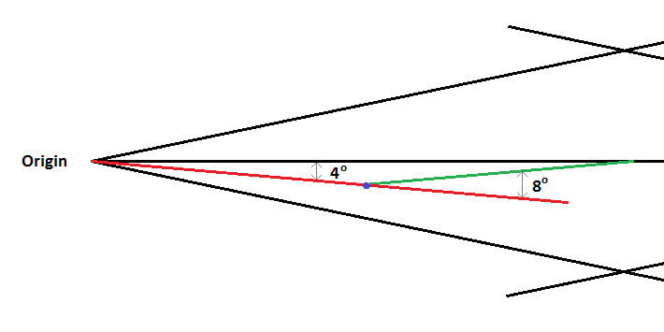
Double Track Error Method
At (•) you are 4° right of your track after 10 mins
  Alter your track 4° left to parallel your track
  Alter your track 4° more left to intercept your track
After 10 mins using the 8° correction you intercept
Alter track 4° right to regain intended track

Slide 55
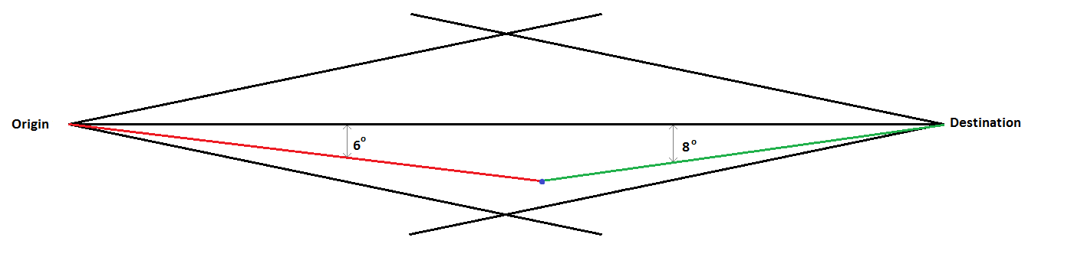
Opening and Closing Angles Method
At (•) you are off track
  Your opening angle is 6° right of track
  Your closing angle is 8° to get to the destination
Add opening and closing angles (12°)
Subtract 12° to correct back to the left and go directly to destination

Slide 56
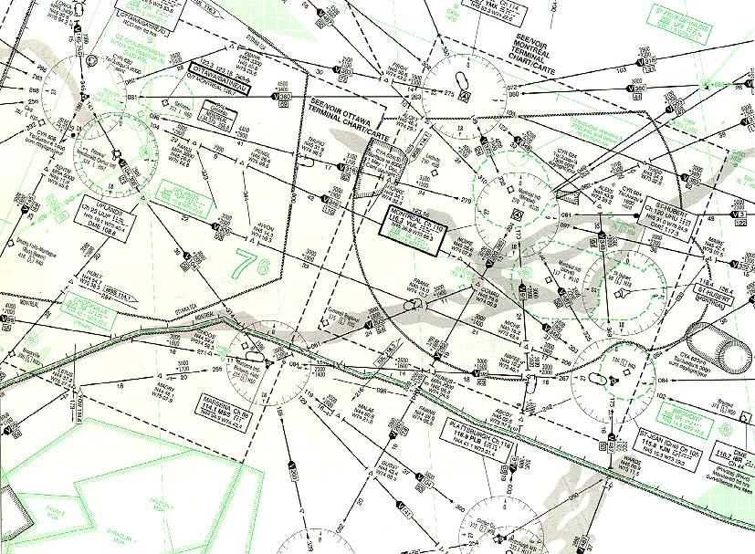
Introduction to Maps

Slide 57
Introduction to Maps
The surface of a sphere cannot be accurately projected onto a flat surface, so all maps show the surface of the earth with some degree of distortion
The two types of projections used for aviation maps are
  Lambert Conformal Conic Projection
  Mercator Projection

Slide 58
Lambert Conformal Conic Projection
This projection is created by placing an imaginary cone over the earth, and then projecting the map onto the places where the cone touches the earth
Properties of the LCCP are
  Meridians of longitude converge towards the pole
  Parallels of latitude are concave towards the nearest pole
  Scale is virtually uniform
  A straight line is a GREAT CIRCLE
VNC, WAV and HI/LO enroute maps are based on this principle

Slide 59
Mercator Projection
This projection is created by placing an imaginary cylinder over the earth so that the only place it’s touching is the equator
Properties of the Mercator Projection are
  Meridians of longitude are straight and parallel
  Parallels of latitude are straight and parallel
  There is no constant scale
  A straight line drawn on this map is a rhumb line
  Areas in high latitudes are greatly exaggerated
  Distances near equator are fairly precise
World map usually uses this principle

Slide 60
Transverse Mercator Projection
This projection is created by placing the imaginary cylinder over the earth to touch the earth at only a chosen meridian
Used to cover a very small area
Properties similar to Mercator:
  Scale is precise regardless of latitude
  Longitude and latitude will appear curved if area coverage is wide enough
  Distance is precise along central meridian and throughout the map because the coverage area is so small
  Some distortion towards East and West margins of the map
VTA map is based on this principle

Slide 61
Basic Elements of Maps
All maps are made up of four basic elements
AREAS
SHAPES
BEARINGS
DISTANCES

Slide 62
Basic Properties of Maps
All aeronautical maps depict:
  Scale
  Relief
  Isogonic Lines
  Communities, roads and railways
  Aerodromes
  Restricted Areas
  Compass Rose
  Aeronautical Information
Notes:
Symbols:
Isogonic lines: shown as dashed line with value printed at regular intervals
Settlements: Towns and villages are yellow squares or circles; cities and large towns are yellow with a black border corresponding to the real shape and size of the settlement
Highways: red or brown line and divided highways are double lines
Railways: black lines with hash marks through it
Aerodromes: small aerodromes are represented by a circle
Larger aerodromes with paved runways are represented in their precise location on the chart by a diagram of their runway layout
Restricted airspace: Circle or shape with hash marks on the inside of the outline
Include alert zones, danger areas, restricted airspace, advisory airspace, altitude reservations and military operation areas
Compass rose: circle divided into 360 degrees printed on chart centered on radio navigation aids (VOR and TACAN) can be used for measuring directions
Aeronautical data: legend explains all symbols and information found on the chart
Aerodrome data: next to the aerodrome symbol is a line leading to a box containing the name of the aerodrome. Under is information about elevation, lighting equipment, longest runway length, zone type and proper frequency
Obstructions: identified by a symbols; usually a tower with elevation in ASL and then (AGL)

Slide 63
Scale
On aeronautical charts, scale is shown with two methods
Representative Fraction
  A fraction showing the size relationship between objects on the ground and objects on the map
  I.e. 1:500,000
Graduated Scale
  A scale printed on the side of the map that allows measurements on the map to be converted to actual distances (one in KM, one in SM and one in NM)
Notes:
Scale: relationship between units of distance on the chart to the real distance on the Earth

Slide 64
Relief
Relief is depicted in four ways on aeronautical charts:
Layer Tinting
  Different colours are used to represent areas of different elevation; water is always blue
Contour Lines
  Lines joining places of equal elevation on a chart
  The closer the contour lines, the steeper the slope
Notes:
Known obstacles or groups of obstacles: elevations are indicated in ASL and AGL in parentheses

Slide 65
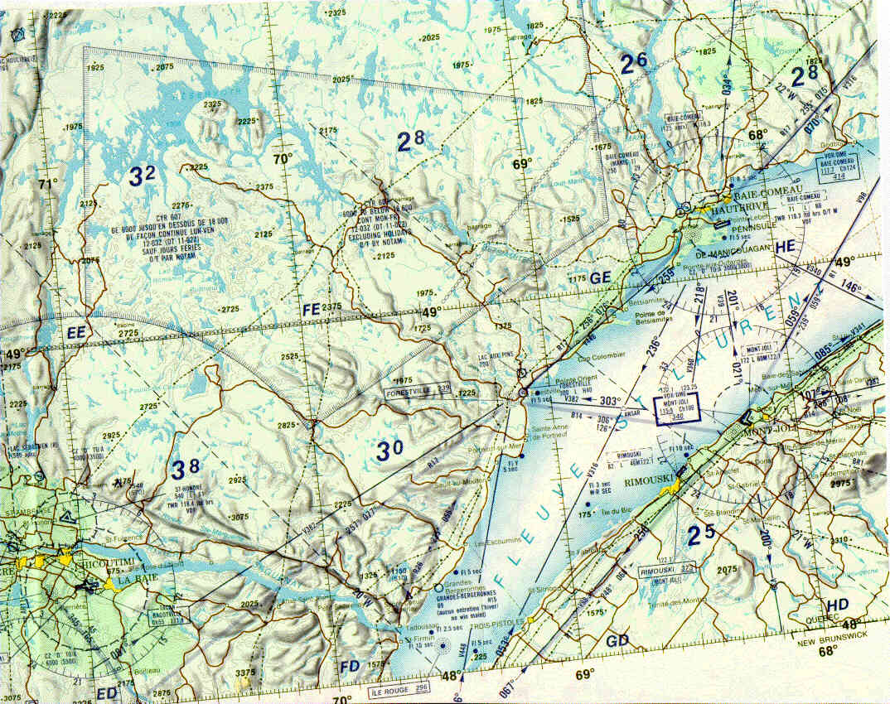
Relief
Contour Lines
Layer Tinting
Shading
  Shading is added to the sides of hills to give them the appearance of relief
Spot Heights
  Points of high elevation are depicted with a dot and the appropriate elevation
  The coordinates of the highest point on a chart are printed in the legend
Spot Heights
Shading
MEF
Notes:
Maximum Elevation Figure (MEF): a large number found at the centre of each section formed by lines of longitude and latitude.
Represents the highest terrain altitude within that section plus 328 feet/100 meters, or the highest obstacles known (whichever is higher) then rounded up to the next hundred of feet
Highest elevation on a chart:
The position and elevation of the highest point on the chart is found in the border over the layer tinting scale, which is found in the legend of the chart

Slide 66
Review
What is the One-in-sixty rule?
What are the basic elements of maps?
What are the three types of projections?
Notes:
A track error of 1 degree will result in an error of 1 mile off track in a distance 60 miles
Area
Shapes
Bearings
Distances
Lambert Conic Conformal Projection
Mercator Projection
Transverse Mercator Projection

Slide 67
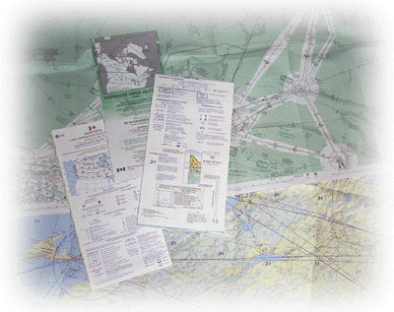
Types of Aviation Charts

Slide 68
VFR Navigation Chart (VNC)
Most commonly used chart for VFR navigation
Used mainly for slower speed aircraft flying at low altitudes
It has a scale of 1:500,000 and uses the Lambert Conformal Conic Projection
Notes:
1 inch = approximately 8 SM
Intended for visual navigation
Chart is printed on both sides
Each chart is designated by the name of its major feature (Toronto, Winnipeg, Montreal...)

Slide 70
World Aeronautical Chart (WAC)
Mainly used for visual navigation at high speeds and high altitudes over long distances
Rarely used anymore
It has a scale of 1:1,000,000 and uses the Lambert Conformal Conic Projection
Notes:
Intended for visual navigation

Slide 72
VFR Terminal Area Chart (VTA)
Used for visual navigation in around airports which are surrounded by Class C airspace
They are printed for 6 airports in Canada (Toronto, Ottawa, etc.)
There scale is 1:250,000 and they use the Transverse Mercator Projection
Notes:
VTA border are drawn on VNC maps to help the pilot identify where they are located and when he needs to refer to them
Contains calling in points and VFR standard procedure inside its boundary

Slide 73
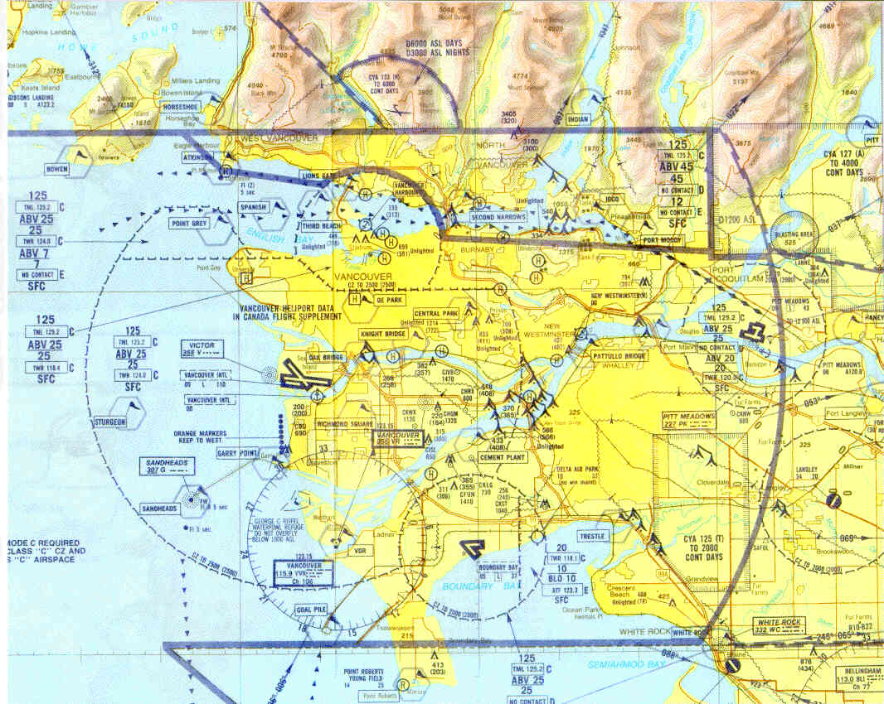

Slide 74
Low and High Enroute Charts
Low and high enroute charts (LO and HI) are used for IFR navigation
They depict very little ground detail, but depict a very detailed picture of the IFR airspace system
Scale is not constant between charts
Notes:
Provide necessary information for radio navigation using the established airways
Designed for IFR use
Do not show cities, towns or geographic features (except major ones)
Show radio-navigation aids, IFR checkpoints, radio frequencies, etc.

Slide 76
TC-AIM
Transport Canada Aeronautical Information Manual (TC-AIM)
Single source of information on rules of the air and other CARs
Subscription available for all pilots or free online at http://www.tc.gc.ca/CivilAviation/publications/tp14371/menu.htm
Notes:
Developed to consolidate pre-flight reference information into a single primary document
Provides crews with single source for information concerning rules of the air and procedures for aircraft operation in CARs of interest to pilots
CARs-Canadian Aviation Regulations
TC-AIM has no legal value and juridical questions must be referred directly to CARs
Updates are published twice a year in April and October. Pilot’s responsibility to ensure document is up to date.
Subscriptions available, copies may be purchased from Transport Canada or available for free online.

Slide 77
Canada Flight Supplement
Lists and provides information about all land aerodromes in Canada
Is updated every 56 days
Also provides information about preferred IFR routing, intercept orders, obstructions and other miscellaneous aeronautical data
Notes:
Indicates diagram of aerodrome, layout of runways, placement of buildings and control tower, alphanumeric code of the aerodrome, geographic co-ordinates, magnetic variation, local time conversions, elevation of aerodrome, radio frequencies, services offered and various other information
Joint civil/military publication
Information on land and some water aerodromes and used as a reference for planning and safe conduct of air operations
Typically only provides information on aerodromes that:
-are open to the public
-used by more than one aircraft
-telephone available to aerodrome users
Information is only current to the date of submission for printing
NOTAMs amend or cancel the information in this document and must therefore be consulted to ensure that current information is sued for flight operation

Slide 78
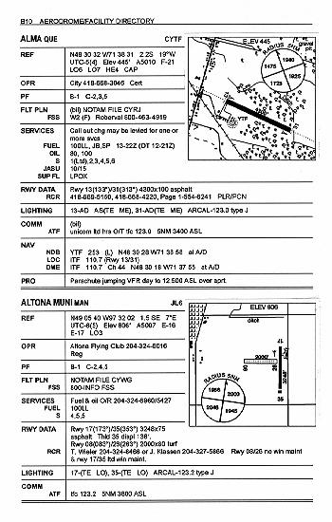
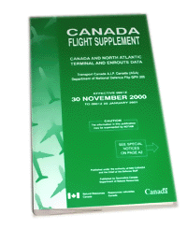

Slide 79
Flight Planning
Adequate and current aviation maps
Carefully prepared navigation
Flight plan or flight itinerary filed
Weather information
NOTAMs
Aircraft performance numbers
Calculate weight and balance
Perform complete passenger and crew briefing
Notes:
Flight time: Time calculated from the moment the aircraft begins to move under its own power with the intention of taking off until the moment that the aircraft comes to a stop at the end of the flight.
Pre-flight inspection:
Pre-flight inspections must be performed in accordance with the manufacturer’s manual, checklists and school procedures before each flight. Verify the validity and conformity of documents carried on board with the requirements before flight and carry them on board.
Weight and Balance:
A weight and balance calculation using the graphs and tables in the POH must be carried out to ensure that the centre of gravity is within permissible limits and to determine if the aircraft is adequately loaded in accordance with the principles of FLIGHT SAFETY.

Slide 80
Review
What is a great circle?
What are the types of charts used in aviation?
What can you find in the CFS?
Notes:
Circle on the surface of the Earth whose plane passes through the centre of the Earth and cuts it into equal parts
VNC
VTA
WAC
HI/LO enroute
Aerodrome name and identifier, elevation
Runway orientation, length, composition
Building and tower locations
Frequencies
Radio navigation facilities
Lighting equipment
Other aerodrome characteristics and facilities

Slide 81
Summary
Topics covered today:
  Definitions
  Latitude and Longitude
  Earth’s Magnetism
  Compass Errors
  Projections
Next class will be airmanship and radios

