Slide 1
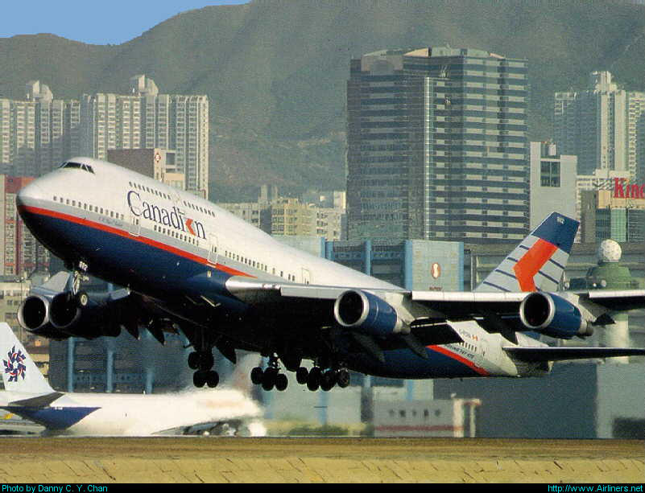
Airmanship, Human Factors & Radio Communication
CI M Norwood
References: FTGU
Pages 259 - 314

Slide 2
Review
What type of projection is used for a VNC?
What is a magnetic heading?
What is the length of a nautical mile?
Notes:
Lambert Conic Conformal Projection
Compass heading corrected for deviation
6080 feet
1.85 KM
1.15 SM

Slide 3
Topics to be Covered
Wake Turbulence
Human Factors
Radio Waves and Signals
Radio Phraseology and Procedures

Slide 4
Wake Turbulence
As the lift producing airfoil passes through the air, the air rolls up and back each wing tip producing two distinct counter rotating vortices, one trailing each wing tip.
The intensity of the turbulence within these vortices is directly proportional to its weight and inversely proportional to its wing span and speed of the airplane.
In cold air the vortices can be expected to be more severe.
Notes:
Higher pressure below a lift-generating wing moves to the area of lower pressure on the upper surface, turning around the tip of the wing. This “tornado” movement of air is very pronounced at the wingtips.

Slide 5
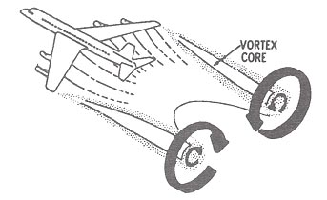

Slide 6
Wake Turbulence
The strength of a vortex is governed by several factors
The vortex strength will increase as:
  Weight Increases
  Speed Decreases
  Drag Decreases

Slide 7
Wake Turbulence
Other factors that affect vortex strength include:
  Configuration of the aircraft
  Position of flaps
  Position of landing gear
  Location of the engines
  Configuration of the tail
The strongest vortex will occur when an aircraft is:
Notes:
To reduce induced drag: can only be reduced during the aircraft design process. A wing with a high aspect ratio will generate less induced drag than a low aspect-ratio wing. This is why gliders are designed with long wingspan and short chord.

Slide 8
HEAVY, CLEAN AND SLOW

Slide 9
Hazards of Wake Turbulence
Vertical gusts encountered when crossing laterally through the vortex can impose structural loads as high as ten G’s on a small airplane.
The combination of upward and downward gusts has been estimated as high as 80’/sec.
Most small airplanes are designed to handle 30’/sec

Slide 10
Structural Damage
There is also a possibility of structural failure when an aircraft crosses a pair of vortices.
The strong up and down forces combined and the pilot’s attempt to counteract them will result in loss of control and airframe design limits being exceeded.

Slide 11
Vortex Generation
Vortex generation starts at rotation (the raising of the nose from the runway) and increases in intensity at lift off when the full weight of the aircraft is sustained by the wings
It ends when the airplane touches down
Vortices may trail as far as 10 to 16 miles depending on the airspeed of the aircraft
Wake turbulence usually dissipates after two minutes, but can remain as long as five minutes
Notes:
Ground effect reduces induced drag when the aircraft is flying at low speed very close to the ground. This is because the rotating air is interrupted by the ground and does not drag the aircraft back

Slide 12
Crosswind Effects
Vortices tend to move laterally outward over the ground at a speed of about 5 knots
This means that the vortices may position themselves parallel to the runway and constitute a hazard to aircraft operating in that area
Crosswind effects wake turbulence. The stronger the cross wind, the more vortices get blown to the side.

Slide 13
Wake Turbulence Avoidance
During Flight
  Although wake turbulence is most likely to be encountered during arrival and departure, it can be a hazard at cruising altitudes as well
  Avoid crossing behind and less than 1000’ below the flight path of large, heavy a/c especially at low altitudes

Slide 14
Wake Turbulence Avoidance
During Taxi
  Stay well behind large aircraft that are taxiing or maneuvering on the ground
  Avoid going behind aircraft doing a run-up
  Avoid taxiing below a hovering helicopter (the down wash is significant and hazardous).

Slide 15
Wake Turbulence Avoidance
During Take-off
  Stay up wind of larger aircraft
  This will keep you above the descending vortices of the descending airplane
  When following an aircraft that has just landed plan to be airborne beyond the point of touchdown of that aircraft
  For an intersecting runway, plan to be airborne before you cross the intersection.

Slide 16
Wake Turbulence Avoidance
During Landing
  When following a heavier aircraft that has just taken off, plan to touch down before the rotation point
  When following an aircraft that has just landed plan to touch down beyond the point where the preceding aircraft touched down.

Slide 17
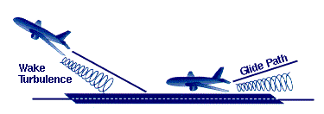

Slide 18
Wake Turbulence Avoidance
Above all
  Avoid a long dragged in approach
  Largest number of dangerous encounters with wake turbulence has been in the last half minute of approach
Wait at least 2 minutes before landing or taking off behind another aircraft

Slide 19
Wake Turbulence Avoidance
ATC Advisories
  ATC can not guarantee that wake turbulence will not be encountered.
  When the ATC advises, “CAUTION WAKE TURBULENCE”, they are warning you of the possible existence of wake turbulence.

Slide 20
Avoidance Responsibility
Wake turbulence avoidance is the sole responsibility of the Pilot in Command
Even though you may have received a clearance to land or take-off it is your responsibility to ensure that no wake turbulence hazard exists
When in doubt, advise the controller that you would like to wait until the risk of wake turbulence has passed.

Slide 21
Accidents and Incidents
Occurrence: Any accident or incident relating to the operation of an aircraft
Accident: An accident related to the use of an aircraft in which:
  A person is seriously injured or killed
  An aircraft sustains substantial damage which affect its structural strength, performance or flight characteristics or is reported lost or inaccessible
Notes:
Substantial damage: any damage which can be repaired locally but which renders the aircraft incapable of flight

Slide 22
Aviation Incident
Fuel starvation.
Refueled with incorrect or with contaminated fuel.
A collision or loss of separation occurs between aircraft
An emergency is declared
Dangerous goods are spilled within the aircraft or are released from the aircraft.
Engine failure
Radio failure
Smoke or fire
Difficulties controlling the aircraft
The aircraft departs the intended take-off or landing area
Flight crew incapable of performing duties
Depressurization
Notes:
Aviation occurrence reports:
When an accident occurs, it must be reported to the Transportation Safety Board of Canada (TSB). The report must contain the following information regarding the accident:
· the type, model, nationality and registration of the aircraft.
· the name of the owner and if applicable the operator and renter of the aircraft.
· the name of the PIC
· the time and date of the accident.
· the last point of departure and intended destination.
· the actual position of the aircraft (latitude and longitude)
· the number of flight crew on board and the number of deaths.
· a description of the accident
· a detailed description of all dangerous materials on board the aircraft
· the name and address of the writer of the report.
Preserving the integrity of an aviation occurrence site, the aircraft, its components and documentation:
It is forbidden to move or touch anything on the site of an aviation occurrence unless authorized by an investigator except: 1) to save a person; 2) protect evidence from destruction by fire or exposure; 3) security of persons or goods.

Slide 23
Saftey

Slide 24
TSB
Transportation Safety Board
  Performs investigations following accident/incident

Slide 25
Seats, Harness and Safety Belts
Safety belts: must have safety belt for each person on board other than infant
At least one pilot at the controls at all times during flight
Notes:
No person shall operate an aircraft other than a balloon unless it is equipped with a seat and safety belt for each person on board the aircraft other than an infant. (2 years or less)
When seats are not provided for passengers or parachutists the pilot must ensure that a restraint system is securely fastened to the main structure of the aircraft.
The pilot-in-command shall ensure that at least one pilot is seated at the flight controls with safety belt fastened during flight time.
If responsible for an infant for which no child restraint system is provided, the infant shall be held securely in the adult passenger's arms.

Slide 26
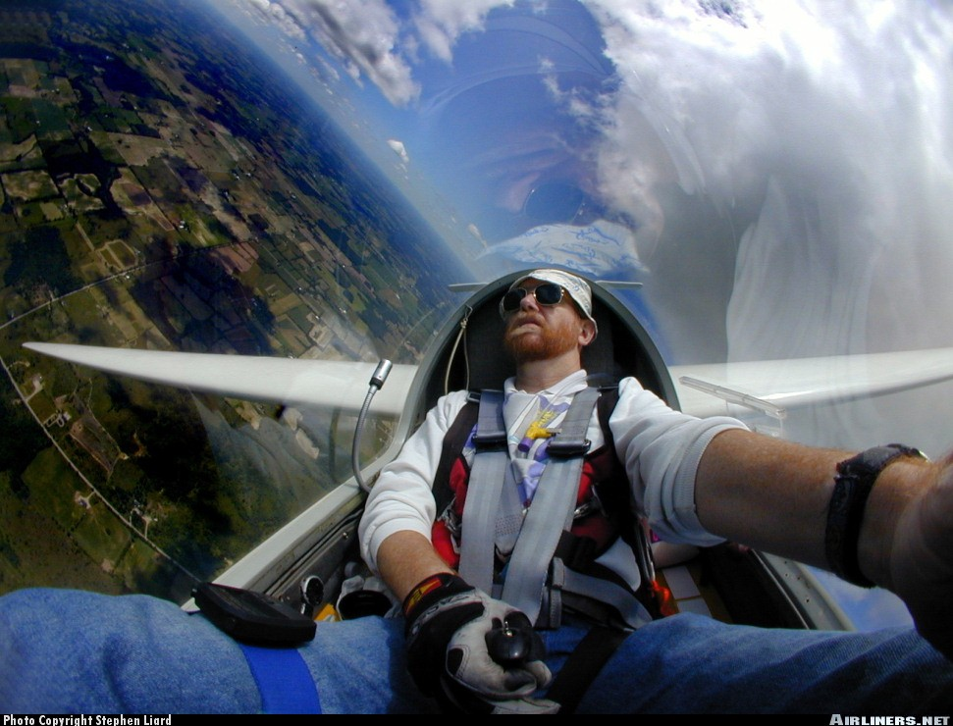
Human Factors

Slide 27
Hypoxia
Hypoxia is a lack of sufficient oxygen in the body cells or tissues
The Canadian Aviation Regulations state that when flying, by day, between 10,000 feet and 13,000 feet for more than 30 minutes or above 13,000 feet, you must carry a supply of oxygen of at least 2 hours for every crew member.
Notes:
Supplemental oxygen required above 5,000 feet at night
Where an aircraft is operated at cabin-pressure-altitudes above 10,000 feet ASL but not exceeding 13,000 feet ASL, each crew member shall wear an oxygen mask and use supplemental oxygen for any part of the flight at those altitudes that is more than 30 minutes in duration.
Oxygen must then be available for at least 10% of passenger (at least one) present onboard.
Oxygen shall be used at all times and by every personal onboard (crew and passengers) when operating at a cabin-pressure-altitude exceeding 13,000 feet ASL.
Cigarette use can result in hypoxic symptoms at lower altitude

Slide 28
Hypoxia
Symptoms of hypoxia include:
  A sense of euphoria
  Reduced vision
  Confusion
  Inability to concentrate
  Impaired judgment and reflexes
  Eventual loss of consciousness

Slide 29
Blood Donation
  It is recommended that pilots wait at least 48 hours before flying after donating blood
  (AIR 3.14)

Slide 30
Scuba Diving
After non-decompression dives, flights up to altitudes of 8,000 ft ASL should be avoided for 12 hours
Where decompression stops have been required before returning to surface, wait 24 hours
Flights above 8,000 ft ASL wait 24 hours, regardless of type of dive
Notes:
Reason above 8,000 feet is even pressurized aircraft may lose cabin pressurization (AIR 3.6)

Slide 31
Alcohol
CARs require that a pilot allow at least 8 hours between the consumption of alcohol and flying
Most companies say 12 hours
48 hours after excessive drinking
NO ALCOHOL IN THE SYSTEM WHEN YOU FLY!!

Slide 32
Drugs
Do not self-medicate
Drugs, as well as the conditions for which they are taken, can interfere with the efficiency of the pilot and can be extremely dangerous
Contact your aviation medical examiner prior to flying if taking any medication which you suspect may impair your abilities

Slide 33
Anesthesia
With spinal or general anesthetics, or with serious operations, you should not fly until your doctor says it is safe.
After local anesthetic, you should wait 24 hours before flying
AIR 3.13

Slide 34
Disorientation and Vertigo
Spatial disorientation: refers to loss of directional awareness or confusion regarding actual position or movement relative to the ground
Flicker vertigo: phenomenon which may occur when a single-engine aircraft is descending directly into the setting sun
Notes:
Flicker vertigo: The spinning propeller at idle power causes a stroboscopic effect which can cause nausea, mental confusion or rarely, unconsciousness in certain individuals
The term ‘vertigo’ is sometimes used to refer to spatial disorientation. Vertigo is a sensation of rotation or turning, a hallucination of movement of the victim or the environment

Slide 35
Review
When do vortices occur?
What is hypoxia?
How long must you wait to fly after donating blood?
Notes:
Upon rotation; as soon as the wing is producing lift
Lack of oxygen in the blood
48 hours

Slide 36
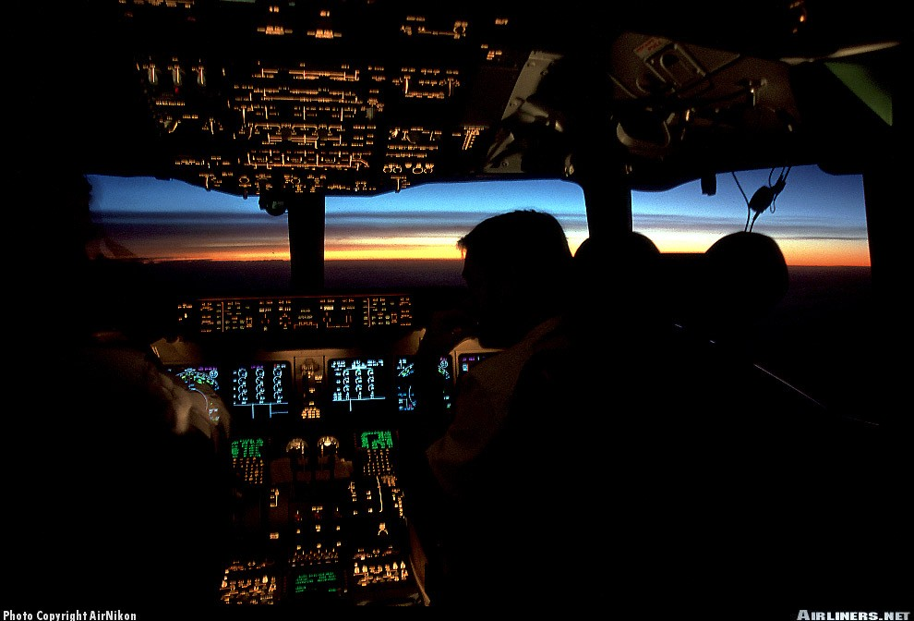
Radio Communications
Notes:
Restricted Radiotelephone Operator’s Certificate:
Issued by Industry Canada
Valid for life
To obtain a restricted radiotelephone operator’s certificate, one must demonstrate competence by writing an examination (pass mark 70%)
Radio Equipment Licence:
Issued by Industry Canada
Radio equipment must be approved or declared technically acceptable by Industry Canada to be eligible for a licence
Equipment must be used on assigned frequencies only

Slide 37
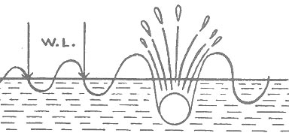
Wavelength
Wavelength is the linear measurement of a wave.
Constant over distance

Slide 38

The crest is the highest part of the wave.
CREST
TROUGH
The trough is the lowest part of the wave.

Slide 39

Cycles
A cycle is one complete vibration from trough to trough or crest to crest.
Cycle
Notes:
Amplitude: intensity of the wave (height difference between crest and trough); diminishes with distance until the signal fades away

Slide 40
Frequency
Frequency is number of cycles per second
Hertz is a measurement of frequency equivalent to one cycle per second
Most aviation frequencies are measured in kilohertz (KHz) or megahertz (MHz)
Notes:
Kilohertz (KHz) = a thousand hertz
Megahertz (MHz) = a million hertz

Slide 41
Low and Medium Frequencies
Frequencies between 200KHz and 535KHz are known as low or medium frequencies (LF/MF)
Commercial broadcasts, radio stations, and navigation beacons such as NDB’s all transmit on low or medium frequencies.

Slide 42
High Frequencies
Frequencies between 2,500KHz and 30,000KHz are known as high frequencies (HF) (3-30MHz)
They are used for communication over long distances
Often used in the far north and during oceanic operations

Slide 43
Very High Frequencies
Frequencies between 30MHz and 300MHz are known as very high frequencies (VHF)
They are used for most civil aircraft communications
The civil aviation navigation band is 108-117.95 MHz
The civil aviation communication band is 118-136 MHz

Slide 44

Ultra High Frequency
Frequencies between 300MHz and 3000MHz are known as ultra high frequencies (UHF)
These frequencies are used by the military and the government for navigation and communication

Slide 45
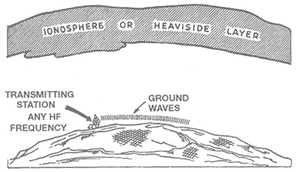
Ground Waves
Ground waves travel along the surface of the earth and can be attenuated or completely blocked by obstacles
Notes:
Follow the Earth’s surface
Travel in straight lines
Can bend around obstacles in their path due to surface attenuation and diffraction

Slide 46
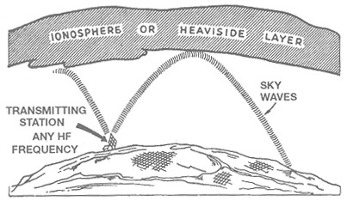
Sky Waves
  Sky waves travel upward into the air and are reflected back to the surface by the ionosphere.

Slide 47
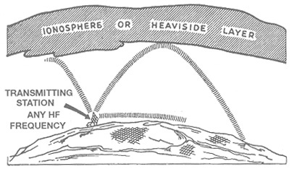
Skip Zone
Skip zone is an area located between the end of the ground waves and the start of the sky waves
Transmissions here can be very erratic or unreadable
Skip Zone
Notes:
Ground wave, sky wave and skip zone are typical of HF signals

Slide 48
Line of Sight
VHF/UHF radio waves travel in a straight line through the air
Therefore, an aircraft must be able to “see” the station in order to receive their transmission
This is known as “line of sight”.
Notes:
VHF/UHF are not reflected off the ionosphere
Follow a straight trajectory until rendered imperceptible through attenuation
Estimating Line-of-sight range:
1.23 x sqrt(altitude)

Slide 49
Emergencies
The VHF emergency frequency is 121.50MHz
  Distress calls should be used only when the flight is threatened by grave or imminent danger and requires immediate assistance
Notes:
1. the distress signal "MAYDAY";
2. the call sign of station in distress (once);
3. the nature of the distress condition and kind of assistance required (i.e., what has happened);
4. the intentions of the person in command;
5. the particulars of its position (airspeed, altitude, heading);
6. the number of persons on board and injuries (if applicable);
7. any other information which might facilitate rescue;
8. the call sign of the station in distress.
Should be repeated at intervals by the aircraft in distress until an answer is received or until it is no longer feasible to continue
Example: In a single engine aircraft that has an engine failure, you may only get one transmission before you need to land

Slide 50
Emergencies
Distress
  The first distress call should be made on the current frequency and if there is no response then transmitted on the emergency frequency.
  The call format is the word MAYDAY repeated three times. A pilot should then include present position, nature of emergency, and intentions.

Slide 51
Emergencies
Urgency
  An urgency call is made on the frequency currently in use
  Urgency calls should be used in situations where the safety of the a/c or any person on board is in question, i.e. icing, medical emergency
  The call format is the phrase PANPAN repeated three times. A pilot should then include present position, nature of urgency, and intentions

Slide 52
Emergencies
Safety
  Messages concerning the safety of navigation or important meteorological warning to aircraft in flight
  The call format is the word SECURITY repeated three times followed by the message

Slide 53
Action to take
If you hear a distress message
  Continue to monitor the frequency the message was heard on; if possible on emergency frequency as well
  Notify any station with direction-finding or radar for assistance unless action has been taken already
  Cease all transmissions which may interfere with distress traffic

Slide 54
Review
What is a trough?
What is the emergency frequency?
What do you say if there is an emergency on board?
Notes:
Lowest part of the radio wave
121.5 MHz
MAYDAY MAYDAY MAYDAY

Slide 55
Priority of Communication
The following are the priority of calls by Flight Service Station (FSS):
Emergency Communications
Flight Safety Communications
Scheduled Broadcasts
Unscheduled Broadcasts
Other air/ground Communications
Notes:
Longer version:
Distress call
Urgency call
Communications relating to radio direction findings (VDF)
Flight Safety communications
Weather information communications
Scheduled broadcasts
Communications relating to the application of the United Nations charter
State communications for which priority rights have been invoked
All other communications

Slide 56
Communications Check
When a communication check is carried out, the receiving station will respond with two numbers. The first number indicates the readability of the transmission on the following scale :
1 Unreadable Bad
2 Readable now and then Poor
3 Readable with difficulties Fair
4 Readable Good
5 Perfectly Readable Excellent
The second number is an indication of signal strength on a scale of 1 to 5

Slide 57
Phonetic Alphabet
A Alfa J Juliet S Sierra
B Bravo K Kilo T Tango
C Charlie L Lima U Uniform
D Delta M Mike V Victor
E Echo N November W Whiskey
F Foxtrot O Oscar X X-ray
G Golf P Papa Y Yankee
H Hotel Q Quebec Z Zulu
I India R Romeo

Slide 58
Numbers
Numbers are pronounced as follows:
0 ZEE-RO 5 Fife
1 WUN 6 SIX
2 TOO 7 SEV-en
3 TREE 8 AIT
4 FOW-er 9 NIN-er
Decimal DAY-SEE-MAL
Thousand TOU-SAND

Slide 59
Time
The 24 hour clock is used to express time.
Examples: 12:00 AM - 0000 hrs
12:30 AM - 0030 hrs
09:00 AM - 0900 hrs
02:30 PM - 1430 hrs
05:45 PM - 1745 hrs

Slide 60
Money
The word “dollars” always is stated first before speaking of money.
For example, $45.32 would be spoken as:
“Dollars FOW-er Fife DAY-SEE-MAL Tree Too”
Notes:
French would say dollars at the end

Slide 61
Standard Phrases
Acknowledge
Affirmative
Break
Confirm
Correction
“Let me know you have received and understood this message.”
“Yes”
“I hereby indicate the separation between portions of the message.”
“My version is…is that correct.”
“I have made an error. The correction is…”

Slide 62
Standard Phrases
Do you read?
Go ahead
How do you read me?
I say again
Negative
Out
“I have called you more than once. If you are receiving me, Reply.”
“Proceed with your message.”
“What is my strength and readability?”
“I will Repeat.”
“No.”
“My transmission is ended. I do not expect a reply.”

Slide 63
Standard Phrases
Over
Read back
Roger
Say Again
“My transmission is ended. I expect a reply from you.”
“Repeat this message back to me after I have given ‘Over’.”
“Okay, I have received your message.”
“Repeat.” (NEVER SAY REPEAT ON THE RADIO)

Slide 64
Standard Phrases
Speak slower
Stand By
That is correct
Verify
Wilco
Self explanatory.
“I must pause for a few seconds.”
Self explanatory.
“Check with the originator.”
“Your instructions received, understood and will be complied with.”

Slide 65
Radio Procedure
Call up
Reply
Message
Acknowledge
End Transmission
Sydney Radio this is Glider Charlie Foxtrot Bravo Juliet Hotel
Bravo Juliet Hotel this is Sydney Radio
Sydney Radio this is Bravo Juliet Hotel on left downwind for runway 19, over
Bravo Juliet Hotel this is Sydney Radio, Roger, the winds are 200 at 15 knots, over
Sydney Radio this is Bravo Juliet Hotel, Roger, out

Slide 66
Good Radio Technique
Pronounce words clearly
Speak at a moderate rate
Use a constant pitch
Avoid “Ums” and “Ahs”
Acknowledge all transmissions
Profanity is prohibited
Do not use for personal use
Know what you want to say before starting
Listen to other transmissions; do not interrupt

Slide 67
Uncontrolled Airport
Monitor a common frequency, which is generally 123.2MHz.
Pilots must broadcast their intentions when arriving or departing the aerodrome on this frequency

Slide 68
Services Offered
Control Tower (ATC)
Ground Control
Flight Service Station (FSS)
Flight Information Centre (FIC)
UNICOM
VHF Direction Finding
Notes:
Control Tower (ATC):
-controls all aircraft landing and taking off as well as all VFR traffic operating in the control zone surrounding the airport
-situated inside a control zone
-permits the safe and rapid circulation of air traffic
Ground Control:
-most controlled airports have ground control
-controls the movements of aircraft, vehicles, and pedestrians on the airport surface
FSS and FIC:
-gives information such as weather, winds, altimeter setting, NOTAMs
-operated by NavCanada
-will accept flight plan/itinerary
-will provide advisory services at uncontrolled airport and control pedestrian/vehicles at that airport
-will provide advisory services at remote uncontrolled airport through RCO
-do not have authority to give instructions to aircraft
UNICOM:
-over uncontrolled airport
-not a control unit
-gives traffic information about the airfield when in operation; wind, preferred runway, traffic, altimeter setting, etc.
-do not have authority to give instructions
VHF Direction finding:
-provides pilot with heading to follow, or a bearing from the VDF station
-provided at the request of the pilot or suggestion of ATC
-pilot must provide position (if known), heading, altitude
-ATC or FSS will give a heading to follow for homing in the VDF station and ask the pilot to transmit at regular intervals to home in on the station

Slide 69
Review
Spell your last name using the phonetic alphabet
What does WILCO mean?
What are the five steps in a radio call?
Notes:
(different for each cadet)
Your instructions have been received, understood and will be complied with
Call-up
Reply
Message
Acknowledgment
End transmission

Slide 70
More Review
When is wake turbulence the strongest?
What are some symptoms of hypoxia?
What does PANPAN mean?
Notes:
Slow, clean, heavy
Euphoria
A sense of euphoria
Reduced vision
Confusion
Inability to concentrate
Impaired judgment and reflexes
Eventual loss of consciousness
Urgency signal

Slide 71
Summary
Topics covered today:
  Wake Turbulence
  Human Factors
  Radio Waves and Signals
  Radio Phraseology and Procedures
Next class will be for Power applicants:
  Aero engines and use of E6B

