Slide 1

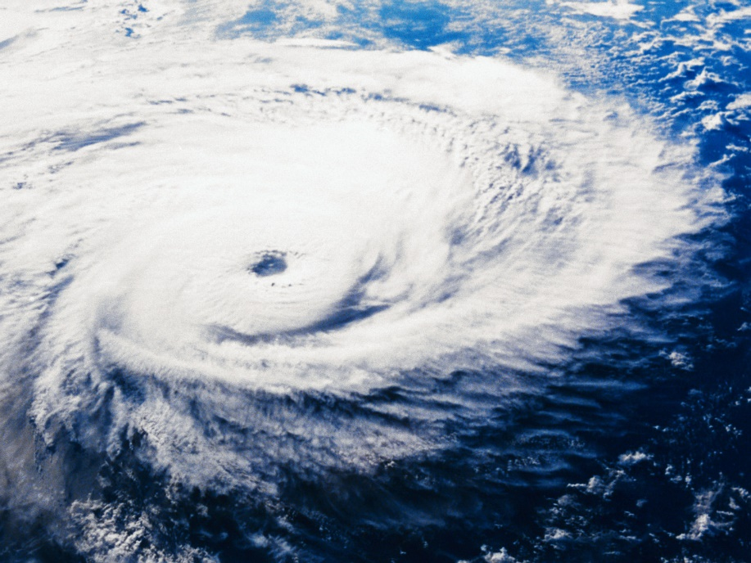
Level 3 Aviation Subjects Review
C.V. Delgado

Slide 2
Aircraft Stability
Defined as the tendency of an aircraft in flight to remain in straight, level, upright flight and to return to this attitude, if displaced, without corrective action by the pilot.
Static Stability. The initial tendency of an aircraft to return to its original attitude, if displaced.
Dynamic Stability. The overall tendency of an aircraft to return to its original attitude.

Slide 3
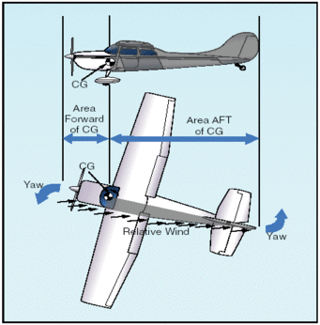
Directional Stability
Directional stability is stability around the vertical or normal axis. The principle factor influencing directional stability is the vertical tail surface, or fin

Slide 4
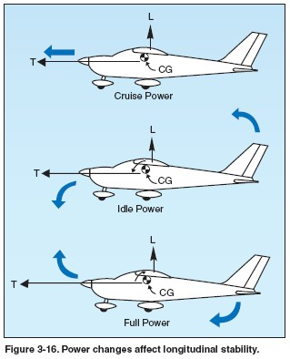
Factors Influencing Longitudinal Stability
Horizontal Stabilizer - function is similar to a counterweight at the end of a lever.
Centre of Gravity - If the centre of gravity is too far forward, it will produce a nose-down tendency; If the centre of gravity is too far aft, it will produce a nose-up tendency

Slide 5
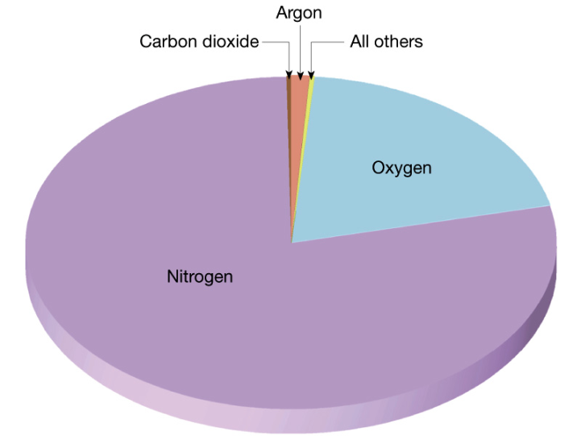
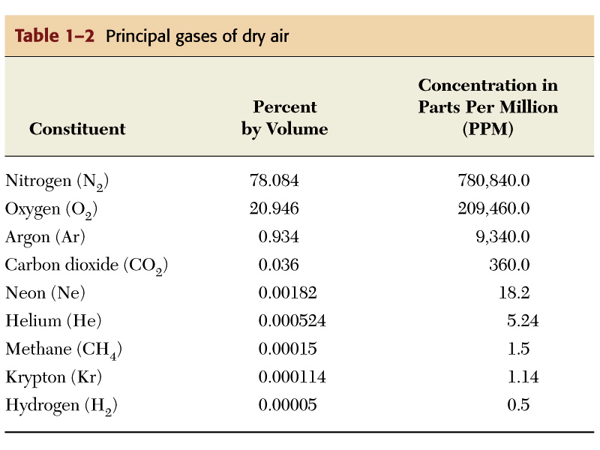
Composition of the Atmosphere
Up to 250,000’ ASL, primarily:
    Nitrogen – 78%
    Oxygen – 21%
  All else – 1%
    Argon
    Carbon Dioxide
    Hydrogen
    Water Vapour
    Other gases

Slide 6
Layers of the Atmosphere
Divided into four distinct layers which surround the earth for many hundreds of miles
  Troposphere
  Stratosphere
  Mesosphere
  Thermosphere

Slide 7
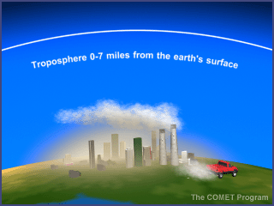
Troposphere
Lowest layer
Starts at ground level and extends to varying heights ASL
Air pressure, density and temperature decrease with altitude
Temperature drops to a low of -56 degrees Celsius
Most weather occurs in this layer due to presence of water vapour and strong vertical currents caused by terrestrial radiation

Slide 8
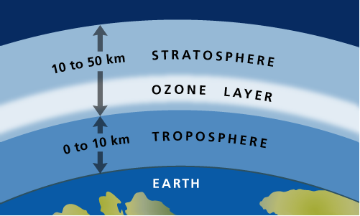
Stratosphere
Extends 50,000’ upwards from the Tropopause
Pressure decreases in the stratosphere
Temperature gradually rises to 0 degrees Celsius
The bulk of the ozone layer
  Prevents harmful solar radiation from reach the earth’s surface (rise in temperature)
Top is called the Stratopause – boundary between the stratosphere and mesosphere

Slide 9

Properties
Three principle properties:
  Mobility – the ability of the air to move from one place to another
    Explains why air mass forms over the arctic but may affect places in the south
  Capacity for Expansion – most important!
    Air is forced to rise for various reasons. As air pressure decreases, the air will expand and cool
    Cooling may be enough for condensation to occur and clouds to form, creating precip.

Slide 10
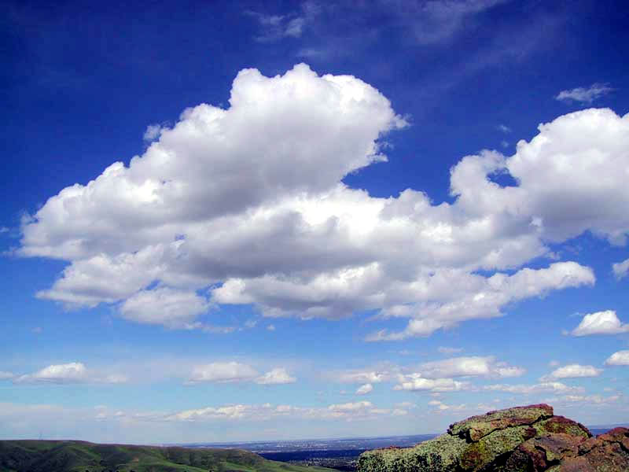
Cloud Classification
Classified based on type of formation and cloud height
There are two main types of cloud formations:
  Cumulus – formed by unstable air
    Cottony or puffy, and are seen mostly during warmer seasons. Cumulus may develop into storm clouds

Slide 11

Cloud Classification
  Stratus – formed by stable air
    Flat and can be seen year round, but are associated with colder temps

Slide 12
Definitions
Isobars
  Areas of like pressure are joined by lines called isobars.
  The isobars form roughly concentric circles, each circle being four hPa different than the circles before and after it.
  Groups of isobars will indicate areas of relatively high pressure, or relatively low pressure.

Slide 13
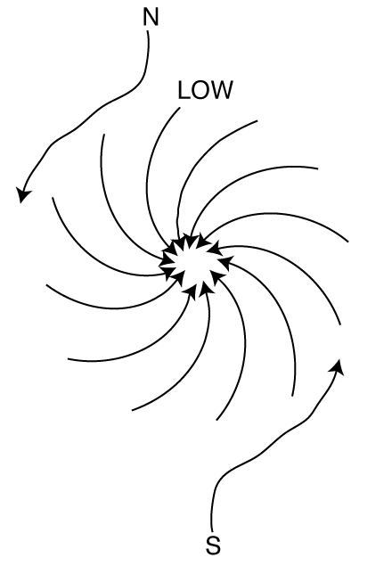
Definitions
Low Pressure Areas
  Low pressure areas (often called lows, cyclones, or depressions) are areas of relatively lower pressure, with the lowest pressure in the centre.
  Lows will normally move in an easterly direction at an average rate of 800 km per day during the summer and 1,100 km per day in the winter.
  Lows are associated with thunderstorms and tornadoes, and do not stay in one place for very long.
  In the northern hemisphere, air moves around a low pressure in a counter-clockwise direction.

Slide 14

Wind
The horizontal movement of air within the atmosphere.
Wind normally moves parallel to the isobars of a pressure system.
Since isobars are not straight lines, this means that the wind direction will vary at different locations along the pressure system.
Wind also moves in different directions based on whether the pressure is a low or high system.

Slide 15
Relative Humidity
The ratio of the actual amount of water present in the air compared to the amount of water which the same volume of air would hold if it were saturated.
Temperature and pressure must remain the same, otherwise the relative humidity will change.

Slide 16
Dew Point
Dew point is the temperature to which unsaturated air must be cooled, at a constant pressure, in order to become saturated.

Slide 17
Convection
The air is heated through contact with the earth’s surface.
As the sun heats the surface of the earth, the air in contact with the surface warms up, rises, and expands.
Convection may also occur when air moves over a warmer surface and is heated by advection

Slide 18
Unstable Air
If a mass of rising air is still warmer than the new air around it, then the air mass will continue to rise.
  Good visibility (except in precipitation)
  Cumulus type cloud
  Showery precipitation
  Gusty winds
  Moderate to severe turbulence

Slide 19

ICAO Standard Atmosphere
For N.A., the ICAO standard is based on the summer and winter averages for 40 degrees north latitude
ICAO Standards for N.A. assume the following conditions:
  Air is a perfectly dry gas
  MSL pressure of 29.92” Hg
  MSL Temperature of 15 degrees Celsius
  Temperature decrease with altitude at 1.98 degrees Celsius / 1,000’

Slide 20
Review

Slide 21
Review
Define aircraft stability
What factors influence longitudinal stability?
What is directional stability?
What is the order of layers of the atmosphere?
What us the largest component of the atmosphere and how much?

Slide 22
Review
What layer is the ozone layer located in?
What are the two types of clouds?
What is in isobar?
Wind is defined as?
What is relative humidity?
Describe dynamic and static stability
Describe convection as a lifting agent
Describe unstable air and the conditions associated with it

Slide 23
Review
Explain mobility as a property of the atmosphere.
Explain capacity for expansion as a property of the atmosphere
Describe the assumptions of Std. Atm.
Describe a low pressure area
Define dewpoint

Slide 24

Good luck!

